Slide 1
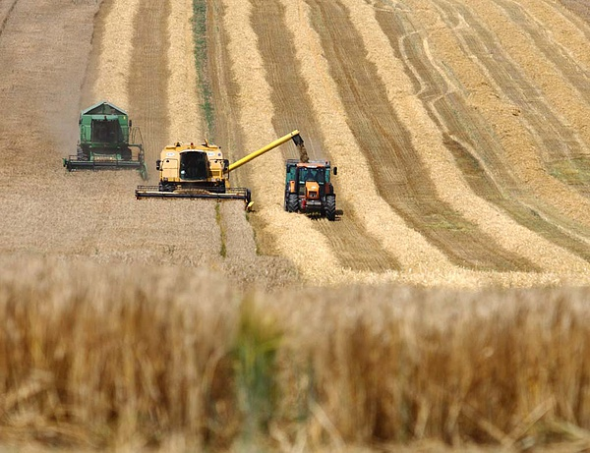
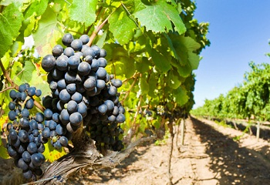




Mezőgazdasági szaknyelvi kurzus „Programsorozat a szakmai fejlődésért„ NTP-SZKOLL-15-0057
Mezőgazdasági szaknyelvi kurzus „Programsorozat a szakmai fejlődésért„ NTP-SZKOLL-15-0057

Slide 2

Hasznos weboldalak továbbiakban
www.glosbe.com
www.linguee.com
www.thesaurus.com
www.visualthesaurus.com
www.quizlet.com (kötelező!! ☺ )
www.macmilliandictionary.com
www.hunglish.hu
www.eurlex.com

Slide 3
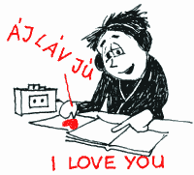
Saját bőrömön tapasztalt tanácsok nyelvtanuláshoz
Önmagában a szó kiírása kevés
70 x kell látnunk egy szót
Ne írjunk tele egy lapot szavakkal
Napi 20-30 perc is sokat számít nyelvtanulásnál
Nagyon sok önszorgalom kell

Slide 4

Az órák felépítése
Aktuális gazdasági/mezőgazdasági témák, kérdések
Fordítógyakorlat
Házi feladatként fordítás + szövegértés aktuális témákból
Megfelel? Ötletek? ☺

Slide 5
The sectors of the economy
Primary Sector: The primary sector of the economy extracts products from the earth. The primary sector includes the production of raw material and basic foods. Activities associated with the primary sector include agriculture, mining, forestry, farming, hunting and fishing.
Secondary Sector: The secondary sector of the economy manufactures finished goods. Activities associated with the secondary sector include automobile production, textile production, chemical industries, aerospace manufacturing, energy utilities, engineering, breweries etc.
Tertiary Sector: The tertiary sector of the economy is the service industry. This sector provides services to the general population and to businesses. Activities associated with this sector include retail and wholesale sales, transportation and distribution, entertainment, media, tourism, insurance, banking, healthcare, and law.
Quaternary Sector:The quaternary sector of the economy consists of intellectual activities,and R&D
Forrás: https://en.wikipedia.org/wiki/Talk:Three-sector_theory

Slide 6

The sectors of the economy - szószedet
To extract: kicsomagol, kinyer (nyersanyagot)
To include+főnév/Ving: magába foglal, takar, érint
Raw material: nyersanyag
Mining: bányászat
Forestry: erdőgazdálkodás
Hunting: vadászat
To manufacture finished good: készterméket állít elő
Retail and wholesale trade: kis- és nagykerekedelem
Research and development: kutatás és fejlesztés

Slide 7
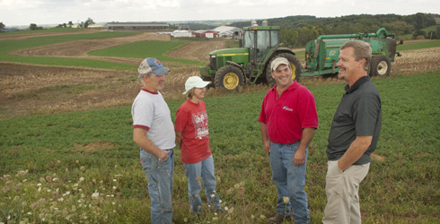
1/A. Is it worth working in agriculture?
worth
Not worth
A good advisory system has been implemented
The EU provides sufficient grant system
Activities boost rural life
Reliable Hungarian products are made
Forrás: saját feladatbank, 2015
It may be a risky business. The yield gained depends on the weather conditions (sunny hours, precipitation)
Sometimes it is a round a clock service during harvesting, seed planting, soil conversion, pruning, fertilization etc.

Slide 8
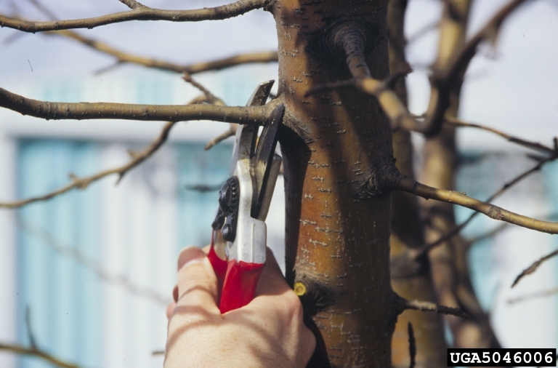
Working in agriculture szószedet
Advisory system: tanácsadói rendszer
Grant system: támogatási rendszer
To boost rural life: élénkíteni a vidéki életet
Yield gained: hozam (nemcsak mg., hanem pénzügyben is)
Precipitation: öntözés
Harvesting: betakarítás, szüretelés, aratás
Seed planting: veteményezés, ültetés, palántázás
Soil conversion: talajművelés
Pruning: metszés
Fertilization: trágyázás

Slide 9

I/B. Fordítógyakorlat
20 éve vagyok magyar gazda, búzatermesztéssel foglalkozom. Agrármérnöki végzettségemet a Debreceni Egyetemen szereztem. Jelenleg 20 ha földdel rendelkezem, aminek a 90 %-a Szabolcs-Szatmár-Bereg megyében található. Szeretem a szakmámat, mindig is a mezőgazdaságban szerettem volna dolgozni. Az év legnehezebb része a betakarítás, hiszen néha napi 20 órát is dolgozni kell, de megéri. A metszést, trágyázást és öntözést 4 alkalmazottam végzi el. A nettó árbevétel 400.000 Ft hektáronként, amely magába foglalja a támogatásokat is.
Forrás: saját feladatbank, 2015

Slide 10
i/c. szövegértés: The impact of agricultural activities
Agricultural activities influence the state of the environment, and water in particular, in different ways. Irrigation and the use of pesticides and _____ are the most notable areas where improved farming practices could make a considerable impact. Irrigation can lead to the ________of water in specific areas of some Member States. Problems arising from irrigation are often linked to specific ________, such as maize and fruits. Irrigation and ______ can affect the level of the groundwater table and lead to salinisation, while drainage in particular can affect wetland ecosystems, which are often important _________ for protected species. Pesticides and fertilisers do not only run off into surface waters, like lakes and rivers. They can also _______ groundwater, raising the level of concentration of potentially harmful substances in these important water sources and potentially causing harm to people, animals and the surrounding ecosystem. (http://ec.europa.eu/agriculture/events/zaragoza/background_en.pdf)
habitats crops fertilizers drainage leach into unsustainable use

Slide 11
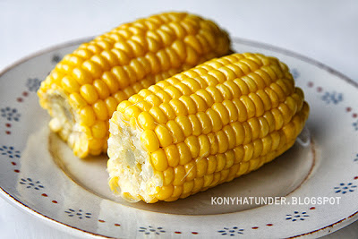
The impact of agricultural activities - szószedet
The impact of: valaminek a hatása
Agricultural activities: mezőgazdasági tevékenységek
To influence something: befolyásol valamit, hatással van rá
Irrigation: öntözés
Pesticides: peszticid/rovarölő
Problems arising from something: valamiből felmerülő problémák
Maize: kukorica
Salinisation: talajszalinitás/szikesedés
Cause harm to people: káros az emberekre
Habitat: élőhely
Crop: gabona
Drainage: vízelvezetés/szennyvíz/csatornázás
To leach into: valamibe szivárog

Slide 12
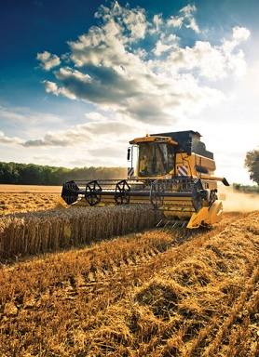
3-4. óra
Kép: http://www.piacesprofit.hu/kkv_cegblog/piac/nagy-valtozas-a-kuszobon-a-mezogazdasagban/

Slide 13
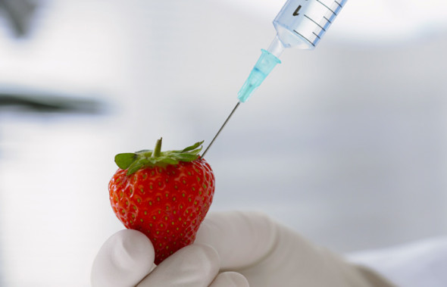
GMO Genetically modified organisms
Definition: GMO is a form of scientific farming where crops are pumped full of chemicals to increase yield and size of crops
It is highly debated and becoming more and more common in everyday foods.
Like a coin, it also has its two sides => advantages and disadvantages
Forrás: http://occupytheory.org/advantages-and-disadvantages-of-gmos/

Slide 14
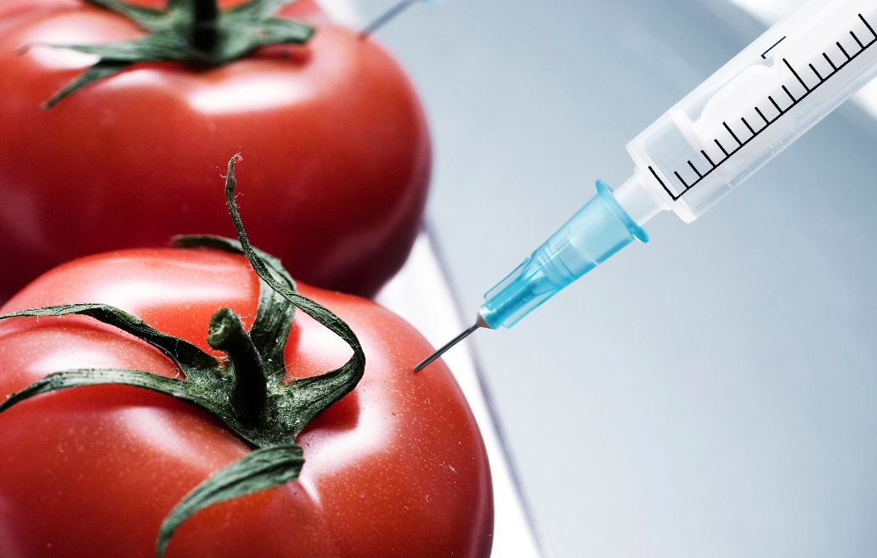
What are the advantages of GMOs?
GMOs is an effective way to provide farmers a larger profit while spending less time a resources
Economically beneficial because they are used to repel pests, which prevents the need for pesticides to be used
Less starvation in the world due to the fact that it cuts food prices
It is more nourishing to the body, which is proven to be effective
Forrás: http://occupytheory.org/advantages-and-disadvantages-of-gmos/

Slide 15
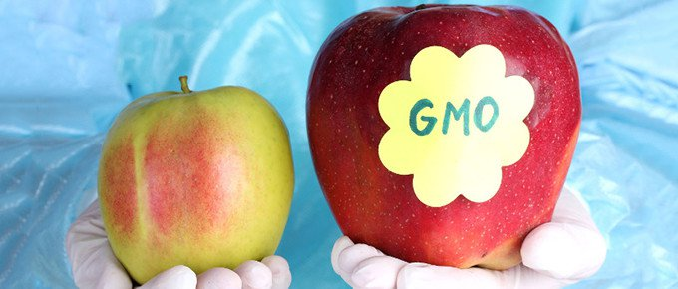
What are the disadvantages of GMOs?
GMOs could be dangerous to some insects. This is because the new genes of the crops can be deadly to certain insects like butterflies that are not actually dangerous to crops
The people who oppose GMOs are not taste good as compared to naturally produced crops.
The tariff, quota and trade issues may become a problem in regions and other countries.
Critics claim that GMOs can cause particular disease or illnesses.
Genetically modified crops may also cause a threat to the environment. This is because it is not a natural way to plant and cultivate crops
Forrás: http://occupytheory.org/advantages-and-disadvantages-of-gmos/

Slide 16
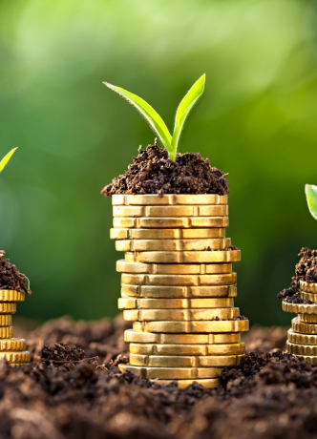
5. óra
Kép: http://www.agroinform.com/gazdasag/tavaly-is-nott-a-mezogazdasag-kibocsatasa-26243-001

Slide 17
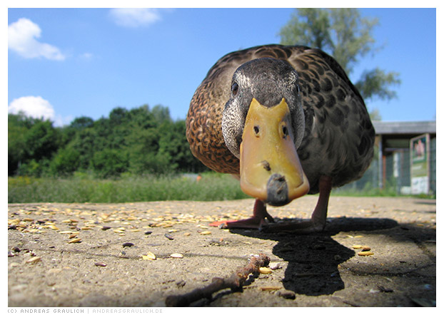
The hungarian agriculture
Introduction
During the communist period about 90 percent of all farmland was organized into collective and state-owned farms. State farms were directly owned and managed by the government.
Animal breeding has fallen by 50 percent in comparison with 1990.
Agricultural production is important to Hungary's economy although its role in the economy has steadily declined.
Hungary has 43,000 square kilometers of cultivated land, covering 52 percent of Hungary's total area.
Hungary's leading agricultural products are a combination of staple crops, famous specialty items such as wine and livestock products, and basic livestock.
Hungary's most important crops include corn, wheat, sugar beets, barley, potatoes, and sunflower seeds. It also produces grapes and wine, including several famous wines such as those from the Tokaj region.
Other well-known specialty items include salami, goose liver, and paprika. Livestock production is also important in Hungary, including cattle, pigs, sheep, horses, and poultry.
The market is commodity driven. – quality is the base of trust and safety. Forrás: http://www.nationsencyclopedia.com/economies/Europe/Hungary-AGRICULTURE.html

Slide 18
fordítógyakorlat
A rendszerváltás után minden megváltozott a mezőgazdaságban. A földek és mezőgazdasági vállalkozások az állam kezébe kerültek. Az állattenyésztés teljesítménye 2 év alatt 50 %-kal csökkent, a növénytermesztés sem volt már a régi. Magyarország művelt területe.
Cégünk állati eredetű termékek értékesítésével foglalkozik.
Tevékenységünk alapja a minőség.
Otthon baromfit, szarvasmarhát és libát tenyésztünk.
Szeretek a mezőgazdaságban dolgozni, mert jövedelmező és az EU támogatja a gazdákat.
Szeretem a munkámat, de nem szeretek robotolni.
Szeretem a munkámat, mert itt minden lehetőség adott.
Forrás: saját feladatbank, 2015

Slide 19
Development of Terms of Trade and Agricultural Product Prices
Livestock prices in Hungary have been always _________(1) the EU-15 levels, except for pork in the year 1994 where it was +7.2 % higher. In general the price gaps between EU-15 and Hungary show a relatively _________ over time (Fig. 3). On average for the years 1993 to 2000 the prices for butter were 50.8 %, beef 46.1%, milk 30.6 %, poultry 19.8 %, Cheese 16.5 %, pork 13.5 %, skimmed milk powder 11.7 % and eggs 10.2 % below EU-15 level. After a tendency towards further increase of the price gaps in the years 1993 to 1996, the difference to EU-15 prices generally decreased ______________ The only ________ is poultry where meat prices declined from a –3.5 % level in 1994 to a level –45 % below EU- 15 price levels in 2000. In the year 2000 for most of the livestock products the __________ have again widened, except for butter and eggs.
Forrás: http://ec.europa.eu/agriculture/external/enlarge/publi/countryrep/hungary.pdf
a: below c: constant pattern e: price gaps
B: exception d: over the following three years.

Slide 20
Köszönöm a figyelmeteket, türelmeteket és kitartásotokat!!

