Slide 1
Case presentation
Name
Insurance number (TAJ):
University Of Debrecen - Faculty of Dentistry

Slide 2
Photograps (dia)
Professional pictures are not needed, but all photos must be sharp and have all the relevant information of the step.
One photo/slide which fills the entire slide.
Irrelevant areas of the image must be cropped.

Slide 3
Reason of referral
Chief complaint
Reason of referal
Edit
Edit
Edit
Edit
Edit
Edit

Slide 4
General and dental anamnesis
History
Medication
Edit
Edit
Edit
Edit
Edit
Edit
Surgeries
Allergies
Edit
Edit
Edit
Edit
Edit
Edit
Notes:
Surgeries, non-dental surgeric procedures, current medical treatments, general medical conditions, allergies

Slide 5
Clinical examinations
Extraoral
Intraoral
Edit
Edit
Edit
Edit
Edit
Edit
Prosthodontics
Upper arch
Lower arch
Edit
Edit
Edit
Edit
Edit
Edit
Kennedy classification
Edit
Edit

Slide 6
Dental Status
8 | 7 | 6 | 5 | 4 | 3 | 2 | 1 | 1 | 2 | 3 | 4 | 5 | 6 | 7 | 8

Slide 7
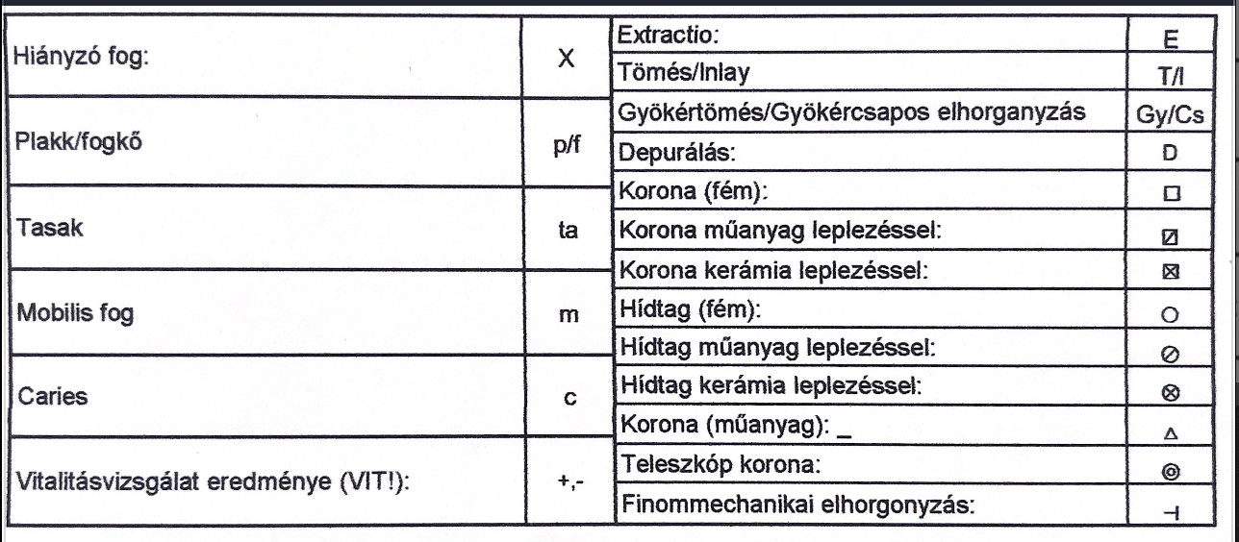
Guide for the charting
Missing tooth
Extraction
Filling / inlay
Plaque/calculus
Root canal filling
Scaleing
Metal crown
Pocket
Polimer fused to metal crown
Ceramic fused to metal crown
Mobility
Pontic - metal
Pontic - polimer fused to metal
Caries
Pontic - ceramic fused to metal
temporary crown
Vitality
Telescopic crown
Precisional sliding attachment

Slide 8
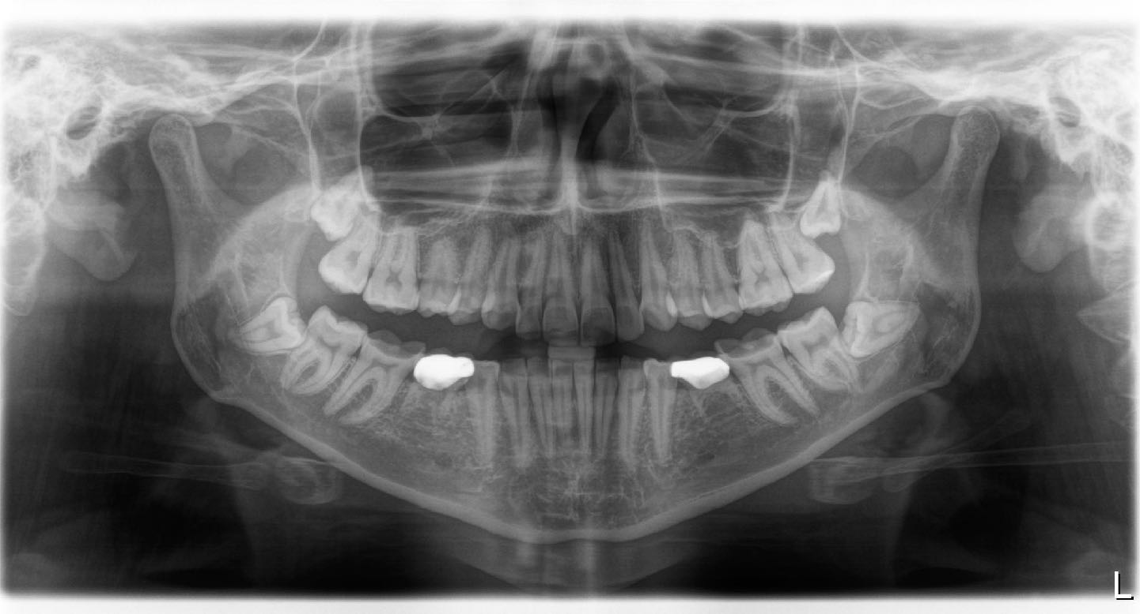
Panoramic X-ray

Slide 9
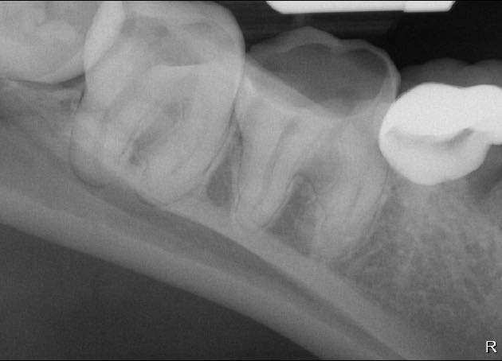
Periapical X-ray - lower
46
46
Notes:
Only clinically relevant periapical x-rays are needed. e.g.: final x-ray of root canal filling.

Slide 10
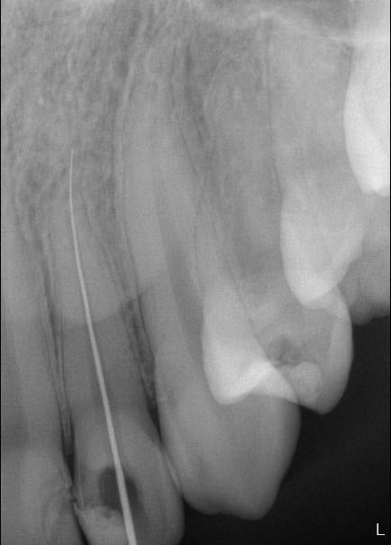
Periapical X-ray - upper
14
14
14

Slide 11
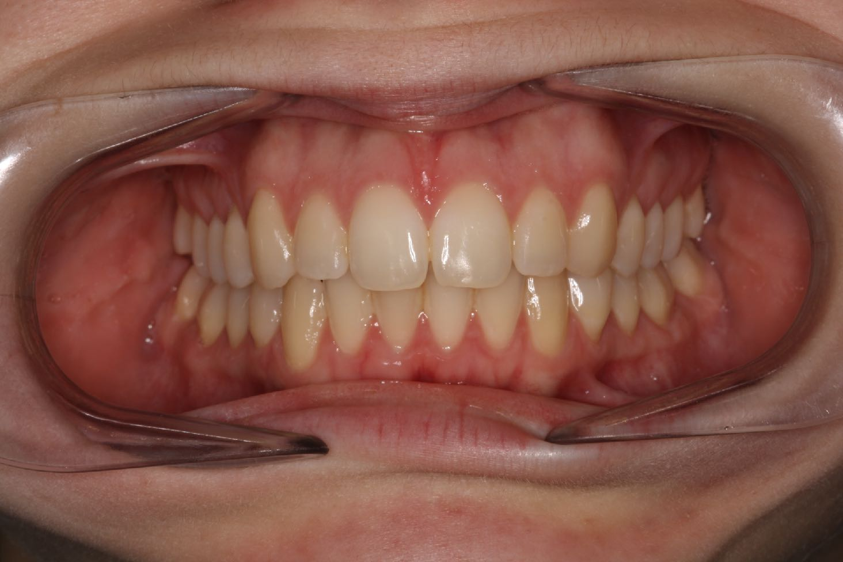
Photograph - ICP

Slide 12
Clinical Examination
Upper and lower study models

Slide 13
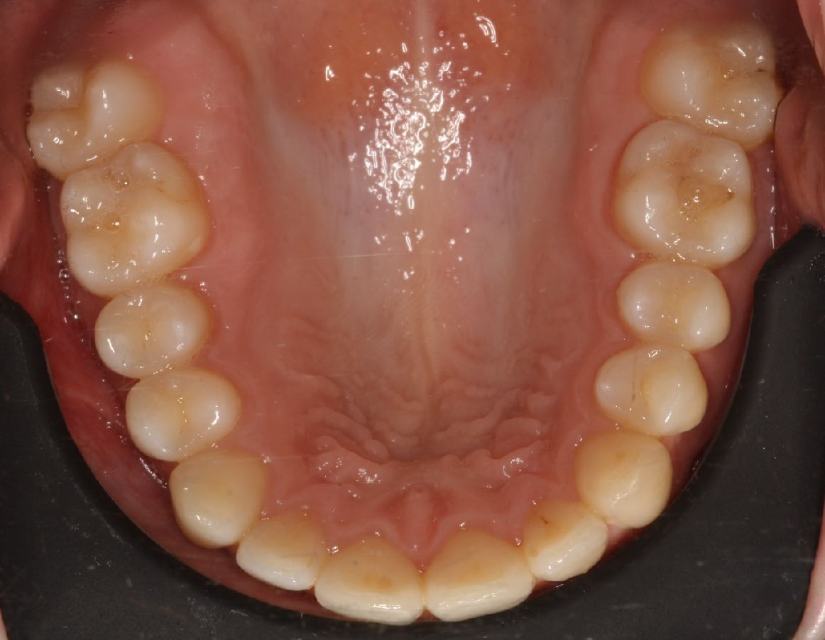
Upper Arch

Slide 14
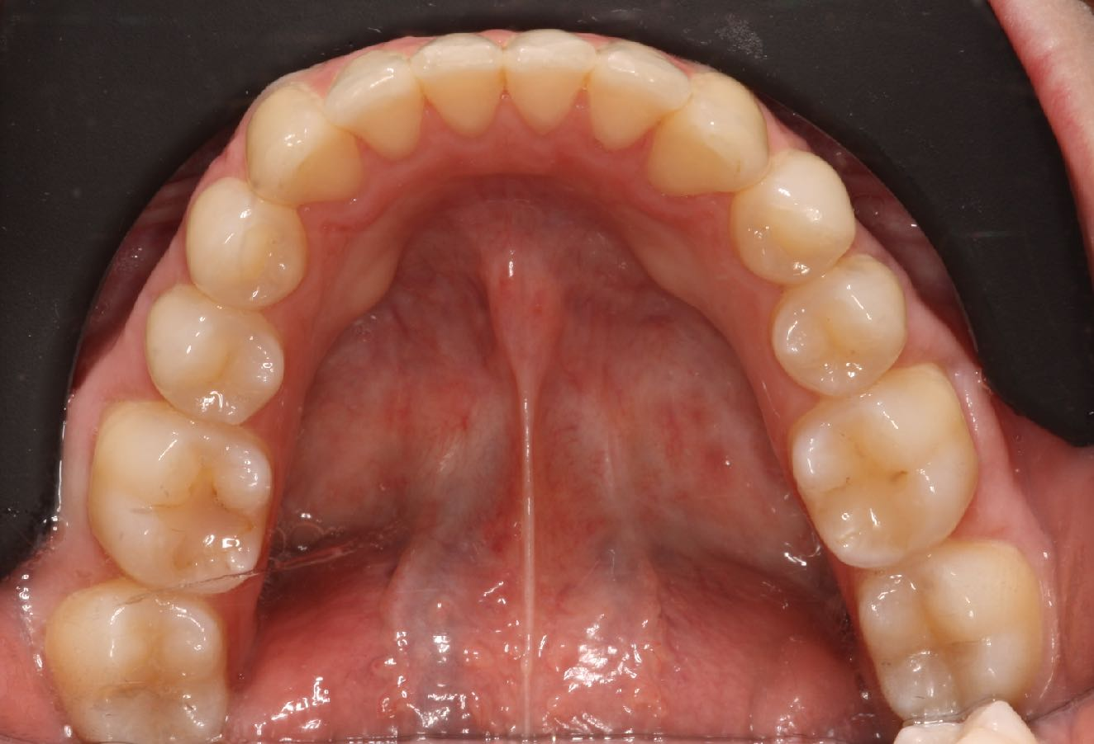
Lower arch

Slide 15
Diagnosis
Surgical
Edit
Periodontal
Edit
Restaurative
Edit
Prosthetic
Edit

Slide 16
Treatment plan
Treatment plan
Prognosis
Edit
Edit
Edit
Edit
Edit
Edit
Alternatives
Edit
Edit
Edit

Slide 17
Photographs of working steps

Slide 18
Camera settings
M mode. (NOT macro!)
f: 22
shutter speed: 125
iso: 200
White ballance: flash
flash: TTL
Focus: auto

Slide 19
List of photographs
Crown-bridge-post-inlay
Removable + fixed
Prepared teeth.
Bite registration or occlusal rim after registration.
Impression
Entire impression
Close-up of the prepared teeth.
Restoration on the model( frame, bisquit try-in, final)
Restoration intraorally( frame, bisquit try-in, final)
All images of the fixed restoration. (see left)
Study casts in an articulator (after inserted with occlusal rim)
Final impressions
Framework (RPD) (on model, intraoral
Framework (RPD) (on model, intraoral)
Delivered prosthesis

Slide 20
Examples

Slide 21
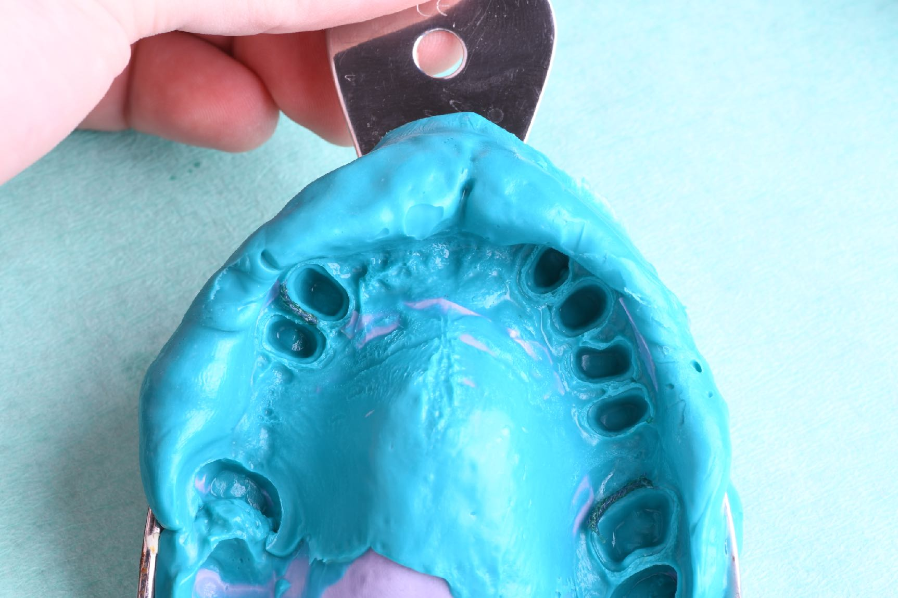

Slide 22
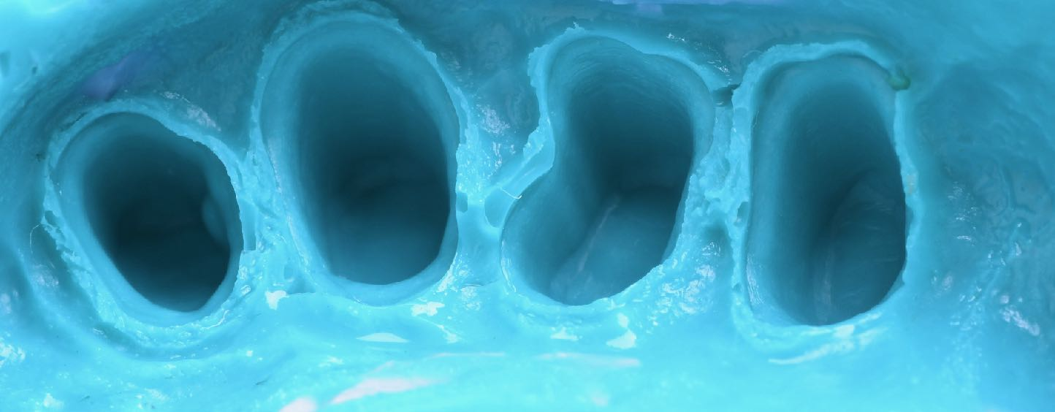

Slide 23
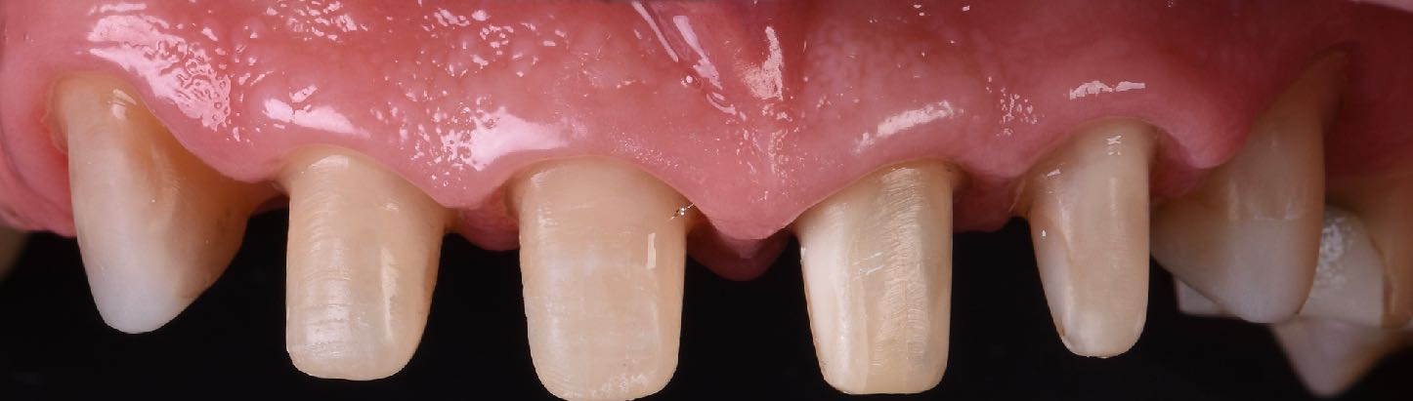

Slide 24
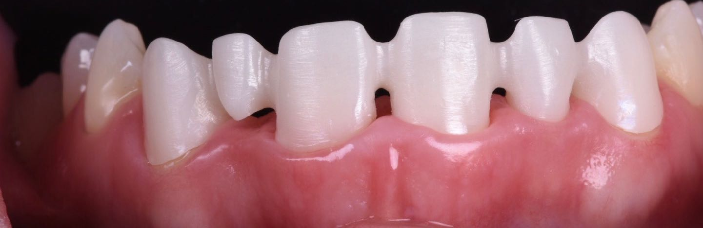

Slide 25
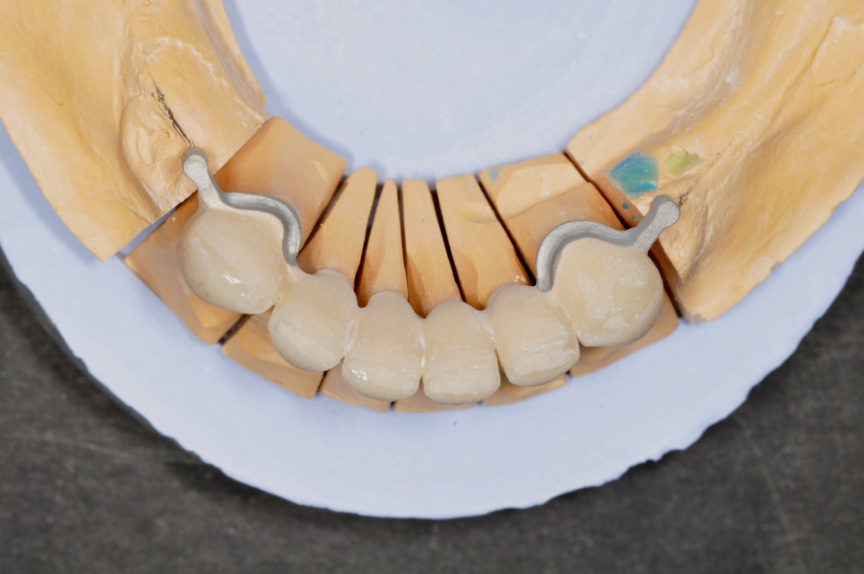

Slide 26
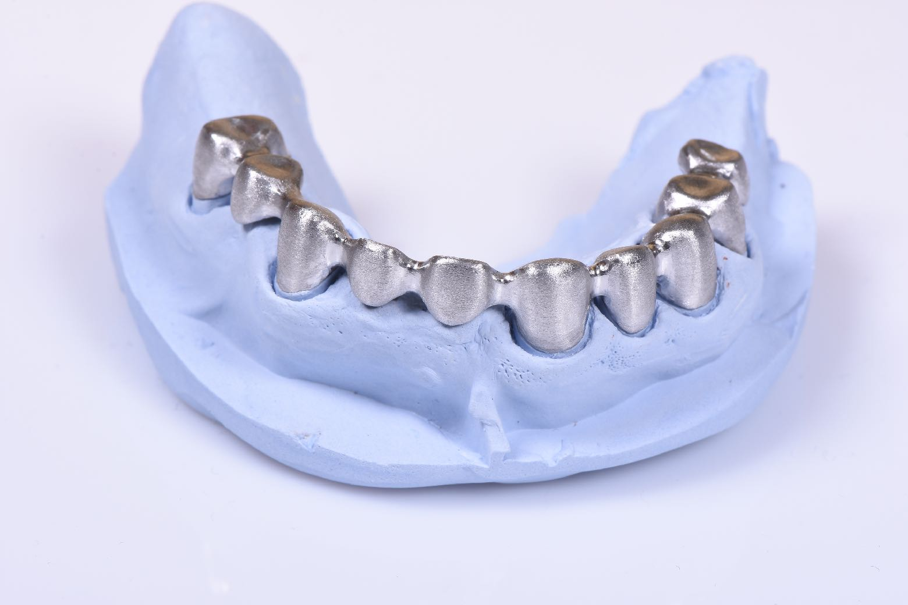

Slide 28
Delivery

Slide 29
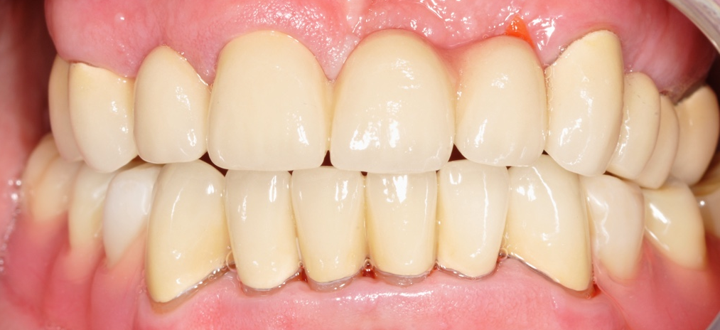

Slide 30
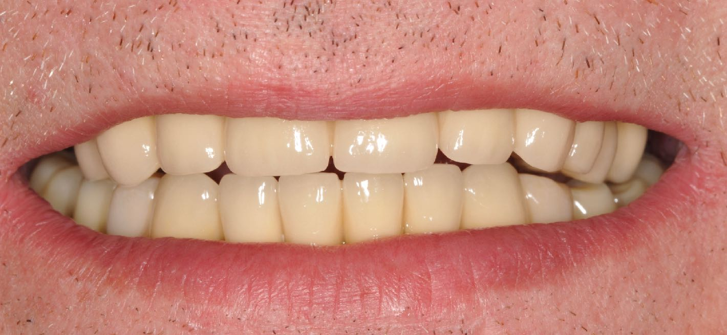

Slide 31
Evaluation, reflection
Edit

