Slide 1
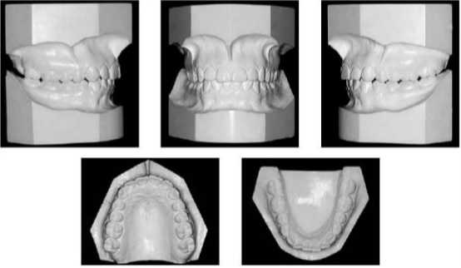
Orthodontic diagnosis
Cast analysis and skeletal maturation and pubertal growth spurt

Slide 2
The aim of the orthodontic diagnosis:
Discovery of dentosceletal disorders in the orofacial region, that will lead to a complete treatment plan for aesthetic and functional rehabilitation.
It is a dinamic process because the growth period influences the growth direction and the rate of dentofacial structures.

Slide 3
What is needed for a comprehensive diagnosis?
Anamnesis
Clinical examination
Functional examination
Cephalometric analysis
Photo analysis
Other x-rays
Cast analysis

Slide 4
Anamnesis
General
Orthodontic

Slide 5
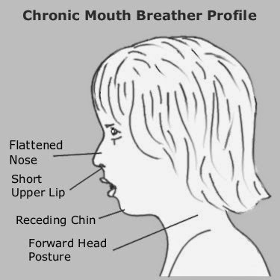
General history/anamnesis
Bone disease
Drug consumption
Is antibiotic prophylaxe needed
Condition of nose tonsilla and pharynx tonsilla
Interoperability of nasal passages
Mouth breath
Intellectual development

Slide 6
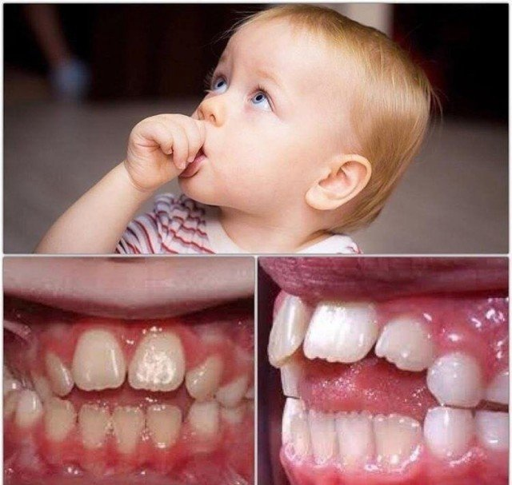
Orthodontic anamnesis
Thumb sucking
Time of tooth eruption
Face or dental injury
Bruxism
Wind instrument us
Previouos ortho treatment

Slide 7
Clinical examination
General intellectual develpoment, attitude, head position
Extraoral face characteristic and soft tissue
Intraoral dentoalveolar, soft tissue and tooth examination

Slide 8
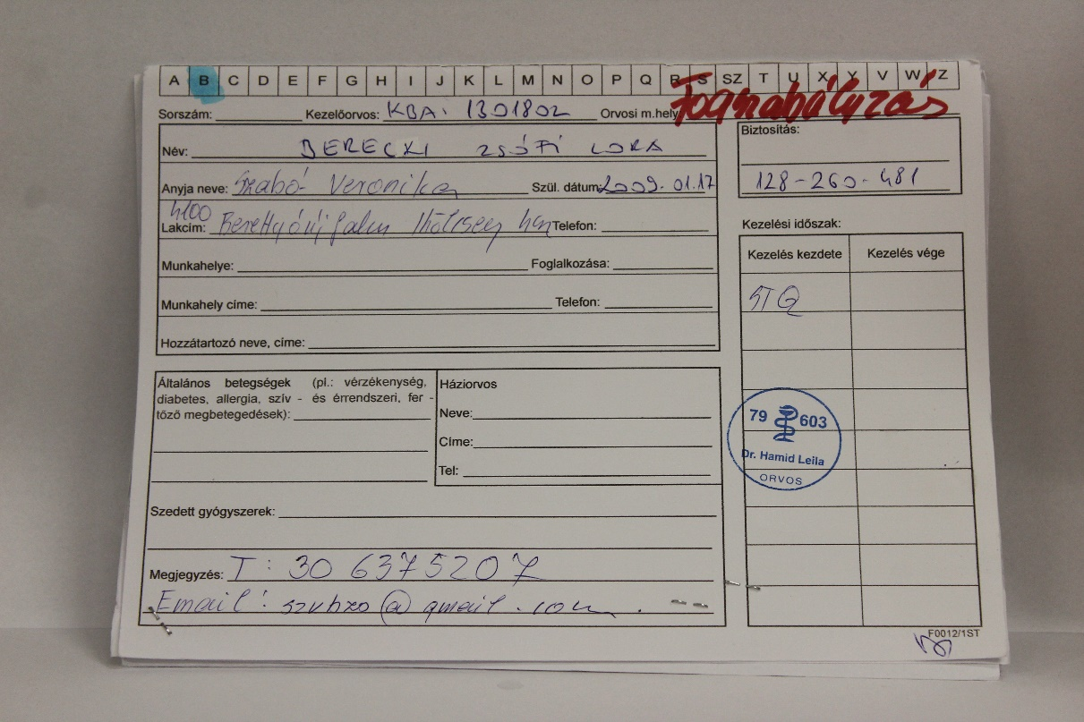
Clinical examination:
Mirror, probe, forceps
Cold spray, electronic pulp tester if it is necessary
Patient cardbord, where we register:
General and dental history, results of clinical examination, diagnosis, treatment plan, patient agreement

Slide 9
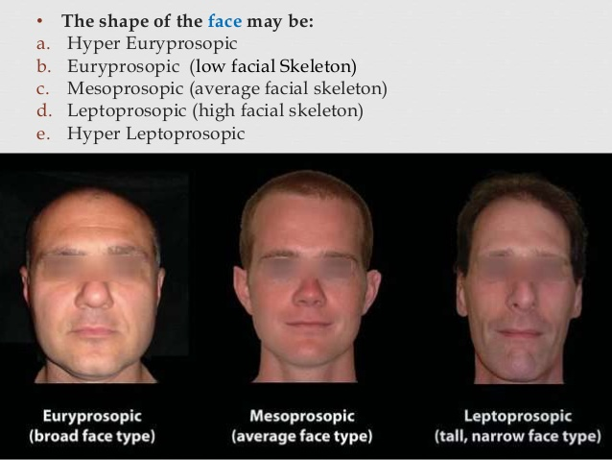
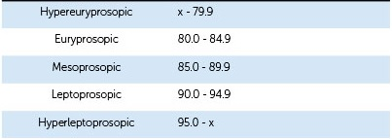
Extraoral parameters
Vertical face form Facial index=I
I= face heigh/face width

Slide 10
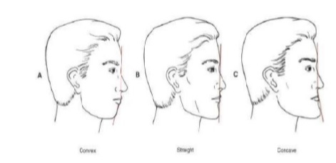
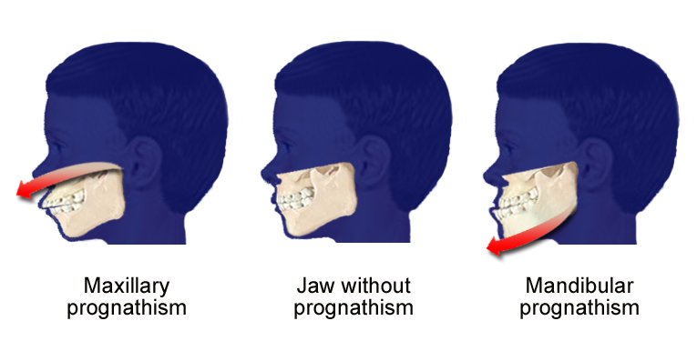
Extraoral dates Face form Saggital
Profile: straight/ convex/ concave
Maxilla position: normal/ prognath/ rethrognath
Mandibula position (size): normal/ prognath/ rethrognath

Slide 11
Extraoral dates Faceform Frontal

Slide 12
Extraoral dates Lips and nose examination
Lips:
- length: normal/ short
- vermilion border: normal/ narrow/ wide
- condition: dry/ cracked/ scrably
- lipclosing: complete/ incomplite
- lip step: normal/ positive/ negative
Nose:
- vertical/ horizontal/ transversal size

Slide 13
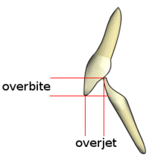
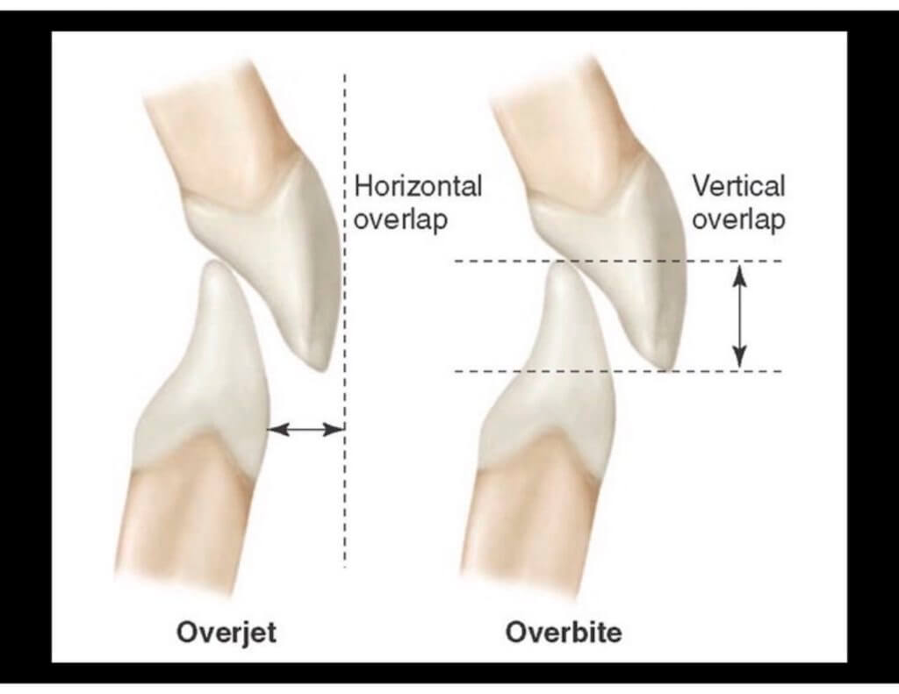
Intraoral dates Dental features
Dental stages: primary/ early mixed/ late mixed/ permanent
Shape and numerical disorders
Positional disorders:
Saggital: - Angle classification (molar, canine)
- overjet
- frontal crossbite
Vertical: - overbite (mm)
- frontal/ lateral open bite
Transversal: - midline shift (dental, face)
- lateral crossbite

Slide 14
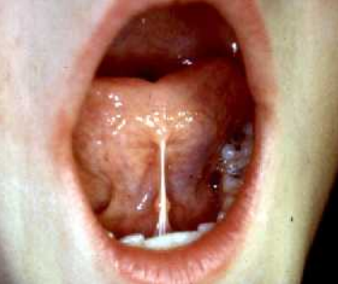
Intraoral dates Dentoalveolar features
Apical, coronal base: normal/ wide/ narrow
Soft tissue parameters:
Gingiva: normal/ inflamed/ hyperplastic
Palatum: high/ flat/ ordinary
Frenulum linguae, labii: strong/ ankyloglossia/ normal
Tongue size: normal/ big

Slide 15
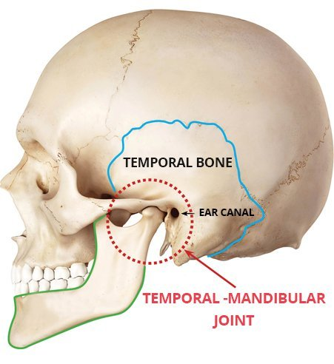
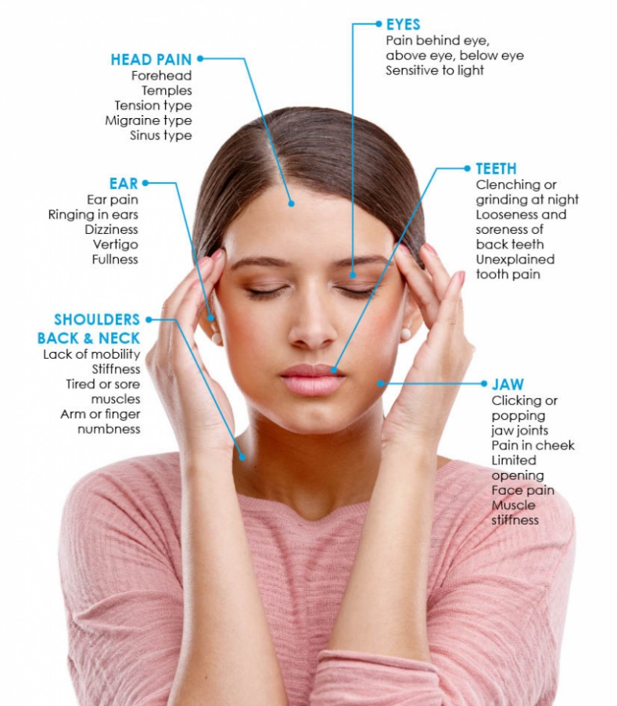
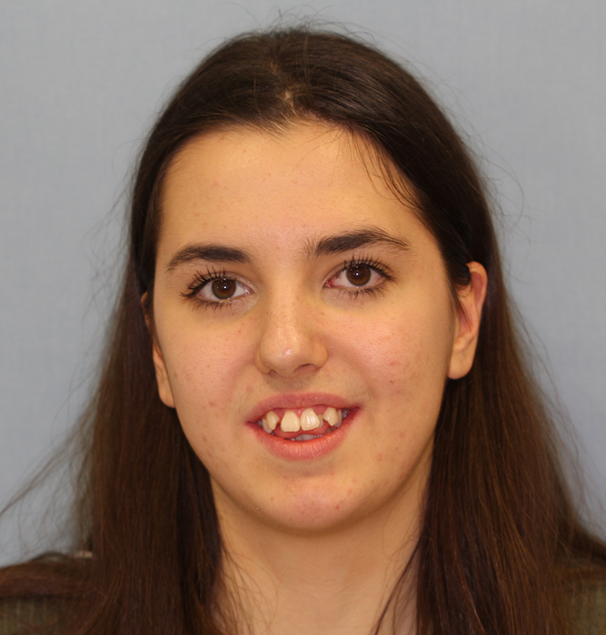
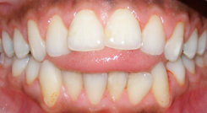
Functional analysis
TMJ inspection
Jaw examination in, released and habitual occlusion position
Functional discrepancy

Slide 16
TMJ analysis
Orthodontic treatment or interventions do not aggravate nor alleviate already formed joint problem.
Examination parts:
Auscultation: looking for crepitation in anteroposterior and sideward position
Palpation: controls the pressure sensitivity of the joints and the muscle involved in jaw movements (m. pterygoideus lat./ m. masseter/ m. temporalis) and the coordinated operation of the condylar
Hypermobility?
Interincisal space, protrusion movement, sideward digestion, deviation

Slide 17
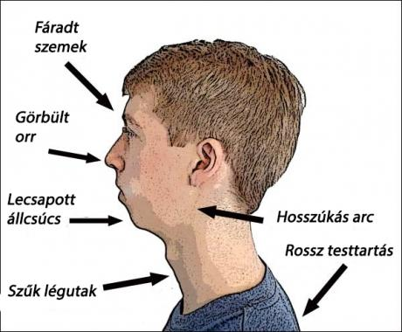
Functional discrepancy examination
Swallowing examination: normal/ tonge thrust
Lips examination: thumb sucking/ lip squeeze swallowing/ lip insufficientia
Bucca examination
Breathing examination: nose breathing/ mouth breathing (adenoid face)

Slide 18
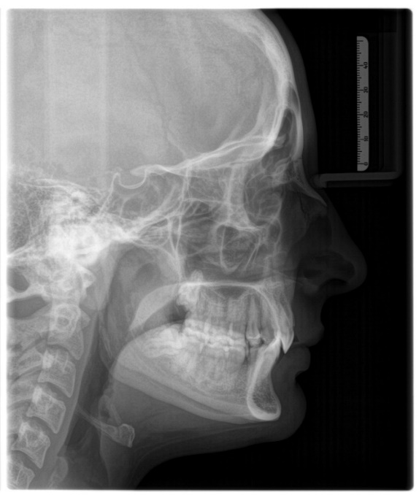
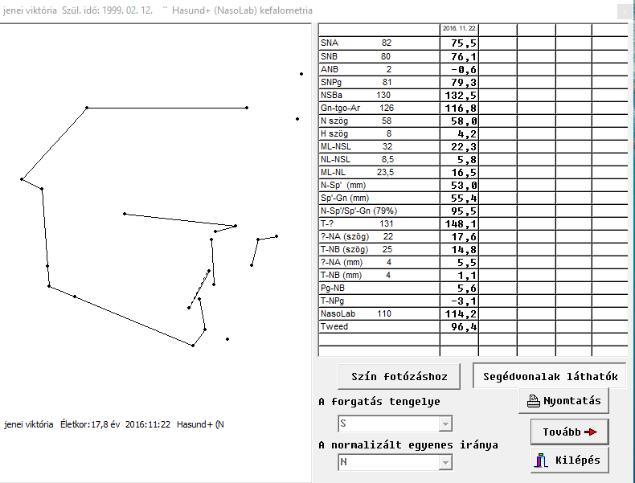
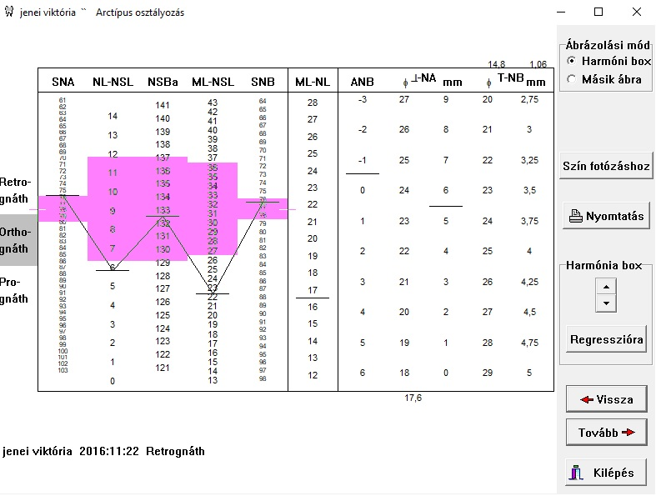
Cephalometric analysis

Slide 19
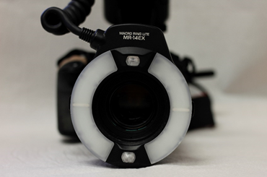
Photo analysis
Photos are made in standardized conditions with same set up, so you can follow the multiple changes.
Extraoral records: - fronal view (serious-macro aesthetic, smile- miniaesthetic)
- semilateral view
- lateral view
Intraoral records: -frontal/ lateral/ occlusal view

Slide 20
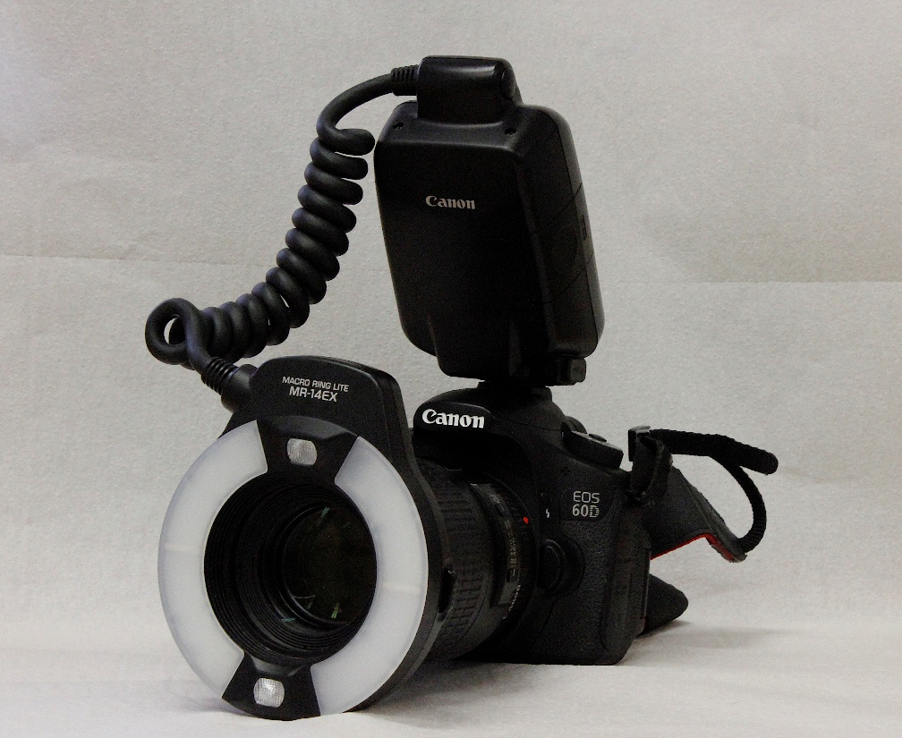
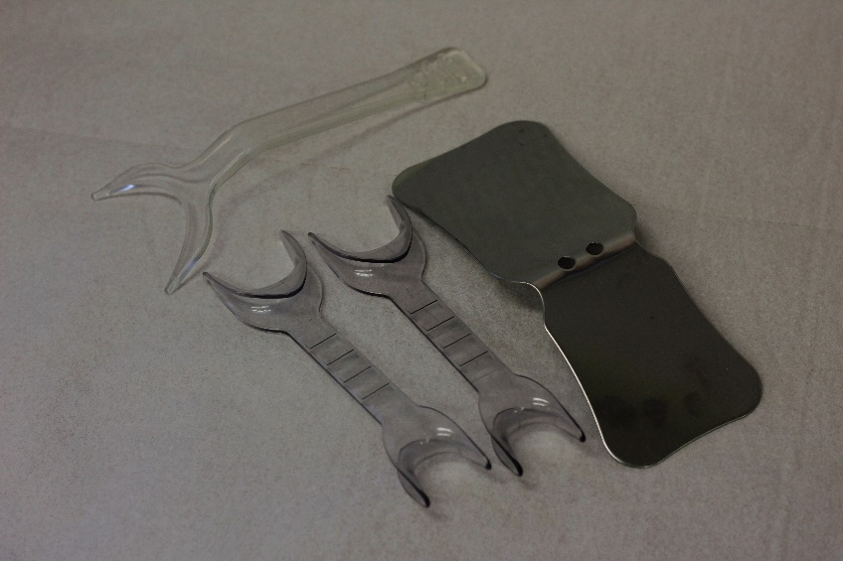
Camera andaccessories
Single-lens reflex camera, macro objective, flash circle
Lip retractors, mirror
Background

Slide 21
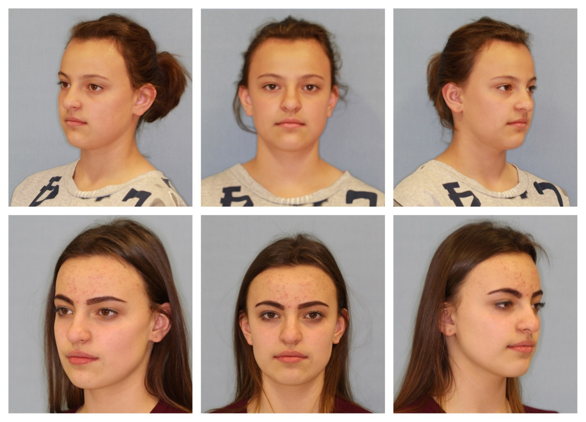
Face photos: before and after the treatment
Before the treatment
After the treatment

Slide 22
Face photos: before and after the treatment
Before the treatment
After the treatment

Slide 23
Face photos: before and after the treatment
Before the treatment
After the treatment

Slide 24
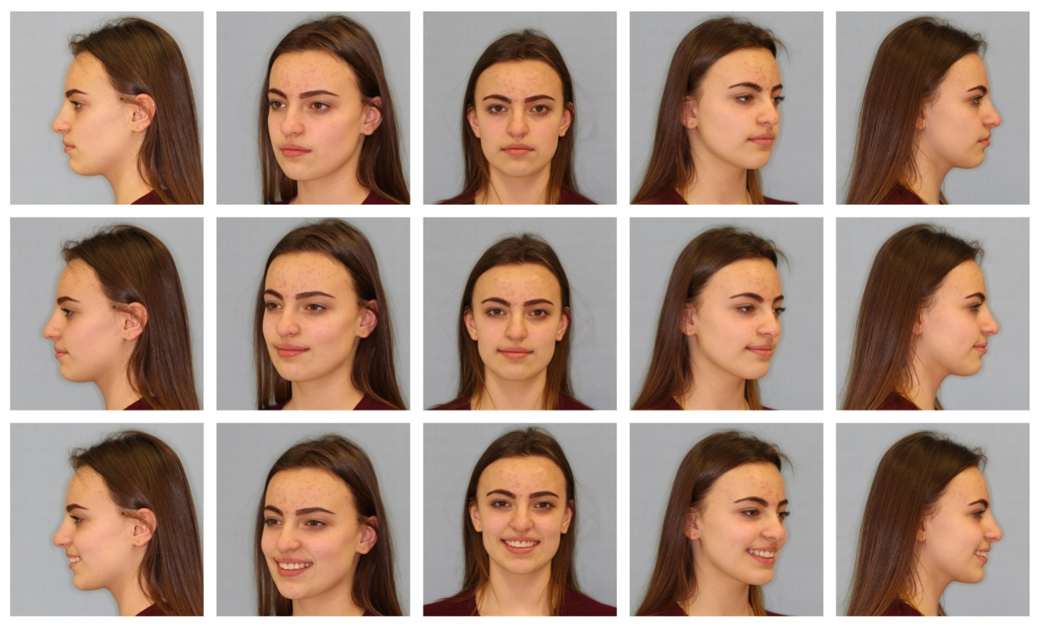
Face photos: before and after the treatment
Frontwise, half profile, profile
Relaxed, small simle, big smile

Slide 25
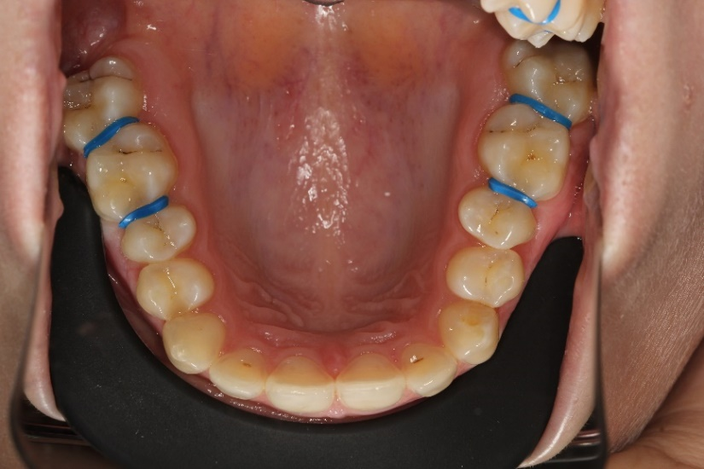
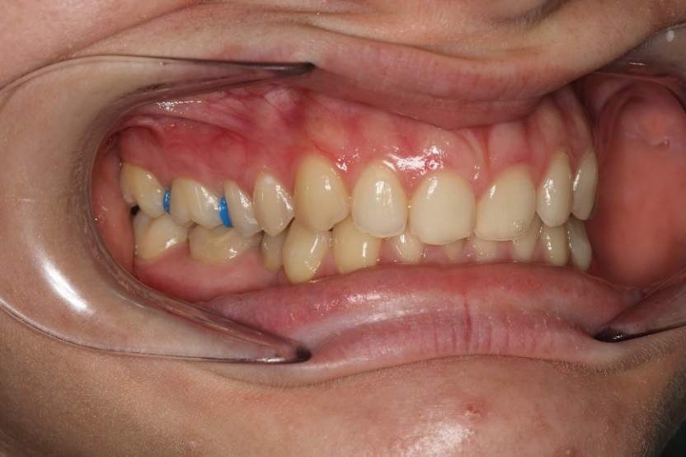
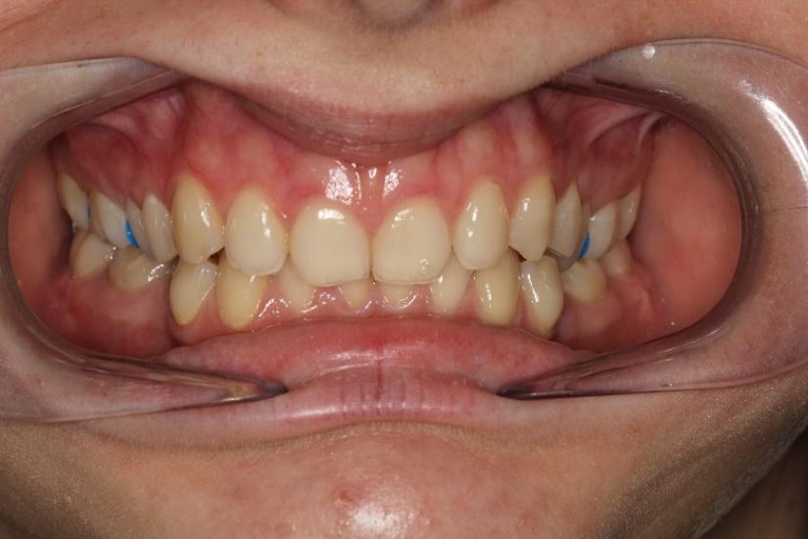
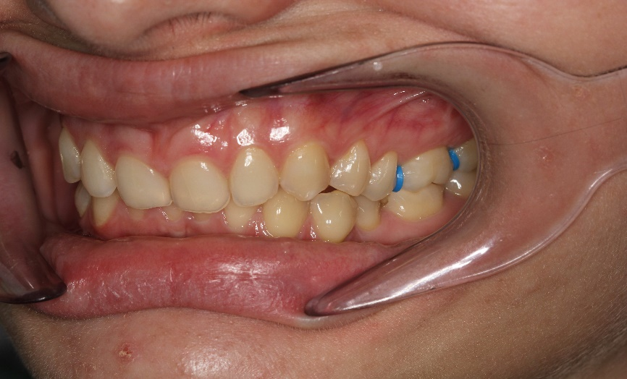
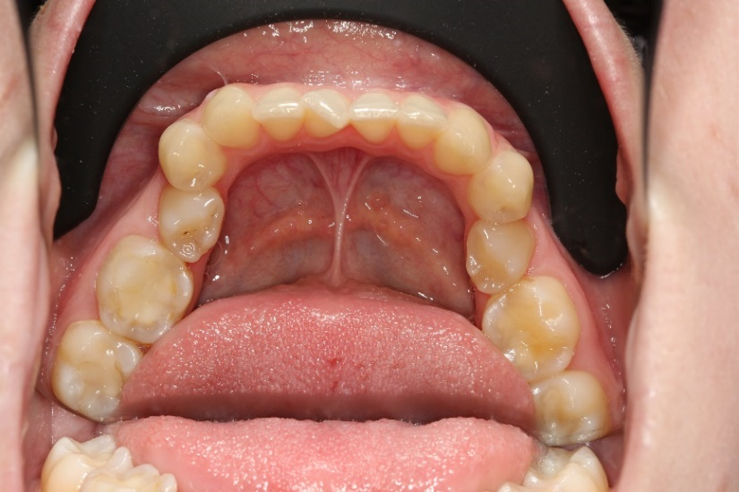
Intraoral photos
Symmetry
Smile line
Smile arch
Buccal corridor
Incisal plane

Slide 26
6. Other x-rays
Aplasia, assymetry, supernumarie tooth, periapical process, absorption can be examined.

Slide 27
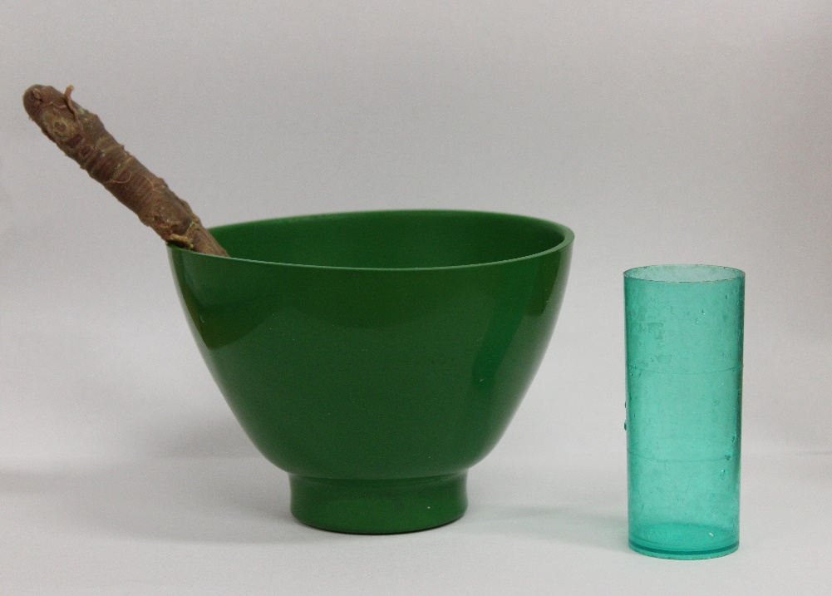
Impression

Slide 28
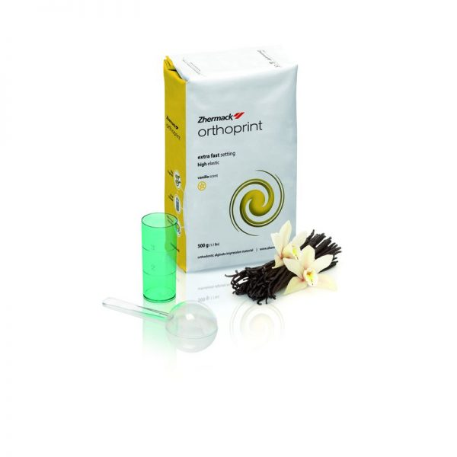
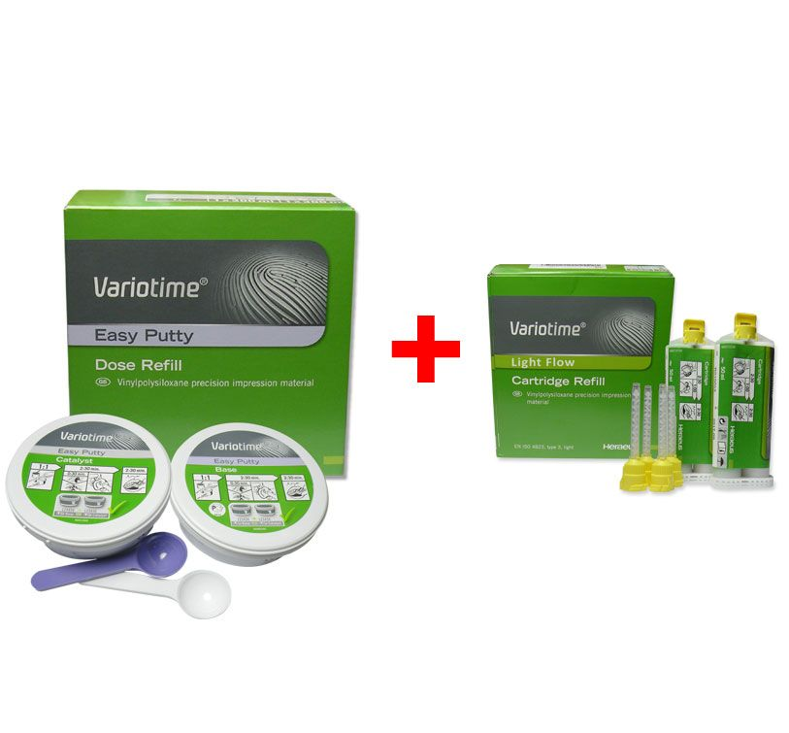
Materials and instruments of the impression:
Material of impression: alginate or silicon
Impression trays
Wax: for register the bite

Slide 29
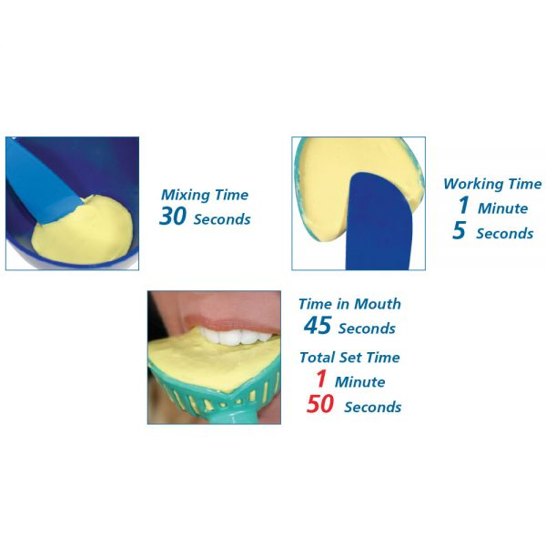
Materials of the impression:
Orthodontics alginate:
Flexible
With vanilla scent
Characteristic feature is the shrinkage: it has to cast in 15 min., or we have to provide wet environment.
Application:
For study cast: it is part of the documentation, diagnosis and the analysis of the cast
For working cast: making of orthodontics appliances

Slide 30
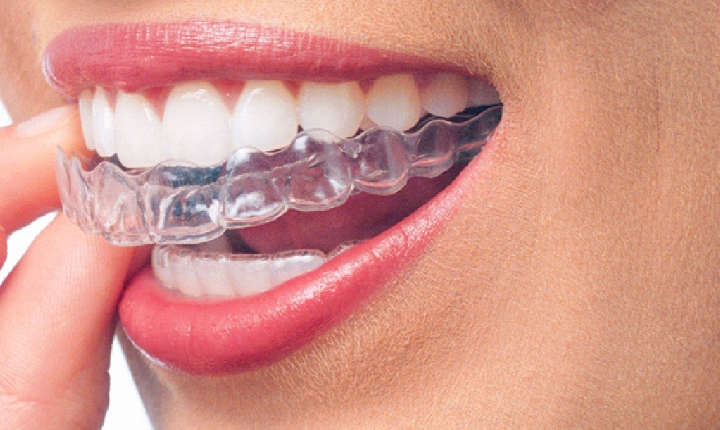
Materials of the impression:
Two phases, two component silicon:
For the working cast of the aligners, what the lab will digitalize.

Slide 31
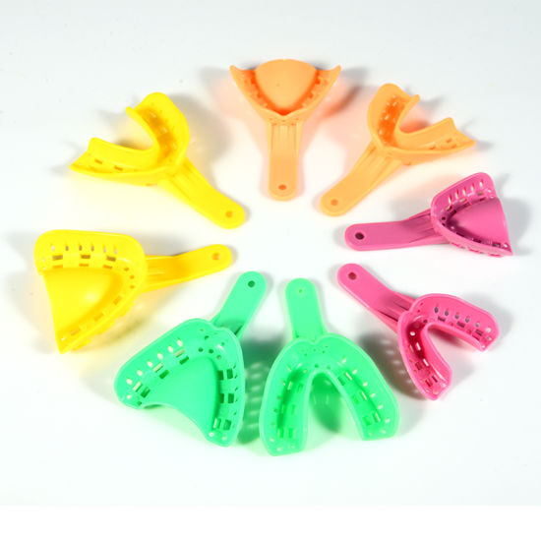
Tray of the impression:
Need a special impression tray: with high edge to mold the teeth and the vestibule.

Slide 32
7. Cast analysis
One of the most important element of orthodontic documentation.
Upper and lower jaw can be examined in three dimension. (saggital, vertikal, transzversal).
Occlusion can be mapped from lingual direction.
It also help for the patient to recognise the severity of the lesion.
Advantage:
Arch form, intercuspidation, occlusal plane, local irregularity can be examined
space analysis (crowding/ spacy)
Disadvantages:
- Soft tissue can’t be examined
- Skeletal relation can’t be analyse

Slide 33
The upper cast has seven side, lower modell has six. The ????soles/ talp are paralell with each other and with the occlusal plane.

Slide 34
What can we examine on the cast?
Angle classification
Arch form analysis
Arch width
Frontal arch lenght
Symmerty analysis
Mixed dentition space analysis
Bolton analysis
Occlusion analysis

Slide 35
1. Angle classification

Slide 36
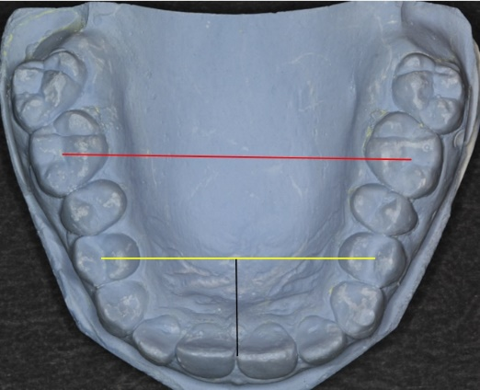
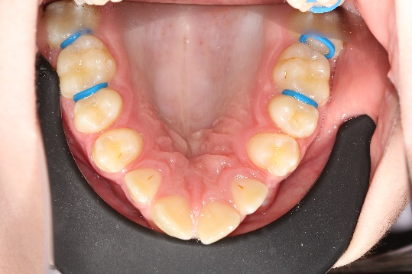
3. Arch width – Pont index
We have to measure the upper four incisor and sum it = Sis
If we have aplasia, we have to measure the lower four incisor and calcule with Tonn formula:
SI_{s} = SI_{i} x 4/3 + 0,5
Frontal arch width: (praemolar region) SI_{s} x 100/85
Posterior arch width: (molar region) SIs x 100/65
If the measured value smaller than the calculated > expansion

Slide 37
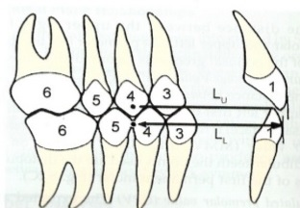
4. Frontal arch lenght – Korkhaus index
Refers to the distance between the most labial point of the upper incisors and the line defining the anterior incisors.
Difference between the standard and the measured values can determine the orovestibular position of the incisors.
SI _{s} x 100/160
The lower lenght is 2mm shorter.

Slide 38
5. Symmetry analysis
It is based on comparison of transverse and mesiodistal position differences between the right and left side.
Measurement requires the determination of the median saggital (raphe palati) and its perpendicular tuberal plane.
Examination of transverse symmerty to verify the presence or absence of congruence between dental or skeletal midlines:
Upper reference plane is raphe palati, the lower is frenulum linguae
Examination of anteroposterior symmerty to determine one side deviation:
- Reference is tuberal plane

Slide 39
6. Moyers mixed dentition space analysis
This is the most widely used proportionality prediction from tables.
We measure the four erupted lower incisor and infer from Moyers index the place requires for the lateral supporting zone.
If the measured value is bigger then the standard we have to make space.
Lateral supporting zone: 3,4,5

Slide 40
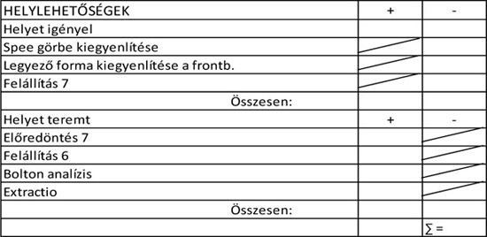
Gross mixed dentition analysis
We can predict the permanent lateral supporting zone space requirement with a special regression eruation.

Slide 41
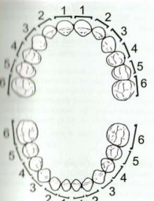
Bolton analysis
Determines the mesiodistal diameter of the upper and lower teeth.
Full rate: we compares the total width of the lower teeth (46-46) with the totoal width of the upper teeth (16-26)
Σ mand₁₂ (m-d) / Σ max₁₂ (m-d) x 100 = 91,3%

Slide 42
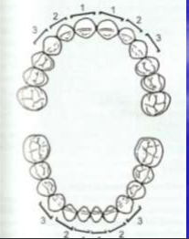
Bolton analysis
Frontal rate: compares the width of the lower six frontal tooth (33-43) to the total of the upper six fronts (13-23)
Σ mand₆ / Σ max₆ x 100 = 77,2%
It has consequence when there is rotation, gap, crowding in the frontal area.
The rate of less than 77,2% there is redundancy at the upper incisors.
If the rate is bigger than 77,2% there is a surplus in the lower incisors.

Slide 43
Occlusion analysis
We can collect information about the relationship between the lower and upper teeth in habituated occlusion.
Transversal discrepancy:
dental and sceletal midline shift
lateral crossbite (one or both side)
Vertical discrepancy:
extended overbite
open bite (frontal, lateral, full)
Saggital discrepancy:
extended overjet
frontal crossbite
disto occlusio/ mesio occlusio

Slide 44
Sceletal age determination
It is important in the field of anthropology, forensic medicine, pediatrics, endocrinology,orthodontics and mainly jaw orthopedics.
During growth, bones undergo many changes, and the order of the changes is always determined.
Theses changes can be examinde in different ways:
radiological examination (cervical and hand bones)
3D images
molecular diagnostic

Slide 45
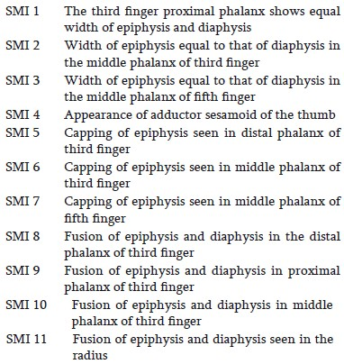
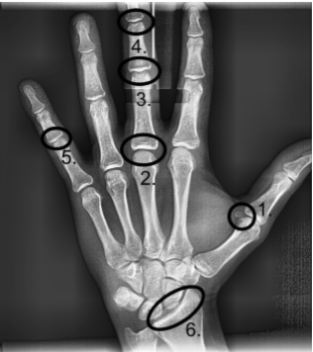
Fishman examined ossification centers on wrist
Girl reach the maximum growth height between SMI 4 to SMI 6, maxilla reach SMI 5 to SMI 6, and the lower jaw reach SMI 6 to SMI 7 the maximum growing.
While boys, all the three the peak is from SMI 6 to SMI 7.

Slide 46
Spine analysis
Lamparski determined for the first time the cervical vertebral differences in 1972.
These stages are called „cervical vertebra stages” CVS
There are six different stages depend on the vertebra lower contour and vertebral body variations
Puberty growth peak is between CVS 3 and CVS 4.
Disadvantage:
The inspector’s expertise is inadequate
Subjective judgement of the cervical vertebras

Slide 47
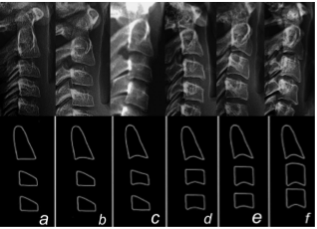
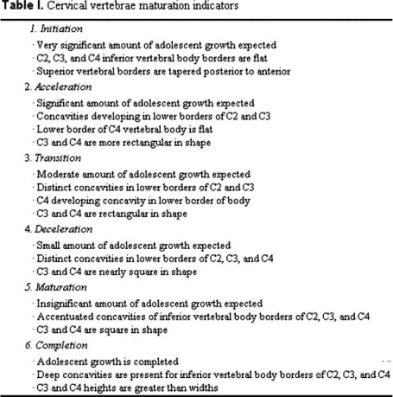
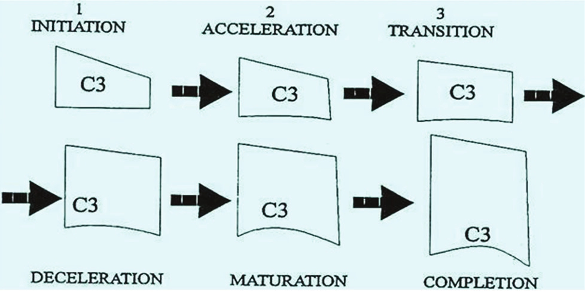

Slide 50
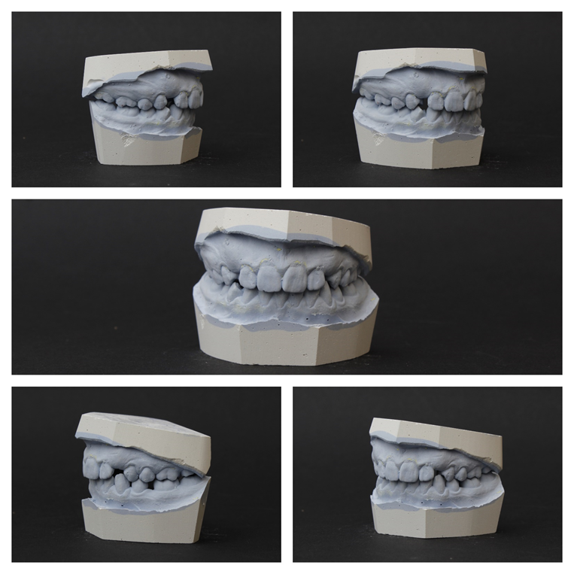
The treatment plan

Slide 51
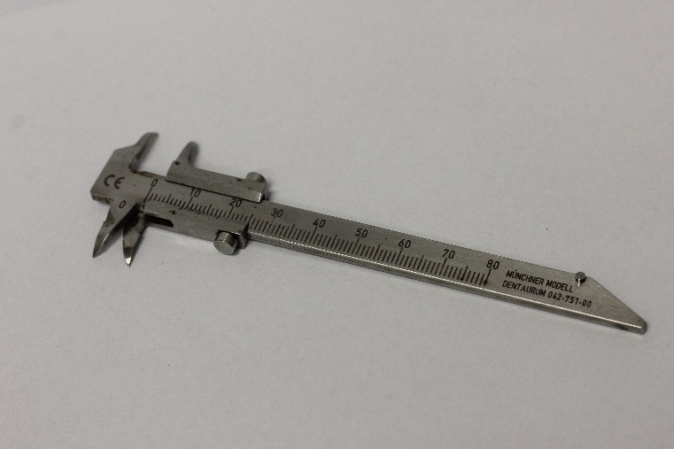
Instruments of the treatment plan:
Study casts
Dental vernier: for the measurement of the casts analyisis.

Slide 52
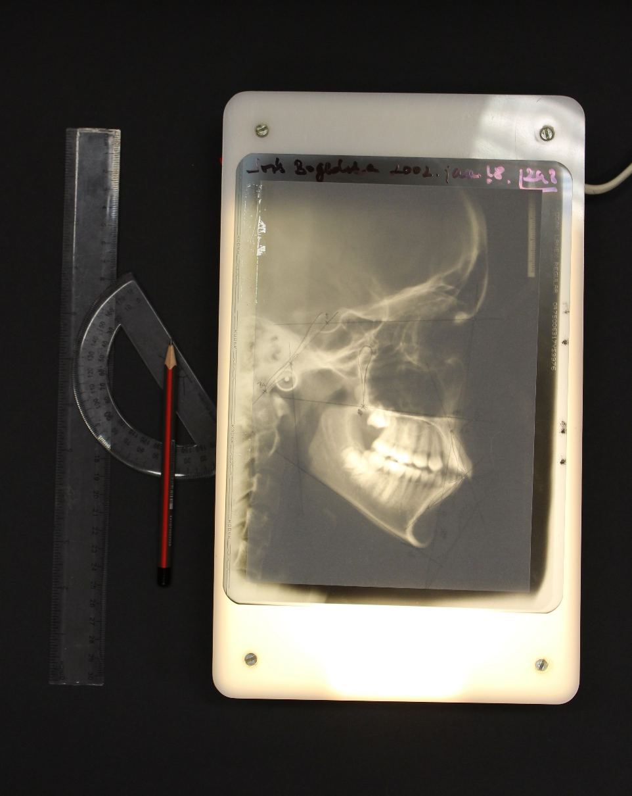
Instruments of the treatment plan making:
lighting box
tracing paper
pencil
Ruler
protractor
analysis paper

Slide 53
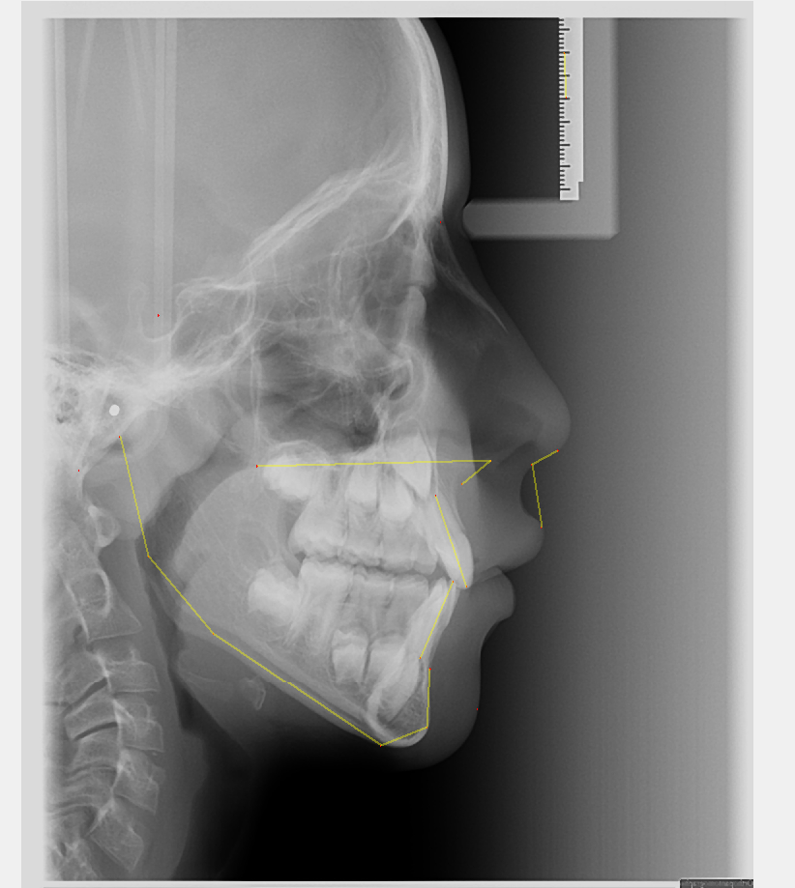
Instruments of the treatment plan making:
Or orthodontics analyst program for digital cephalometric analyisis ( for example: SMILE program)

Slide 54
Thank you for your attention!

