Slide 1
X-ray diagnostics
Lateral cephalometric analysis by Hasund and Ricketts

Slide 2
X-ray diagnosis is essential in orthodontic treatment.
The place and extent of the disorder can be determined.
Changes in treatment response can be assessed.
They serve a documentation purpose.

Slide 3
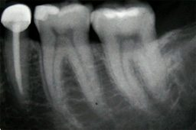
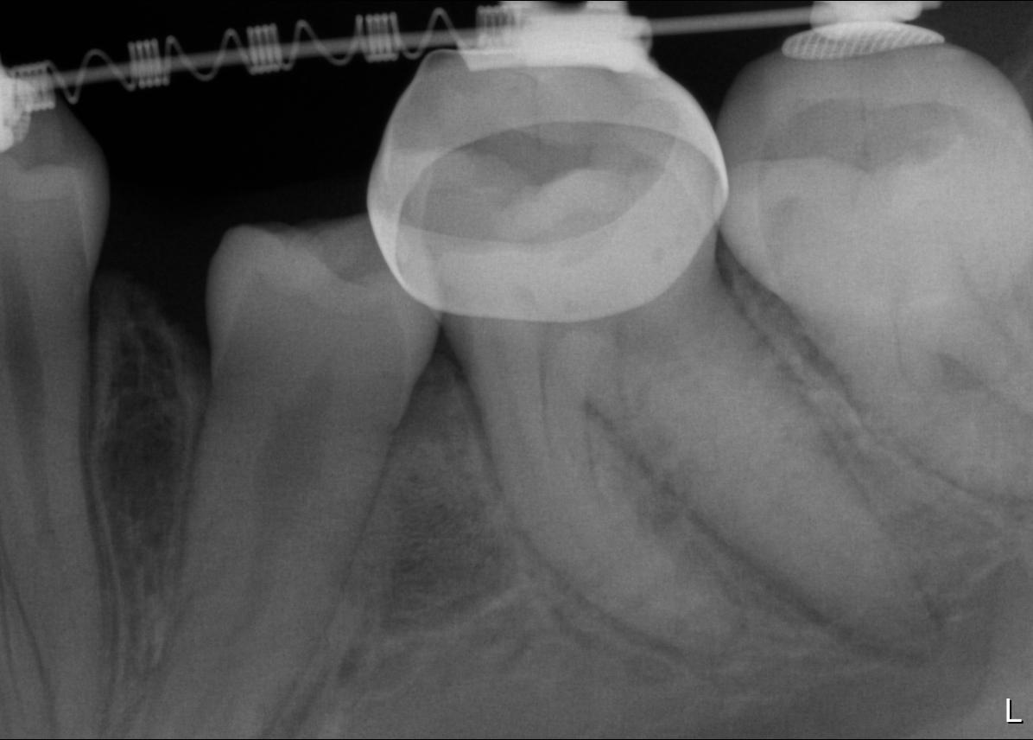
Types of X-rays Intraoral x-rays
Periapical x-rays:
it is justified in the case of pathological processes on OPT
- formal disorder
- positional disorder
- numerical disorder
- eruption disorder
it can be used to determine the axis position of teeth
examination of caries and related diseases
it can be used to represent the whole tooth or the tip of the tooth and the bone around it

Slide 4
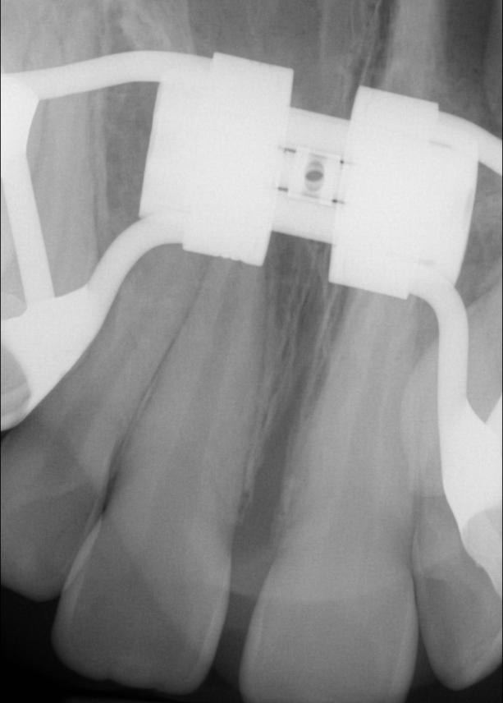
Bitewing x-rays:
the patient bites on the film, the film is in the occlusal plane
size: 7,5 x 5,75 cm → we can depict a larger area
easy to make it → it is worth making the first bite shot in the temporary teeth
it can be defined with:
- presence, location, shape of mesiodens (examination of supernumerary and retinal teeth)
- presence of impacted canine
- presence or absence of incisors
- cleft palate
- bone lesions
- inspection of opening in the palatal suture fracturing
- the retinated tooth located palatally is sharper on the x-ray than the other teeth

Slide 5
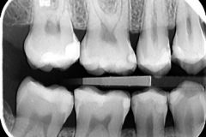
Crown x-rays:
usually in pediatric dentistry to examine approximate caries and their extent
it is advisable to shoot a bitewing film → thus, the crowns of the antagonist teeth are also visible
the x-ray is suitable:
- detect the pulp chamber shape
- determine the depth and extent of caries
- detect the absence or presence of the permanent premolars
- we can see the space relation after early milk teeth extraction

Slide 6
Extraoral x-rays Panoramic x-rays
1. Panoramix (magnified panoramic shot)
allows you to make separate images of the lower and upper jaws
the source of radiation is intraoral, and the film is placed in a flexible plastic cassette placed on one face
the area of ​​the incisors is clearly perceptible, but the molar areas are not suitable for a more detailed analysis of bone structure
suitable for examination of tooth development, jaw bones
not up-to-date, rarely used

Slide 7
2. Orthopantomographia
the most important records of the orthodontic diagnostics
completely displaced of the panoramix
we can study the upper and lower jaw and the TMJ at the same time
disadvantage: distort in frontal region due to cervical spine projection (projecting the approximate surface of the premolars, setting sensitive)
shooting:
- the x-ray tube runs from the right side of the ramus to the left behind the head in a 260º circle
- the film in the cassette (15x30) moves in the opposite direction to the head
- different details of the film are always exposed

Slide 8
Usability:
symmetry relations
numerical disorders: aplasia, supernumerary tooth
impacted, retained teeth
general dental problems: caries, periodontology
wisdom teeth
tooth erupting
condylar process
sinus maxillary
examination of source of infection
for the evaulation of smaller, mandibular asymmetries

Slide 10
1. maxillary sinus | 12. lateral border of the orbit | 23. condyle | 34. submandibular gland fossa
2. pterygomax. fissure | 13. infraorbital ridge | 24. coronoid process | 35. internal oblique ridge
3. pterygoid plates | 14. infraorbital foramen | 25. sigmoid notch | 36. mental fossa
4. hamulus | 15. infraorbital canal | 26. medial sigmoid depression | 37. mental ridge
5. zygomatic arch | 16. nasal fossa | 27. styloid process | 38. genial tubercles
6. articular eminence | 17. nasal septum | 28. cervical vertebrae | 39. hyoid bones
7. zygomaticotemp. suture | 18. anterior nasal spine | 29. external oblique ridge | 40. tongue
8. zygomatic process | 19. inferior concha | 30. mandibular canal | 41. soft palate
9. external audit. meatus | 20. incisive foramen | 31. mandibular foramen | 42. uvula
10. mastoid process | 21. hard palate | 32. lingula | 43. posterior pharyngeal wall
11. middle cranial fossa | 22. maxillary tuberosity | 33. mental foramen

Slide 11
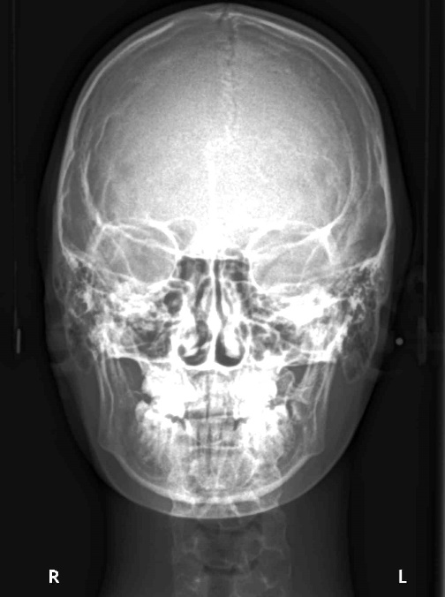
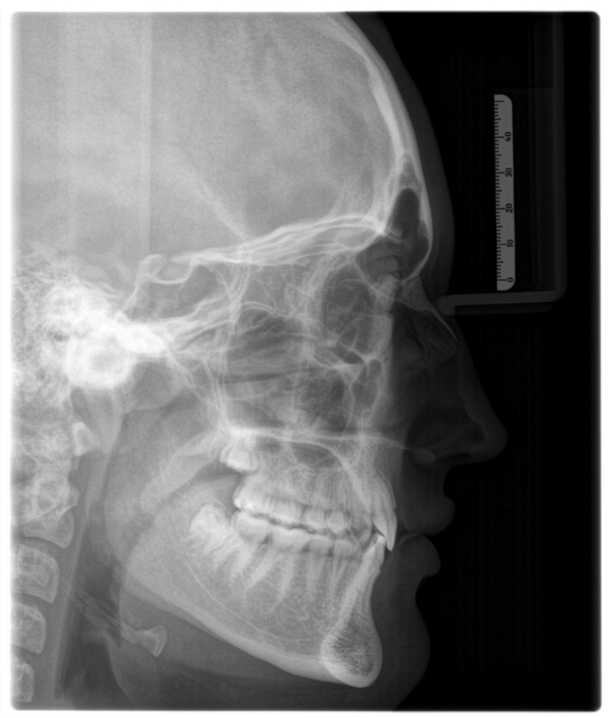
Cephalometric X-rays:
lateral
postero-anterior

Slide 12
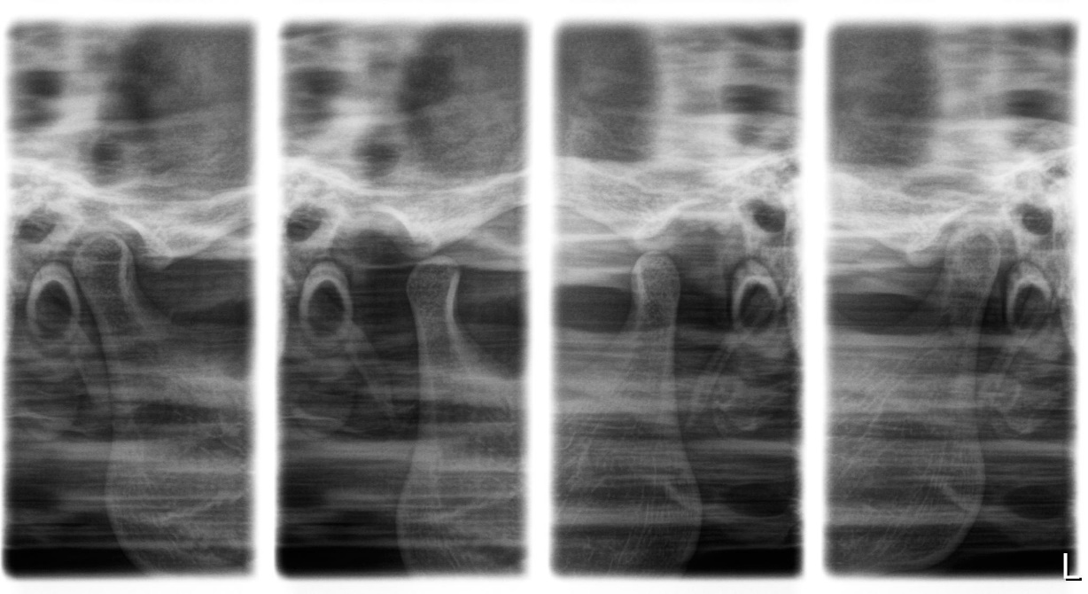
TMJ:
OPT also allows special settings → you can adjust the device so that the sharp layer falls on the area of ​​the TMJ
we can take pictures with open or closed mouth
this, or OPT are the first choices
Schüller’s admission is also possible

Slide 13
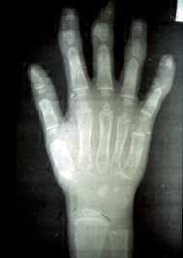
Bone maturity tests:
Wrist and hand bones
X-rays of distal epiphysis of large tubular bones (fibula, tibia)
X-rays of the vertebrae

Slide 14
Cephalometric X-rays
It is made with approximately parallel rays from a relatively distant source.
We get a true-to-life (dimensionally correct) image without rejection.
The position-shape differences of the maxilla and mandible, as well as of the dental arches relative to each other and the skull can be examined on the images taken in this way.

Slide 15
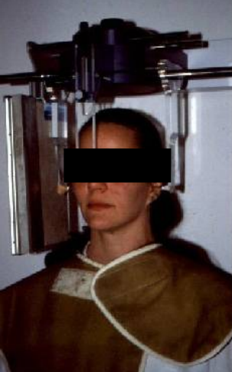
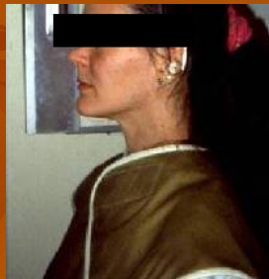
Rules of taking lateral cephalometric x-rays
The distance between the head’s median-sagittal plane and the focus of the x-ray is 1,5 m.
The main beam is perpendicular to the head’s median-sagittal plane.
The main beam pass through the two auditory meatus.
The film is paralell to the head’s median-sagittal plane (15-18 cm).
Because of the paralell beams the picture is proportional.
The denture is in central occlusion.

Slide 16
Application of lateral cephalometric X-ray
Diagnosis and treatment plan, prognosis
For examining the growth and development of the skull (series)
For the evaluation of treated disease
To assess changes in treatment
Monitoring stability after orthognathic surgery
Diagnosis of craniofacial deformities
Assist in the localization of non-erupted teeth
Determination of skeletal age by evaluation of cervical vertebral development
Documentation, education, scientific work

Slide 17
Sagittal and vertical deviations of the jaws and dentition can be studied.
Bones and soft parts appear in the same image separately.

Slide 18
X-ray cephalometric analysis
The first description is given by Holly Broadbent (1925) from special measurements and interpretations of extraoral x-rays in human growth and development research.

Slide 19
Steps to evaluate lateral cephalogram
1. X-ray overview, redrawing important formulas (light source)
2. Mark measuring points:
bony, dentoalveolar and soft tissue areas
cranial, maxillary and mandibular points
anatomical and edited points
3. Drawing lines

Slide 20
4. Perform measurements:
angle and distance measurements
skeletal measurements: determines the position and extent of jaws relative to each other and to the base of the skull
dental measurements: determination of the position of the teeth relative to each other and to the jaw or skull structures
soft tissue part’s measurements: full profile and a description of the position of the lips in relation to the tip of the nose and to the jaw

Slide 21
5. Evaluation and analysis of received data:
Information obtained from lateral cephalometric analysis:
- vertical and sagittal configuration of the cranium
- relation of the jaws bases
- relation of incisors inclinations
- soft part profile characteristics
- directions of growth
- localization of malocclusion
- treatment options and limitations

Slide 22
There are many methods for cephalometric analysis
They are used to determine the vertical and sagittal configuration of the facial cranium.
Differences: position and number of reference points, normal values ​​used for comparison.
Common analyzes:
Down
Steiner
McNemara
Tweed
Ricketts
Hasund/Bergen

Slide 23
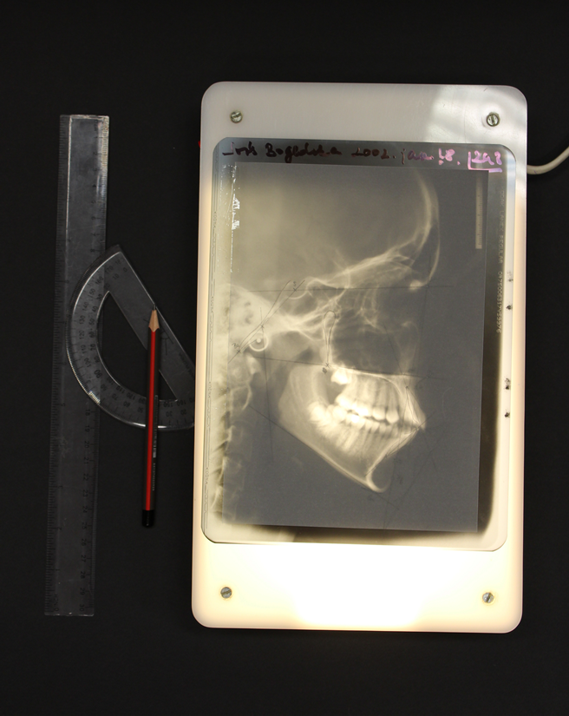
Instruments of X-ray redrawing
Light source (lightbox)
Acetate paper
Tape
Ruler, protractor
Pencil

Slide 24
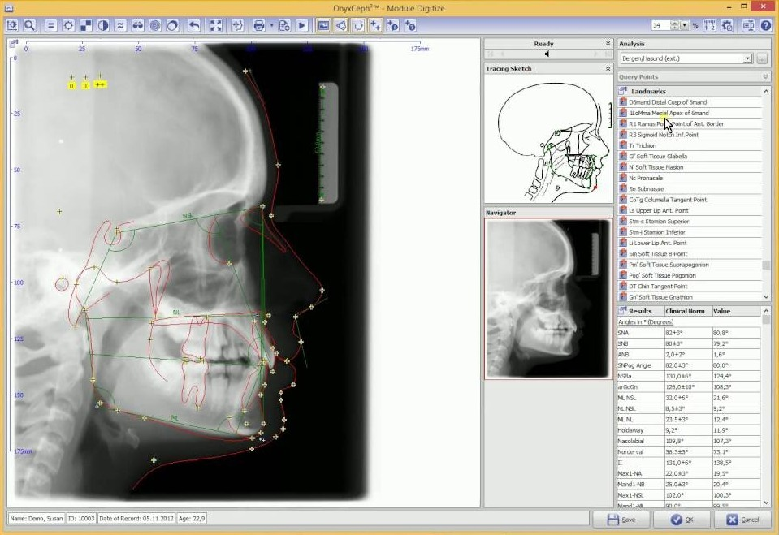
With the spread of digital X-rays, many analytical software has become available (Smile, Onyx Ceph, …)
After defining the reference points, the reference lines are constructed, measurements and comparisons are made.
At the end of the analysis, they show deviations from normal values.
The analysis is also graphically displayed, allowing for comparison and overlapping with later analyzes of new X-rays.

Slide 25
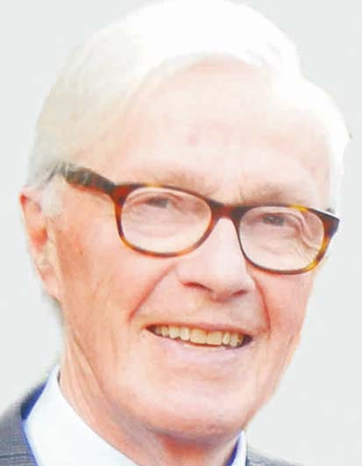
Bergen-analysis
One of the most commonly used forms of evaluation used in Hungary.
Description by Asbjörn Hasund (1974)
Computer adaptation of the method by Dietmar Segner (1989)

Slide 26
Bergen-analysis
General features:
Its simple, unique, advantageous feature is the sliding norm concept.
During the development of the method, 275 untreated, with perfect occlusion, aesthetically acceptable young adult’s cephalograms were examined for facial structure.
Variable correlations were found between 5 skeletal measurements (SNA, NL-NSL, NSBa, ML-NSL, SNB).
The tabulation of these values ​​forms the basis for the sliding norm concept of the Bergen analysis.

Slide 27
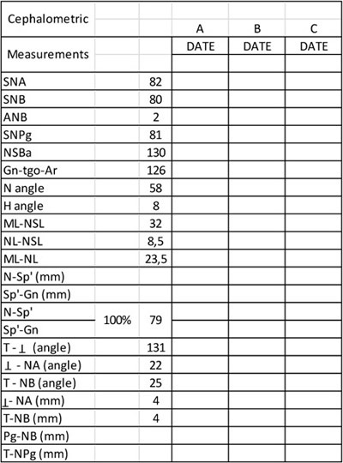
Hasund harmony table (sliding norm)

Slide 28
Hasund calls a balanced face to harmonious look.
The different harmonic faces are called facial types:
- Prognathic
- Orthognathic
- Retrognathic
Each horizontal row in the table contains the basal indicators of a harmonic face type.

Slide 29
A harmony frame has been constructed for Hasund analysis and placed vertically on the patient's sliding table values ​​so that they are within the frame, the face can be considered harmonic.
The horizontal axis of the harmony frame is the harmony line, which represents the patient's face type.

Slide 30
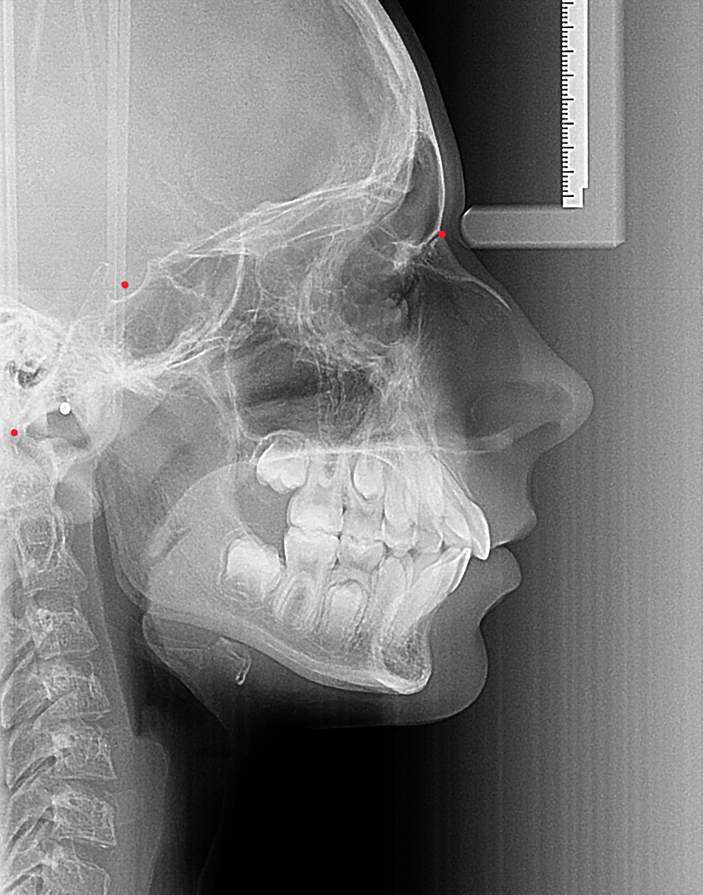
Reference points in the Hasund cephalometrics
S, sella: the midpoint of the sella turcica. It is constructed point at the midpoint of the largest diameter.
N, nasion: the most anterior point of the nasofrontal suture in the mid-sagittal plane.
Ba, basion: the most inferior and posterior point on the clivus, one of the least visible points due to superimposition of the cranial base.
Nasion
Sella
Basion

Slide 31
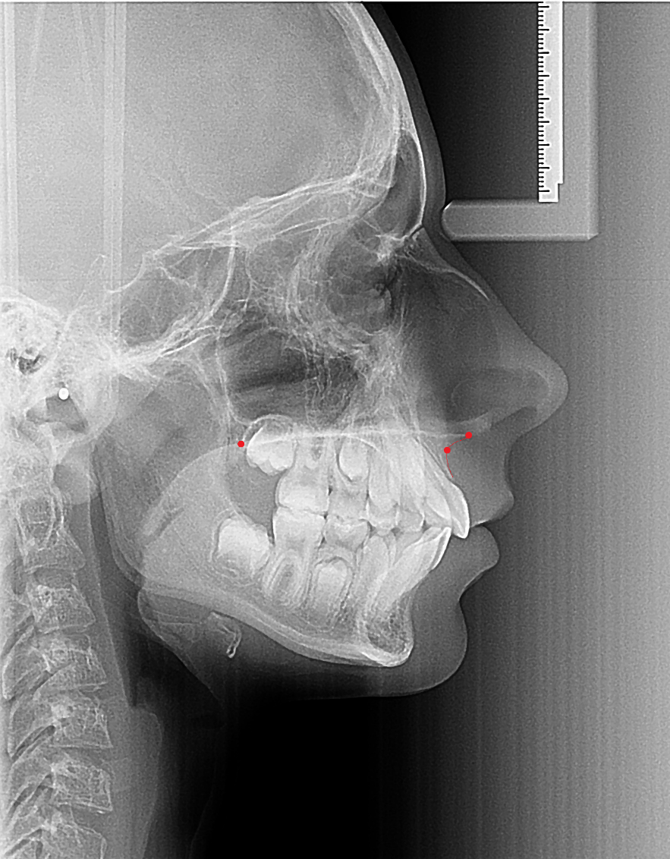
Sp, anterior nasal spine: the most anterior point of the maxilla in mid-sagittal plane.
Pm, pterygomaxillary: point of intersection between the tuber maxillae and the palate. The distal part of the palate is sometimes covered by erupting teeth making it harder to visualize.
A, point A: the deepest point of the anterior curvature between the anterior nasal spine and the edge of the alveolar process.
Pterygomaxillary
Anterior nasal spine
Point A

Slide 32
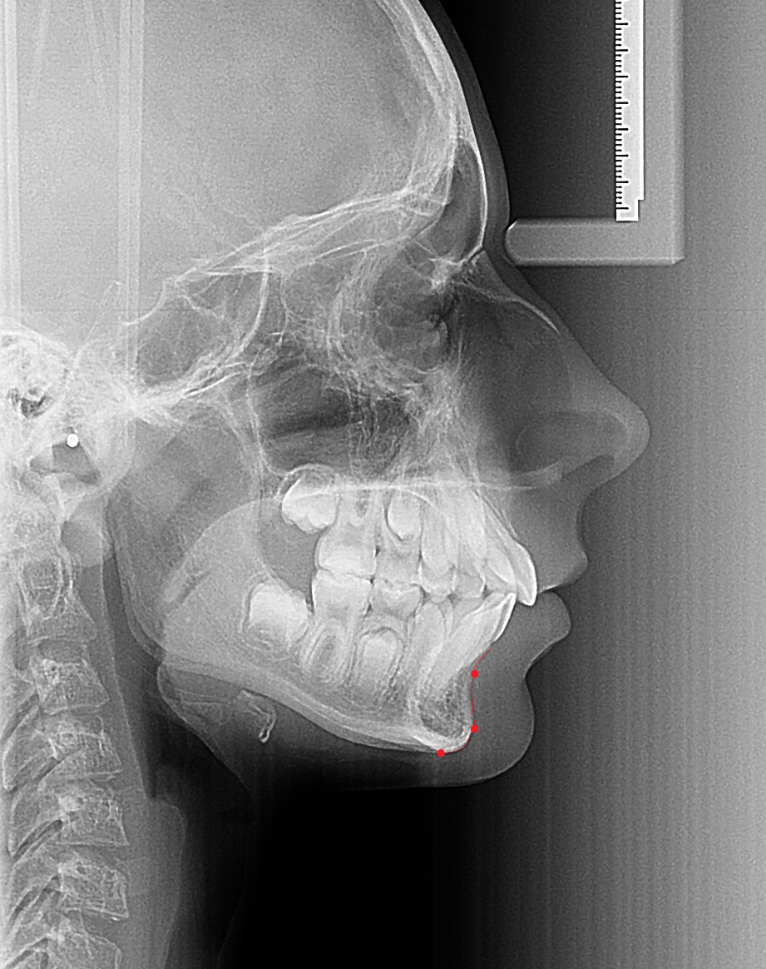
B, point B: it can be determined as the deepest point on the anterior curvature of the mandible between the alveolar process and the Pogonion point.
Pg, pogonion: most anterior point of the chin in the midsagittal plane.
Gn, gnathion: also called Menton (Me) is the inferior point of the symphysis.
Point B
Pogonion
Gnathion

Slide 33
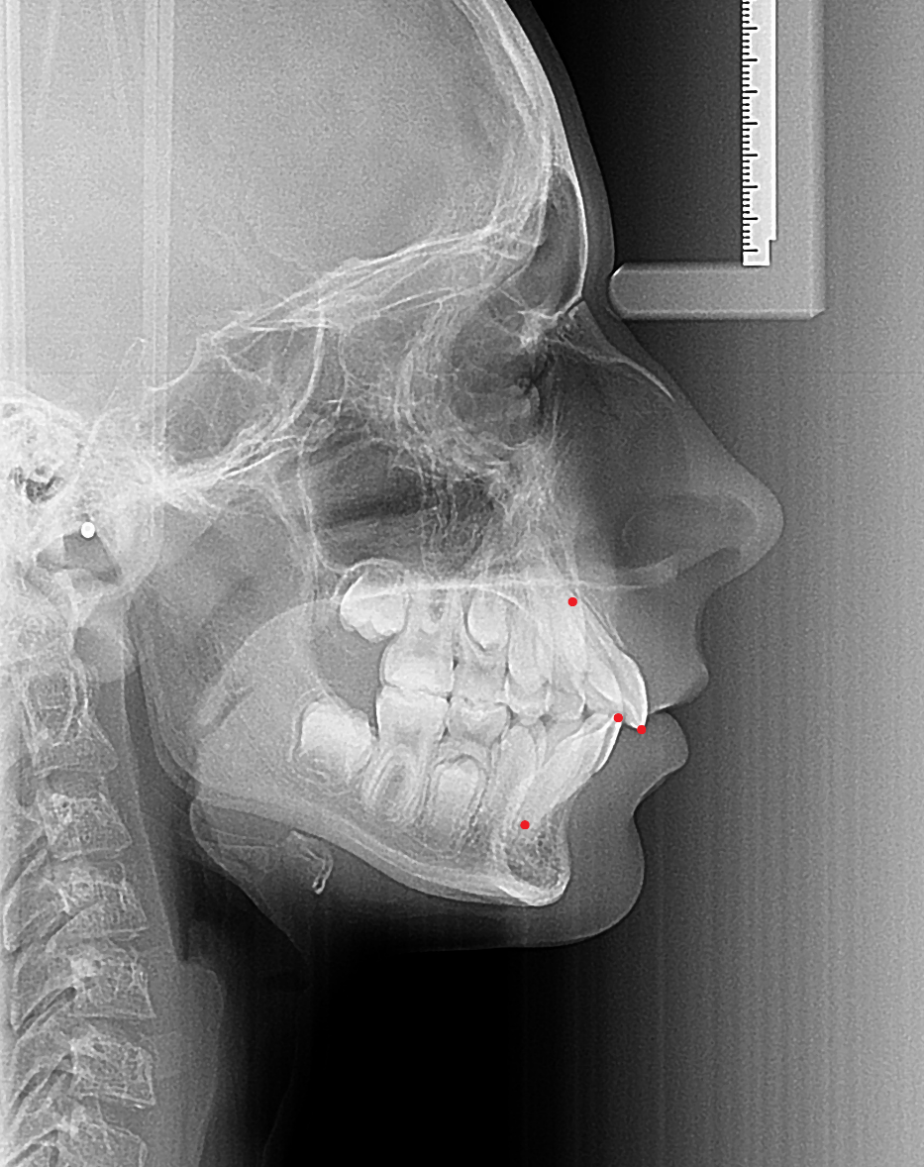
iss, incisal point of the maxillary central incisor: incisal point of the most forward positioned maxillary central incisor.
isa, apical point of the maxillary incisor: apical point on the root of the maxillary central incisor.
iis, incisal point of the mandibular incisor: incisal point of the most forwarded positioned lower central incisor.
iia, apical point of the mandibular incisor: most apical point of the lower central incisor.
isa
iss
iis
iia

Slide 34
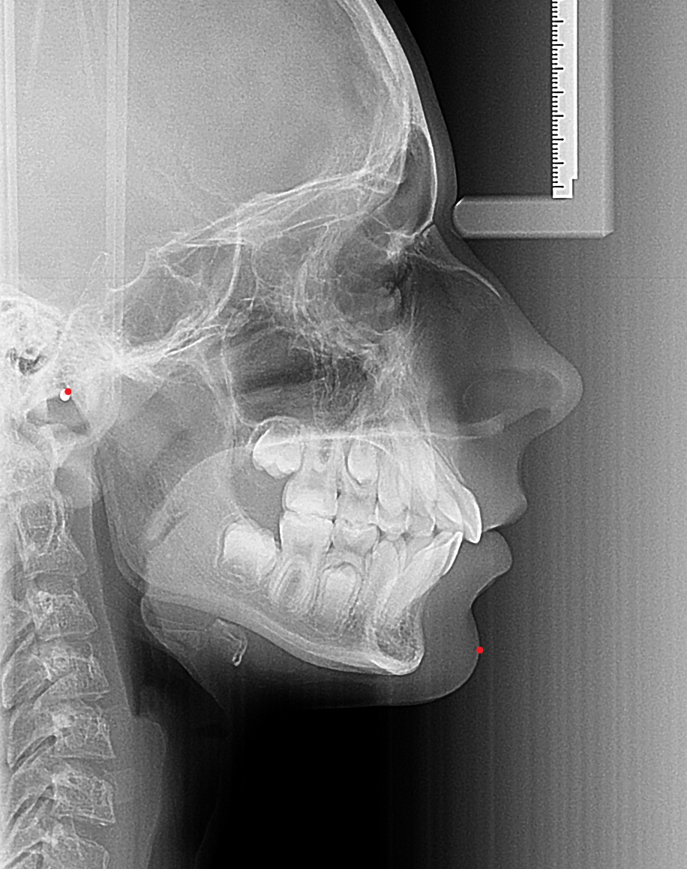
Ar, articulare: point of intersection between the posterior condyle and the lower border of the clivus. It is a constructed point, it has no anatomical analogue. In case a double contour it should be determined at the midpoint.
Pg’, pogonion prime: the most anterior point on the soft tissue chin.
Articulare
Pogonion prime

Slide 35
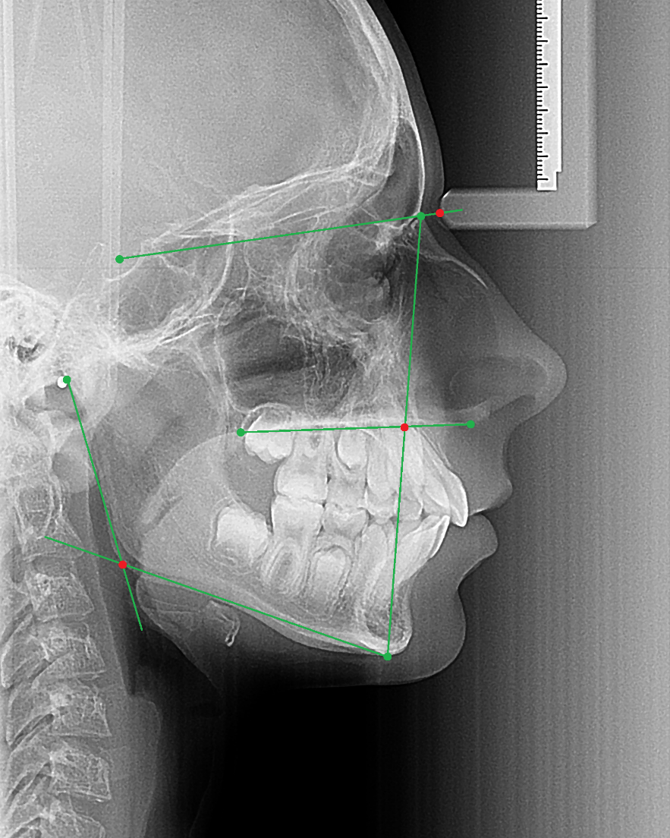
N’, N prime: point on soft tissue over nasion.
Sp’, spina prime: constructed point, the intersection between nasion-gnathion and nasal line (Sp-Pm).
tgo, gonion tangent point: constructed point, the intersection between the tangent from Ar and Gn to the posterior and lower border of the mandibular angle.
N prime
spina prime
tangens gonion

Slide 36
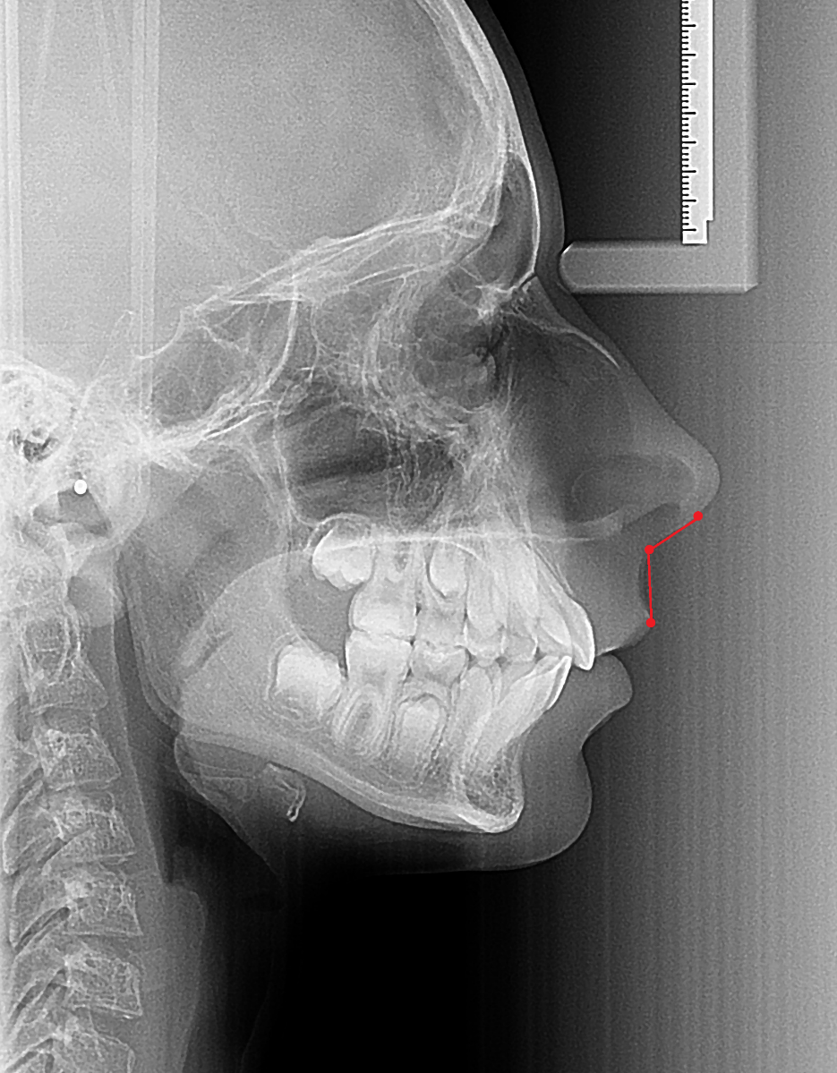
ctg, columella-tangent: the nose contour usually has a straight line below. The ctg-point is where this line bends upward into the convex section of the nasal contour.
Sn, subnasale: in the midline, the junction where base of the columella of the nose meets the upper lip.
UL, upper lip point: foremost point on the upper lip vermilion border.
columella érintő
subnasale
Upper lip point

Slide 37
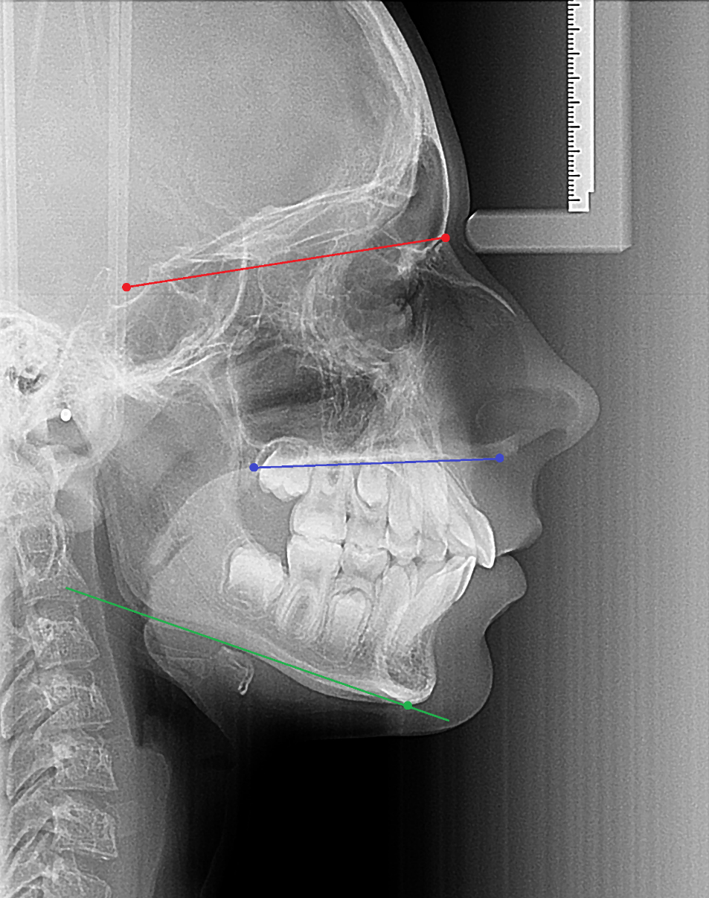
Reference lines in the Hasund cephalometrics
NSL, nasion-sella line: the main reference line. It’s the connection between Nasion and Sella points. This is the cranial base to which we relate the rest of the facial skeleton.
NL, nasal line: the connection between Pterygomaxillare and Anterior nasal spine points. It indicates the base of the maxilla.
ML, mandibular line: the tangent from Gnathion to the lower border of the mandibular angle and this is used as the reference line for the mandible.
NSL
NL
ML

Slide 38
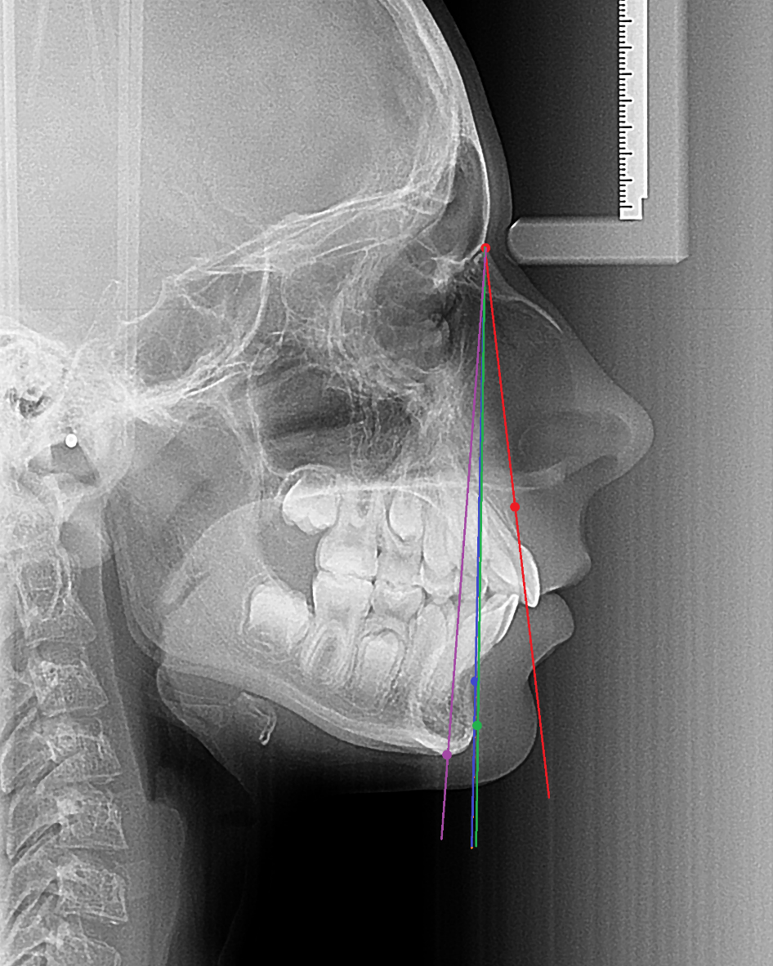
NAL, NA line: line between the Nasion and A point for position of maxilla and maxillary incisor.
NBL, NB line: connection between Nasion and B point used for evaluation of mandibular and mandibular incisor position and also the chin proeminence.
NPgL, NPg line: connection between Nasion and Pogonion point.
NGnL, NGn line: line between the Nasion and Gnathion point.
NAL
NGnL
NPgL
NBL

Slide 39
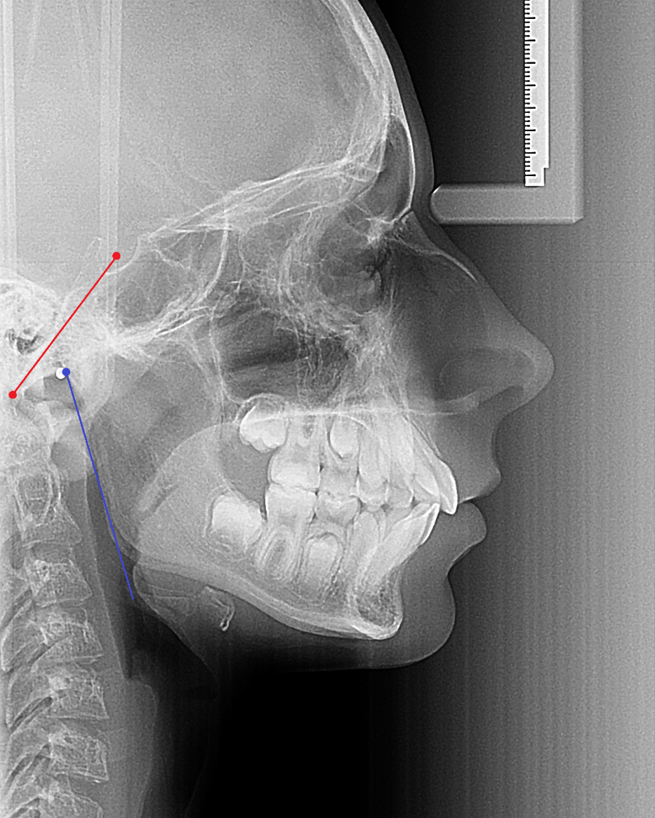
SBaL, SBa-line (clivus-line): the line connecting the sella point and the basion point. Measurement line of the posterior cranial base.
ArtgoL, ramus line: line passing through the articular and tangential to the posterior contour of the mandible.
SBaL
ArtgoL

Slide 40
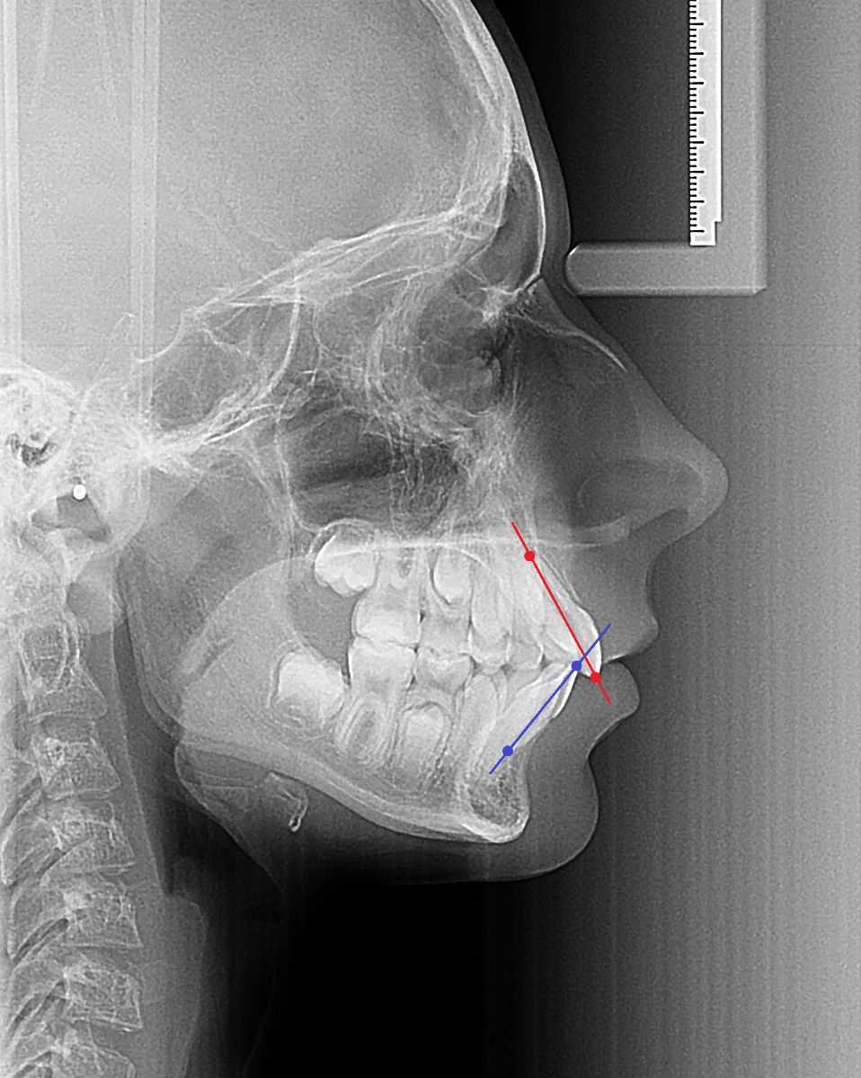
1 upper incisor-axis: the line passing through the iss and isa points.
$\overline{1}$ lower incisor-axis: the line passing through the iis and iia points.
upper incisor axis
lower incisor axis

Slide 41
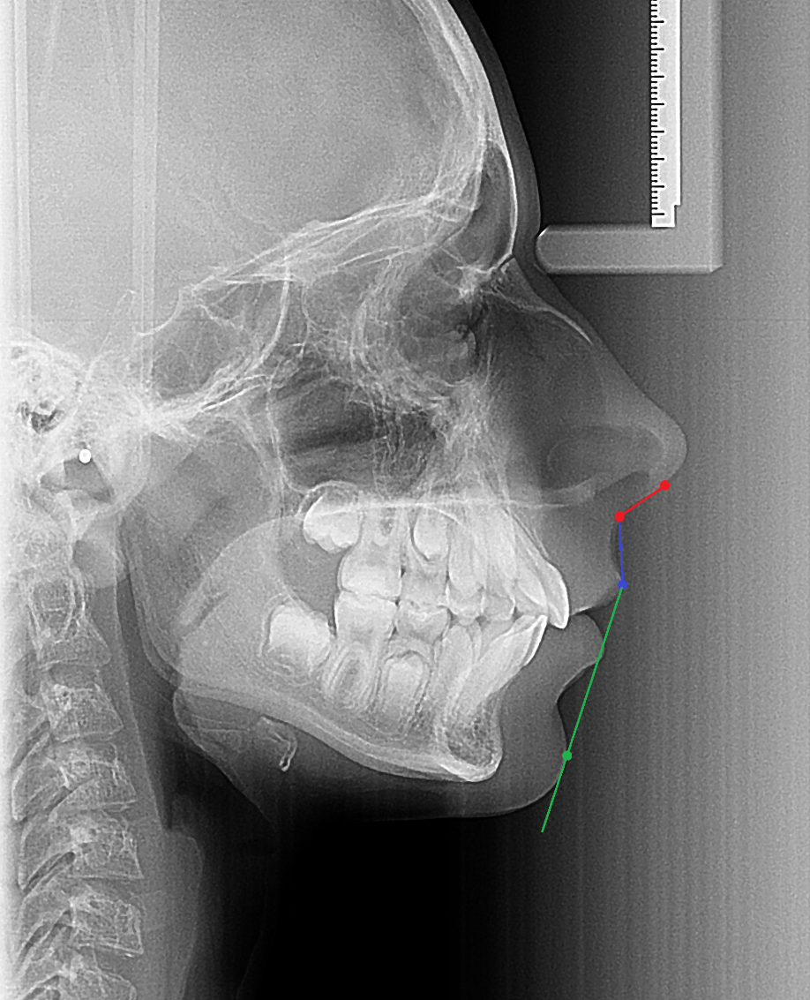
ctgL, columella tangent: line connecting subnasal to columella.
ULL, upper lip line: line connecting subnasal and upper lip point.
HL, H-line (Holdaway-hamony line): connecting line soft tissue pogonion and upper lip point.
ctgL
ULL
HL

Slide 42
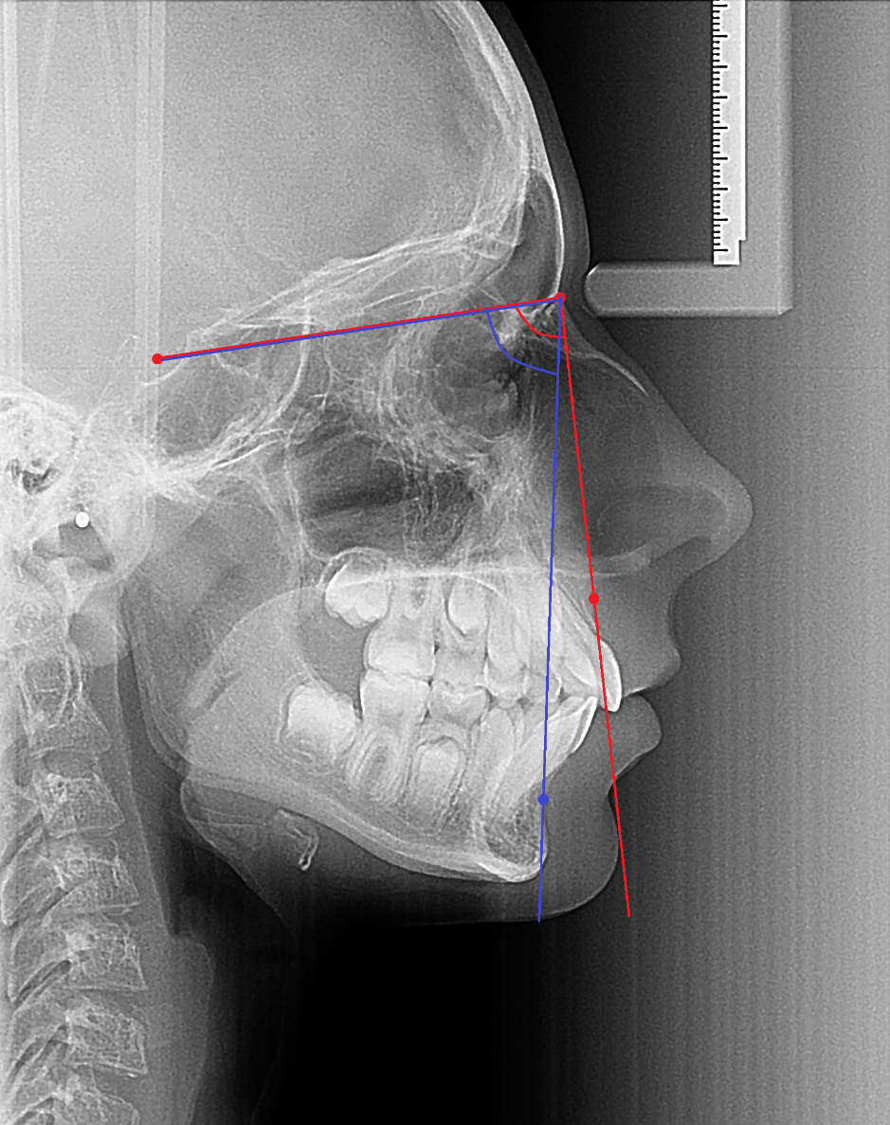
Angular and linear measurements in the Hasund cephalometrics
SNA: the angle formed between NSL and NAL. This gives us the anteroposterior position of the maxilla through the point A in reference to the cranial base.
SNB: angle between the NSL and NBL. Describes the anteroposterior position of the mandible according to the cranial base.
S
N
SNA
SNB
A
B

Slide 43
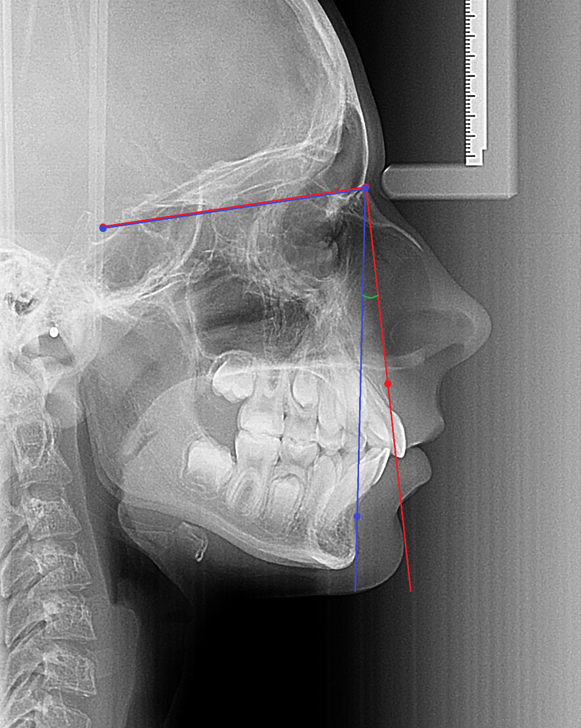
ANB: angle between the upper and lower jaw reflects their sagittal relationship.
N
S
ANB
A
B

Slide 44
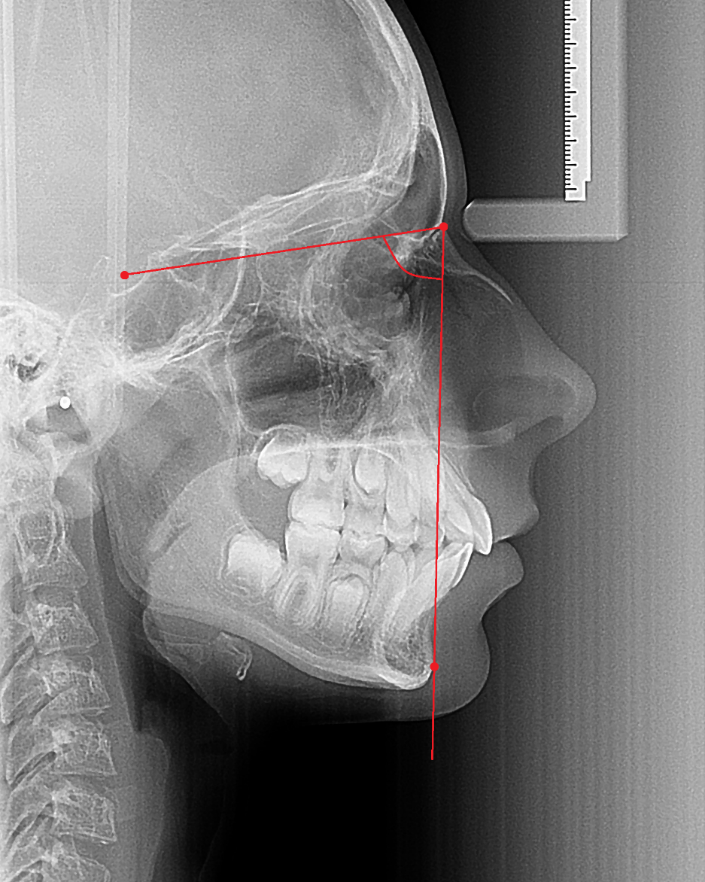
SNPg: angle between NSL and Pogonion which relates the anteroposterior position of the chin and also the mandible according to the cranial base.
S
N
SNPg
Pg

Slide 45
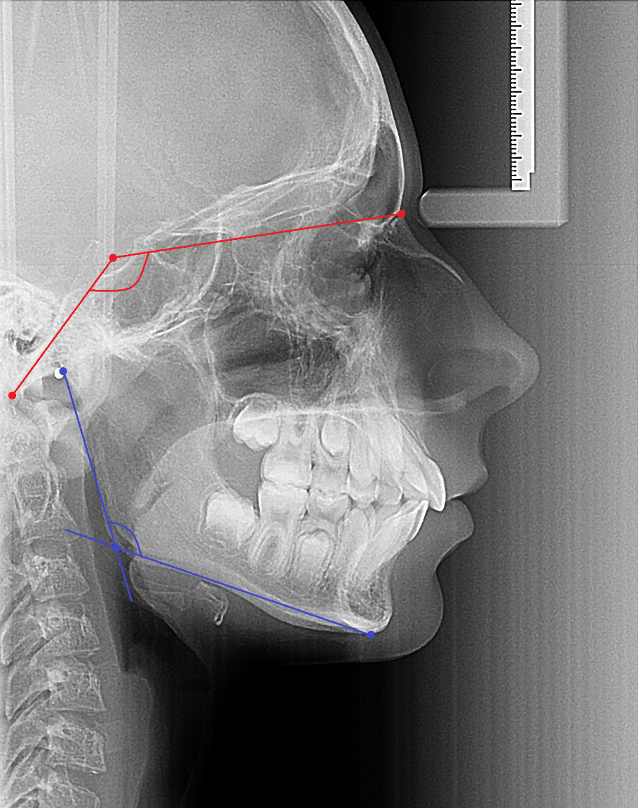
NSBa: also referred to as cranial base angle. Formed between the anterior base of the skull and clivus.
Gn-tgo-Ar: describes the form of the mandibular angle and he relation between the ramus and the body of the mandible.
N
S
NSBa
Ar
Ba
Gn-tgo-Ar
tgo
Gn

Slide 46
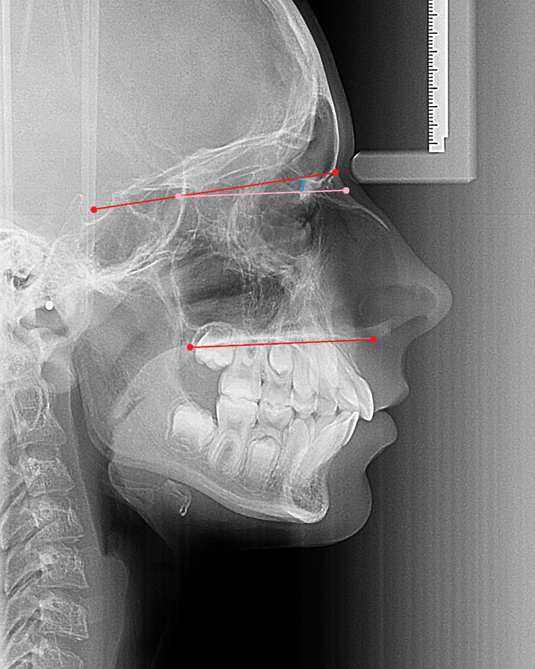
NL-NSL: expresses the inclination of the maxilla according to the cranial base.
NSL
S
NL-NSL
N
NL
Pt
NL
Sp

Slide 47
ML-NSL: it gives the inclination of the base of the mandible to the cranial base.
NSL
S
N
S
N
ML-NSL
ML
ML
Gn

Slide 48
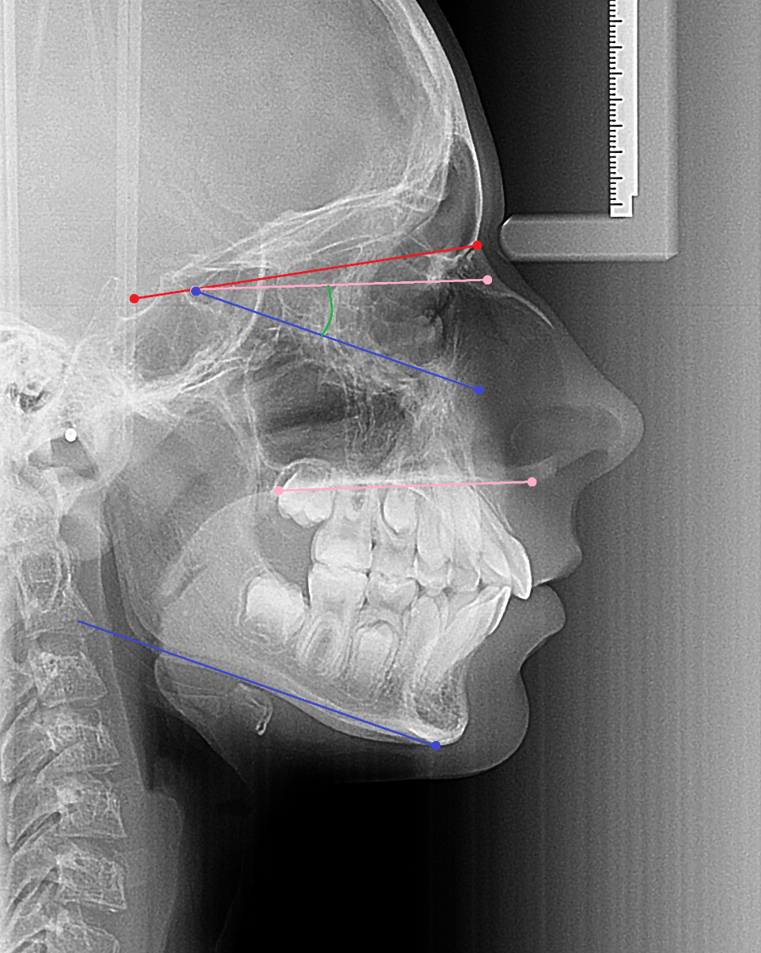
ML-NL: shows the degree of iclination between the maxillary and mandibular base.
NL
ML-NL
ML
NL
ML

Slide 49
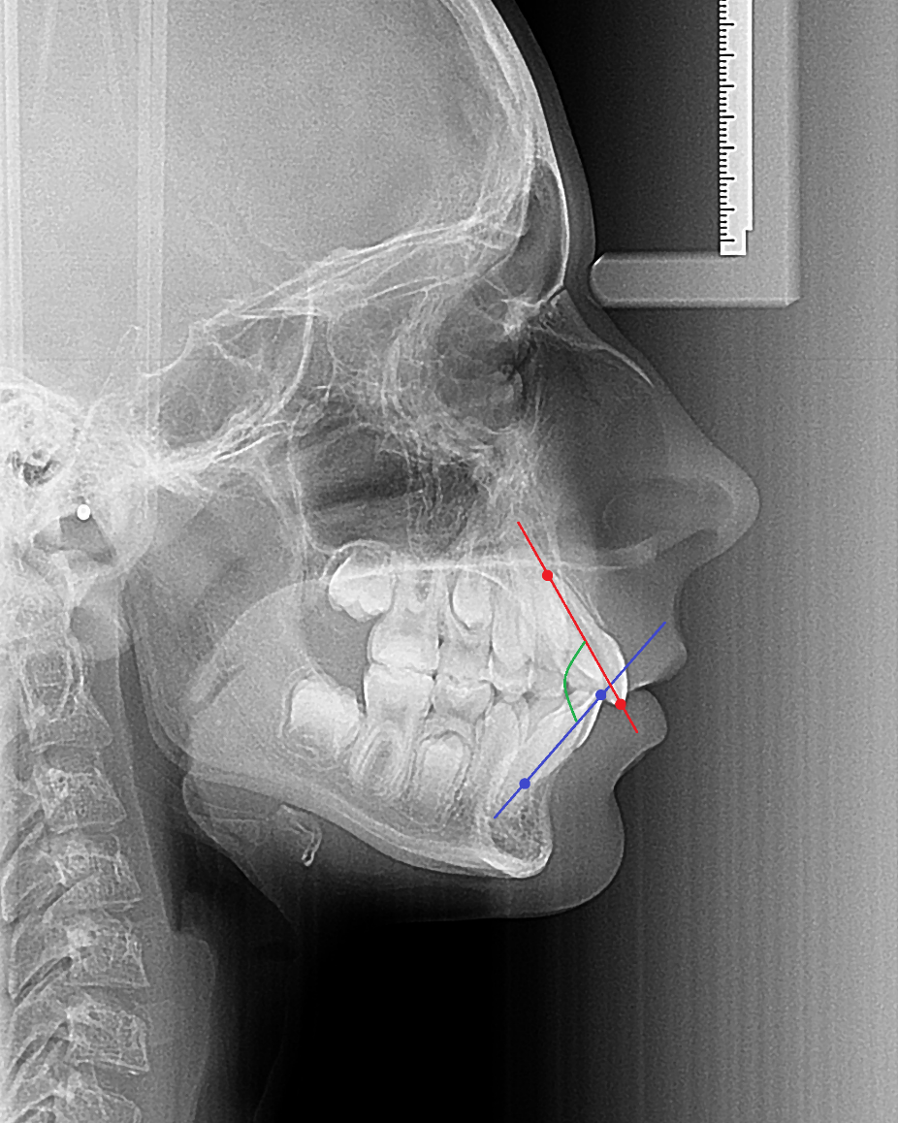
1-$\overline{1}\text{: }\text{Interincisal} \text{angle}\text{: }\text{formed} \text{between} \text{the} \text{upper} \text{and} \text{lower} \text{incisor} \text{axis}\text{, }\text{it} \text{is} \text{used} \text{for} \text{the} \text{evaluation} \text{of} \text{the} \text{two} \text{incisors} \text{in} \text{relation} \text{to} \text{each} \text{other}\text{. }$
Upper incisor axis
Interincisal angle
Lower incisor axis

Slide 50
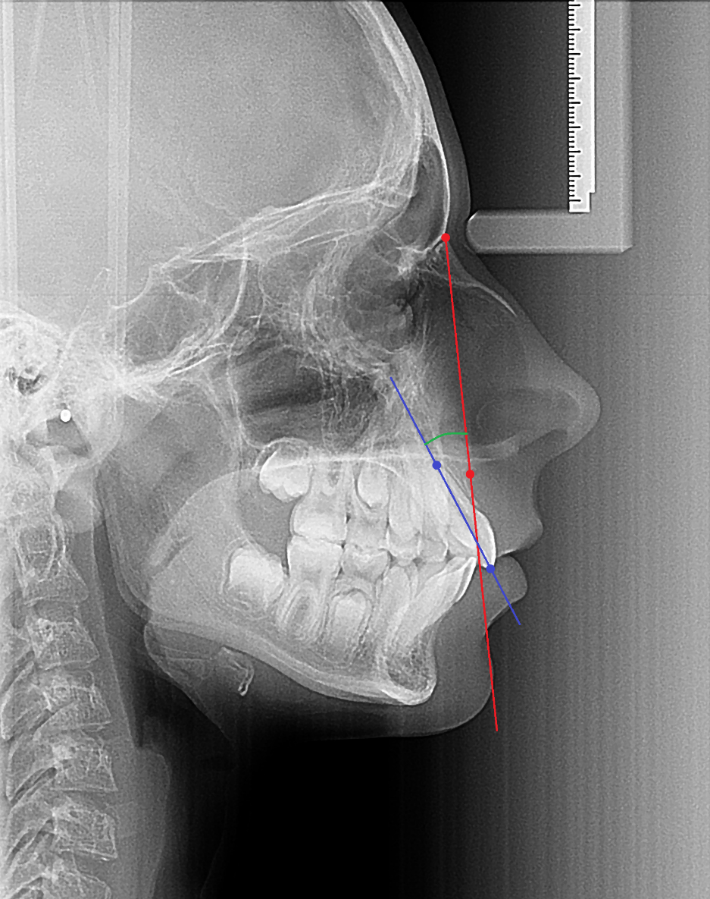
1-NA angle: the angle is formed between the upper incisor axis – between iss and isa – and the NAL.
1-NA
NAL
Upper incisor axis

Slide 51
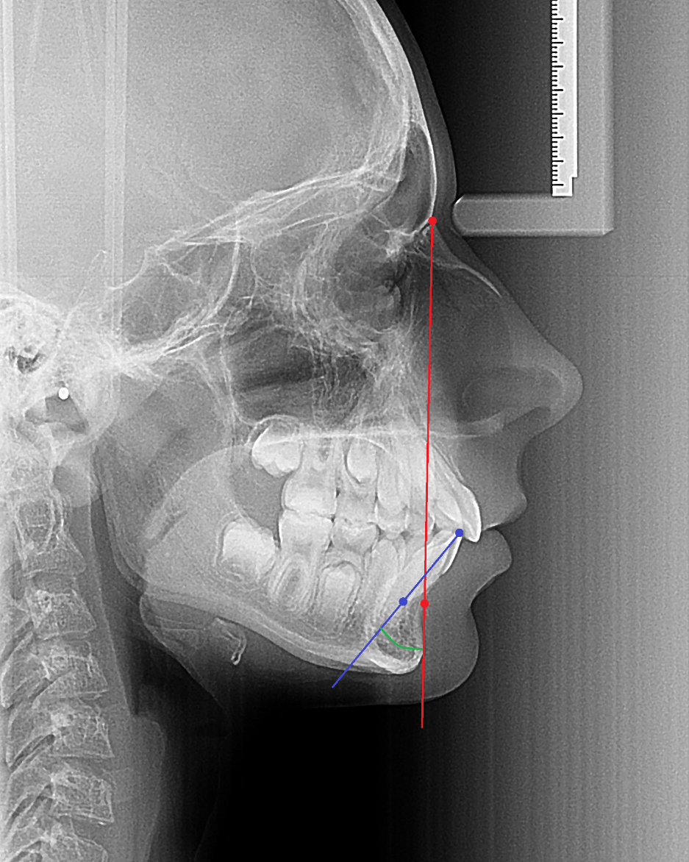
$\overline{1}$-NB angle: the angle is between the lower incisor axis – draw between iis and iia – and the distance from the iis to NBL is mm-s.
NBL
Lower incisor axis
$\overline{1}$-NB

Slide 52
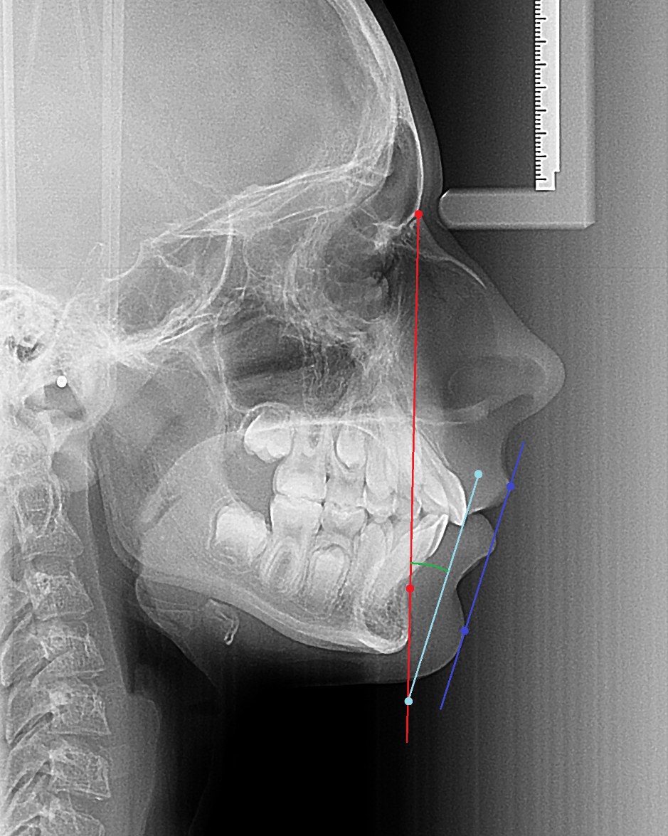
H angle: formed between the HL and NBL. It relates the soft and hard tissue profile to each other.
NBL
H
HL
HL

Slide 53
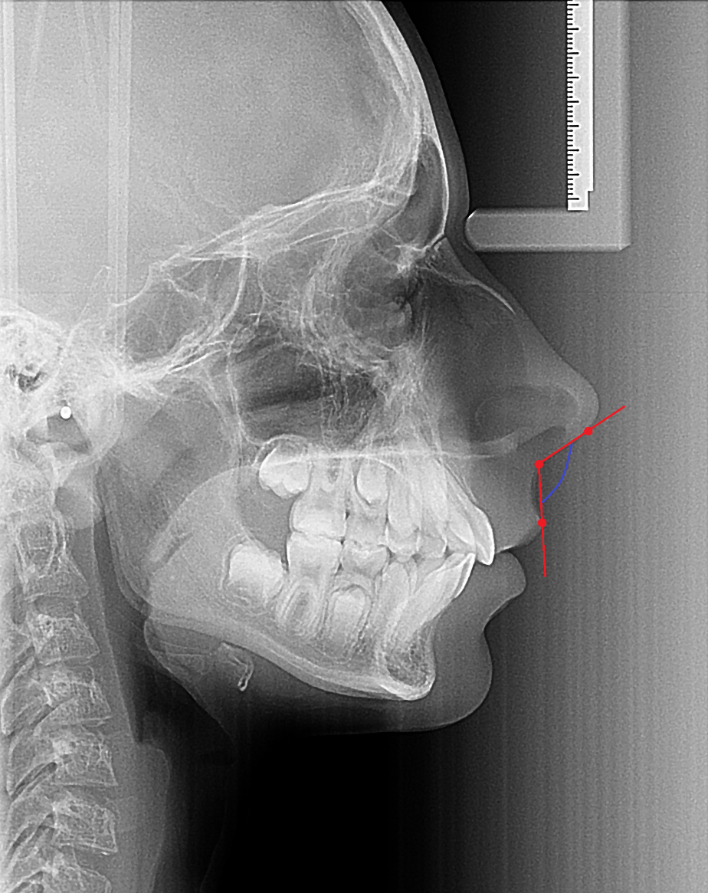
NL-angle (nasolabial angle): angle between columella line and upper lip line.
ctg
Sn
NL
ULL

Slide 54
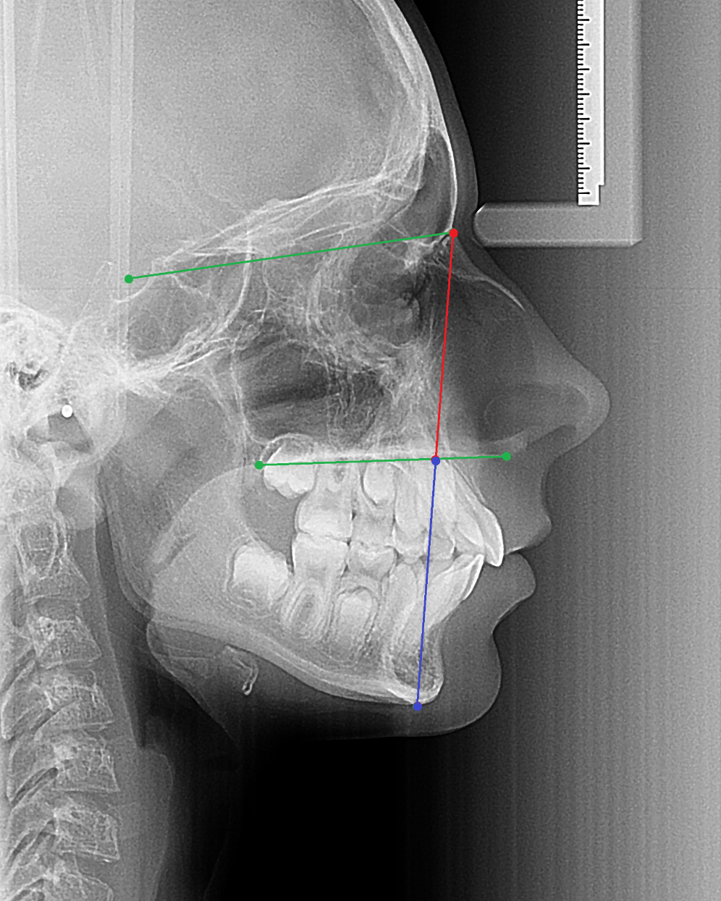
N-SP’ mm: upper front face height
Sp’-Gn mm: lower front face height
$\frac{N−Sp′}{Sp^{′}−Gn}$ x 100 : face height index
N
N-SP’
Sp’
Sp’-Gn
Gn

Slide 55
Index: it is a vertical indices relating the upper and lower facial heights. For this we draw a line between points N and Gn. Where this line intersects th NL is considered Sp’ point. This point divides the N-Gn line into two segments. The index is calculated by dividing N-Sp’ distance with Sp’-Gn times 100.

Slide 56
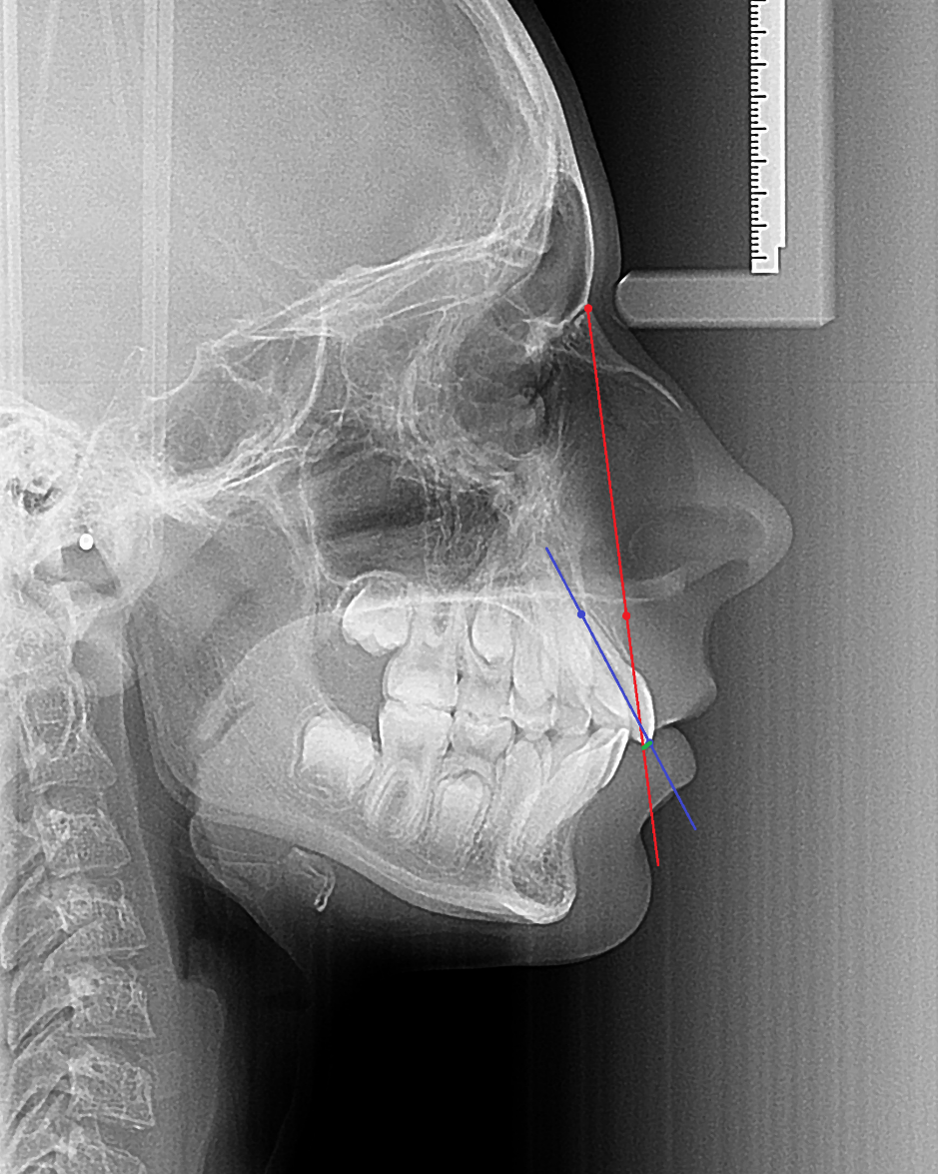
1-NA mm: this is a linear measurement. We draw a perpendicular from the iss point to the NAL and measure the distance in mm-s.
NA
Upper incisor axis
1-NA mm

Slide 57
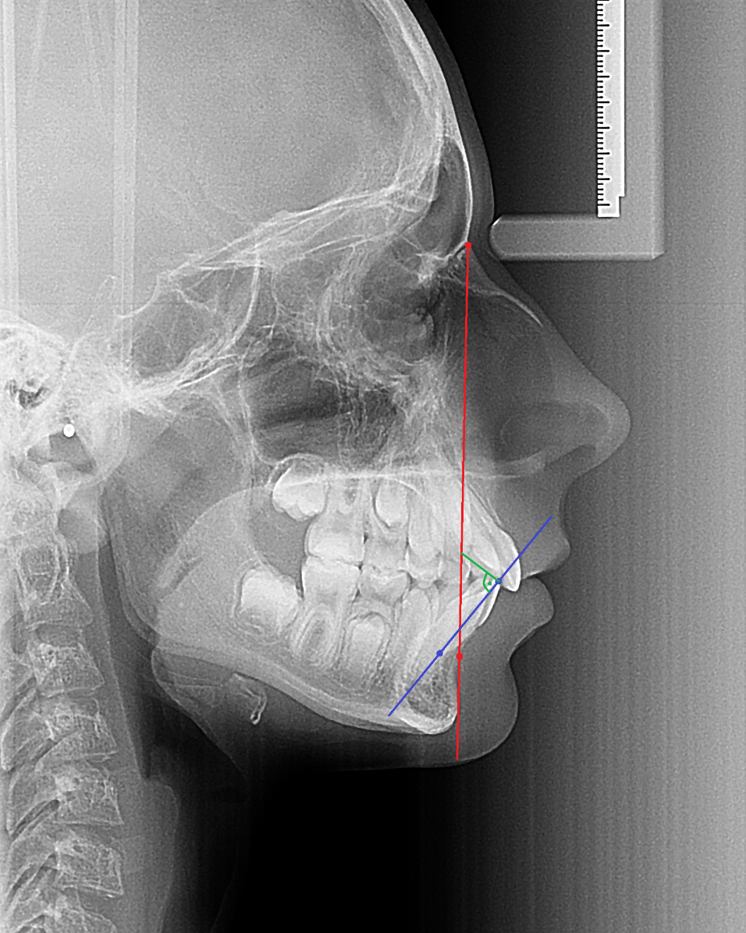
$\overline{1}$-NB mm: this is a linear measurement. We draw a perpendicular from the iis point to the NBL and measure the distance in mm-s.
NB
$\overline{1}$-NB mm
Lower incisor axis

Slide 58
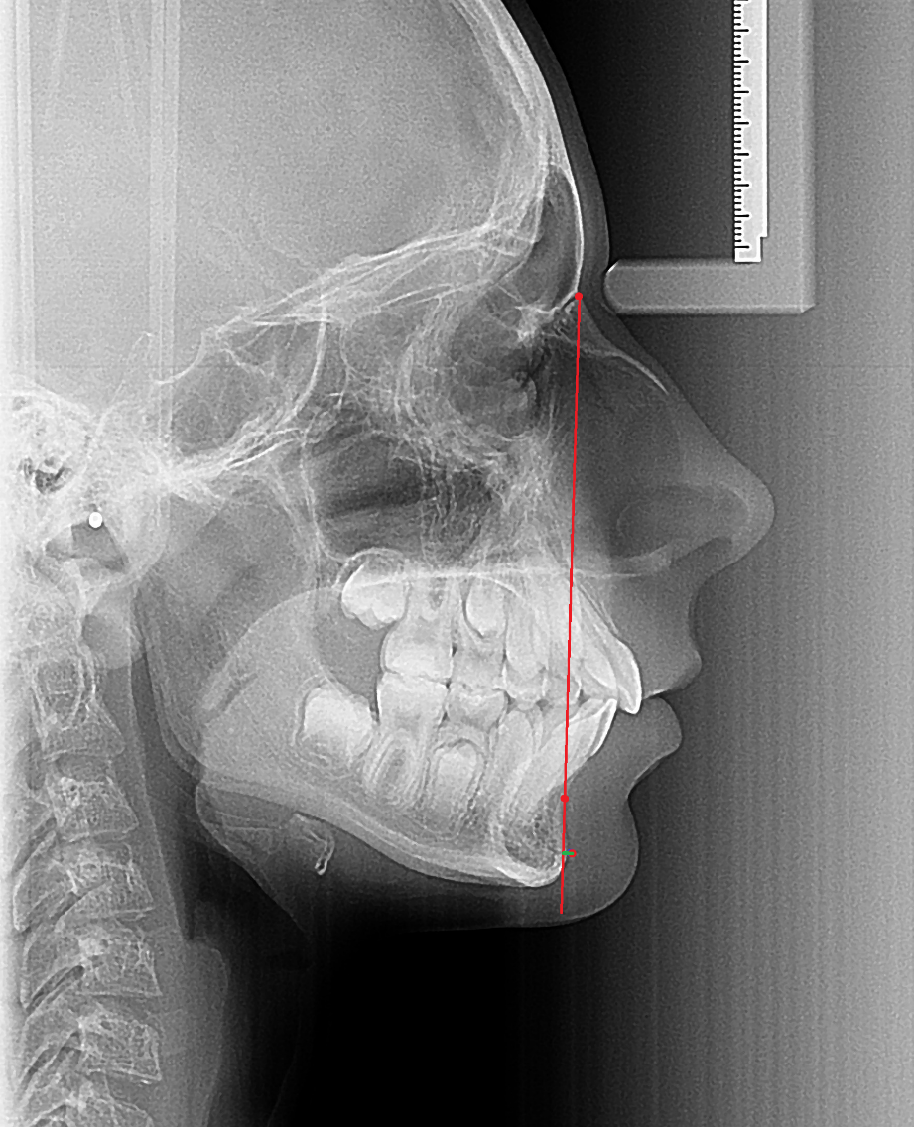
Pg-NB: this is a linear measurement which expresses the chin proeminence in mm-s.
NB
Pg
Pg-NB mm

Slide 59
Steps of the cephalometric analysis
Determination of the face type
The face type is mainly determined by the prognathism of the jaws. Each type can be harmonious if the values are in the box.
Face types:
Orthognathic SNA 78º-86º
SNB 77º-84º
Retrognathic < SNA 68º-86º
SNB 77º-84º
Prognathic > SNA 78º-86º
SNB 77º-84º

Slide 60
2. Sagittal basal relationship
The ANB value according to the face type will give us the sagittal basal relationship, which can be mesial, neutral and distal. The ideal would be a neutral configuration where both SNA and SNB are in the box. If there is a disharmony between the jaws in the sagittal dimension this will be mesial or distal sagittal basal relationship which can be due to a problem in the maxilla or in the mandible or in both jaws. Ideally in an orthognatic face type if SNA is 82º, SNB should be 80º, making ANB 2º.
In orthognathic face type: ANB: 2º
In retrognathic face type: ANB 0º
In prognathic face type: ANB 4º

Slide 61
3. Vertical dimension
Index: the ideal is 80 %
N (neutral vertical relation in the facial skeleton): 71%-89%
T (deep facial structure): > 89%
O (open facial structure): < 70%
4. Relative interbasis angle
It is also dependent on the facial type.
In an orthognathic face type the ML-NL value should be 21+6, this would be considered normo divergent, signed with „2”.
If this is larger – in the same face type - this would indicated hyper divergent jaws, larger lower face high and a possible open bite, signed with „1”.
If the value is smaller, than it is hypo divergent vertical basal relationship, signed with „3”.

Slide 62
5. Determination of dento-basal task
$\overline{1}$-NB and PgNB in mm-s and ANB angle are used to determine it. It shows where we have to position the lower central incisor.
6. Cephalometric analysis of the soft tissues
H angle: mean of harmonic arch: 8º
Nasolabial angle

Slide 63
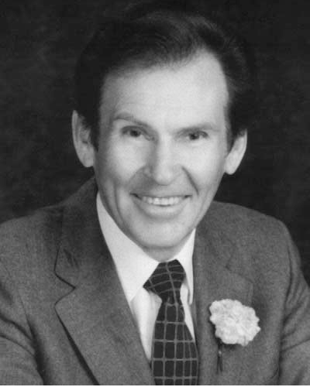
Ricketts-analysis
Robert Ricketts developed his computer analysis method in 1969 to diagnose, monitor patients and determine expected growth and development.

Slide 64
General features:
Using reference points defined by the exit points of some vascular and nerve formulas.
It adapts certain measurments to age.
Use of expected growth forecasting in the treatment planning process.
One of its greatest advantages is the precise positioning of the upper first molars.

Slide 65
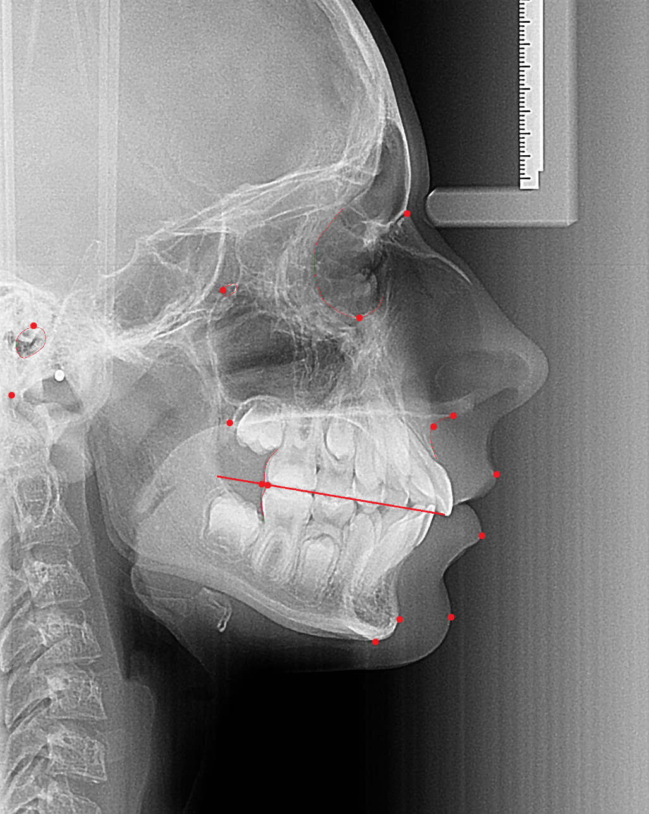
Reference points
Anatomical reference points:
N, nasion
SNA, anterior nasal spine
Pog, pogonion: the most anterior midpoint of the mandible
A point
Me, menton
Ba, basion
Po, porion: the highest point on the upper margin of the external cutaneous auditory meatus
SNP, posterior nasal spine
Pt, pterygoid: intersection of the inferior border of the foramen rotundum with the posterior wall of the pterygomaxillary fissure
Or, orbitale: the lowest point on the lower margin of each orbit
Ls (labiale superior): the most anterior point of the upper lip
Li (labiale inferior): the most anterior point of the lower lip
A6: mapping the distal surface of the upper six to the occlusal plane
B6: mapping the distal surface of the lower six to the occlusal plane
Pog’: soft tissue pogonion
N
Pt
Po
Or
SNP
SNA
Ba
A
A6
Ls
B6
Li
Pog
Pog’
Me

Slide 66
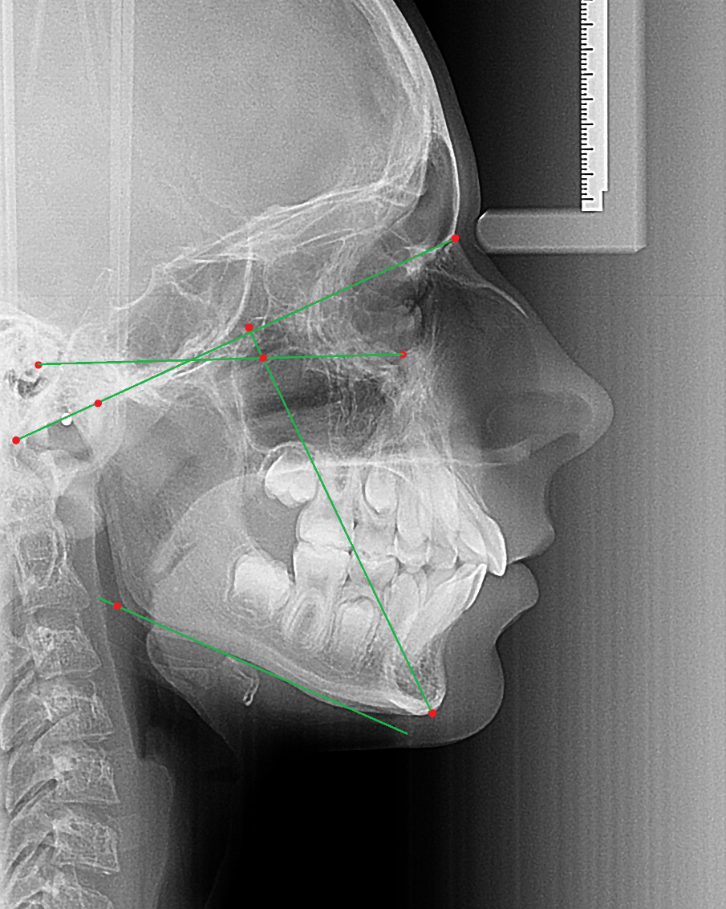
Structured reference points:
Gn, gnathion: the lowest point in the midline on the lower border of the chin
Go, gonion: the most lateral point on the mandibular angle close to the bony gonion
XI pont: geometric center of the ramus mandible
DC pont: marker point on the N-Ba line indicates the center of the mandibular condylaris projection
CC (center of cranium): cephalometric landmark formed by the intersection of the two lines Ba-N and Pt-Gn
CF (center of face): cephalometric landmark formed by the intersection of FH and the perpendicular through Pt point
N
CC
Po
CF
Or
DC
Ba
Go
Gn

Slide 67
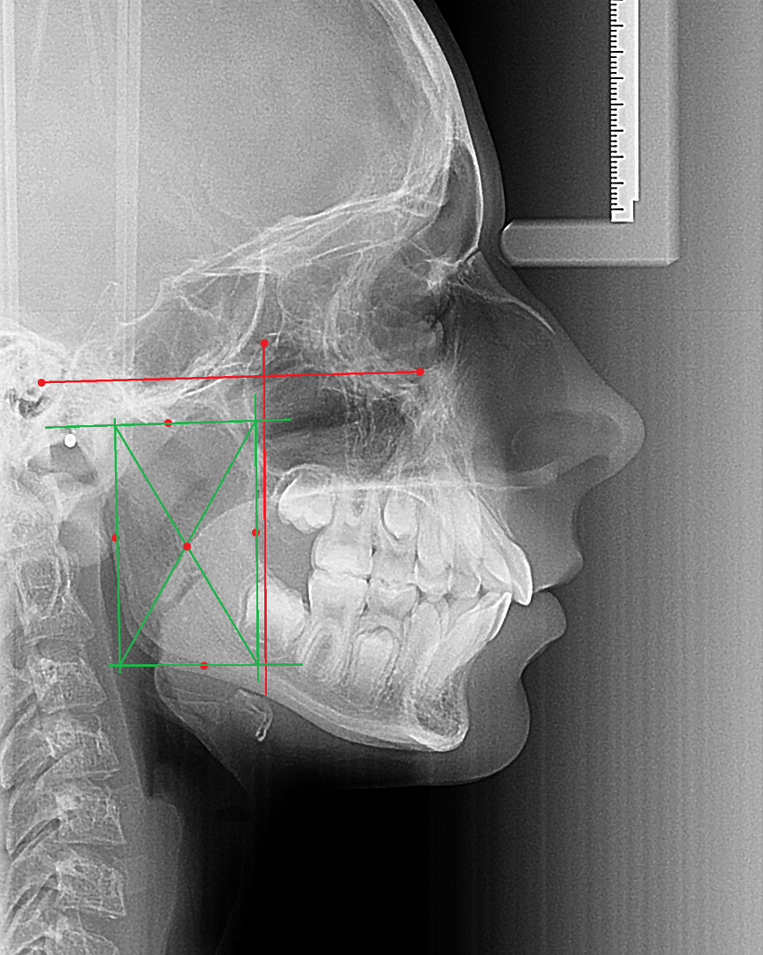
Determination of Xi-point:
Planes perpendicular to FH and PtV are constructed.
The constructed planes are tangent to points R1, R2, R3, R4 on the borders of the ramus.
R1: the deepest point on the curve o the anterior border of the ramus, one half the distance between the inferior and superior curves.
R2: a point located on the posterior border of the ramus of the mandible.
R3: a point located at the center and the most inferior aspect of the sigmoid notch of the ramus of the mandible.
R4: a point on the lower border of the mandible, directly inferior to the center of the sigmoid notch of the ramus.
The constructed planes form a rectangle enclosing the ramus.
Xi is located in the center of the rectangle at the intersection of the diagonals.
FH
R3
XI
R2
R1
PtV
R4

Slide 68
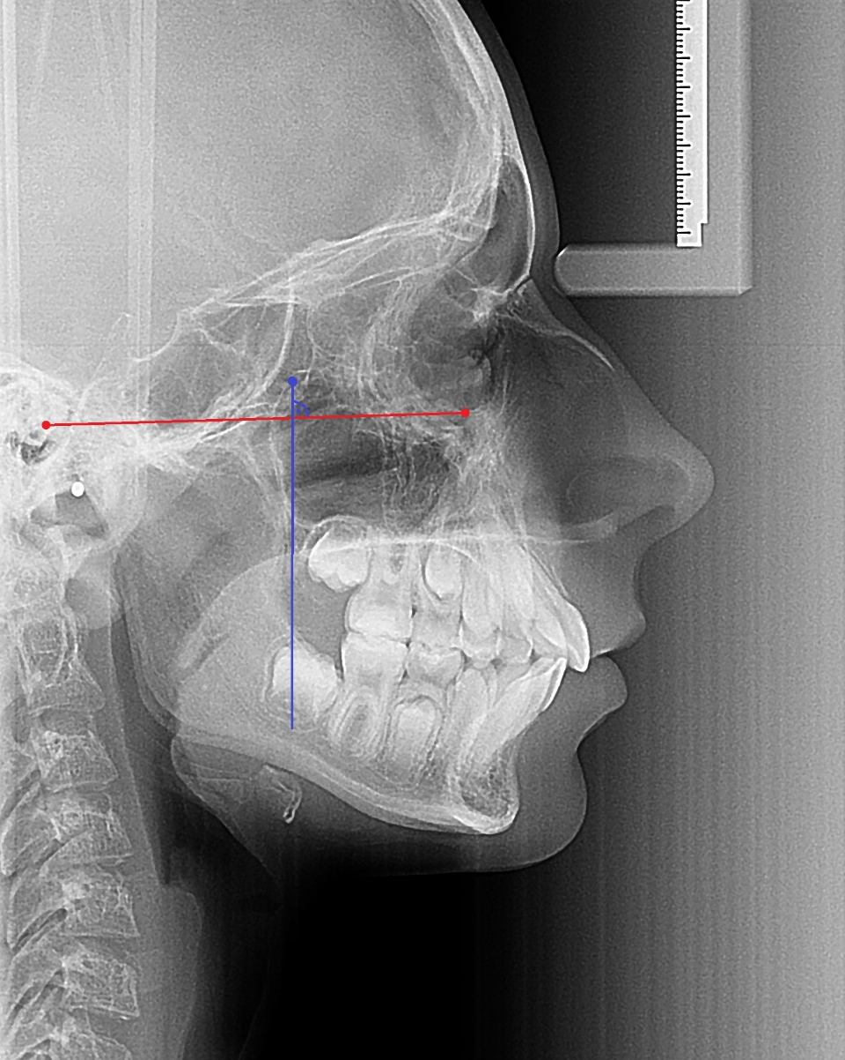
Referenciavonalak
Frankfurt horzintal (FH): a line drawn through Po and Or.
Pterygoid vertical (PtV): a line perpendicular to FH through Pt.
Pt
Po
FH
Or
PtV

Slide 69
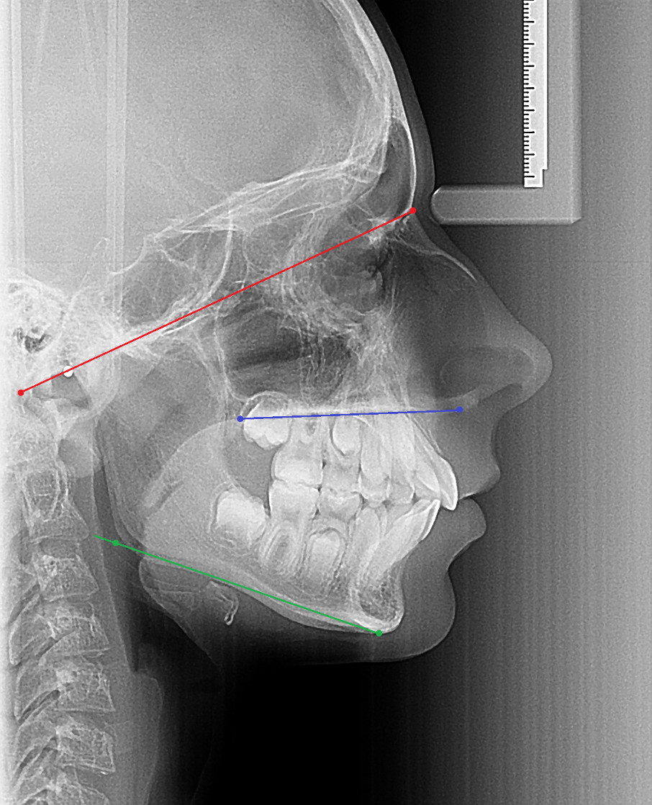
Cranial base plane (Ba-N): constructed by a line drawn from N to Ba. On average 30º to the FH line.
Palatal plane: constructed by a line drawn from ANS to PNS.
Mandibular plane (Go-Me): constructed by a line drawn from Go to Me tangent to the inferior border of the mandible.
Cranial base plane
Palatal plane
Mandibular plane

Slide 70
Facial axis: the angle formed between the Ba-N plane and the plane from foramen rotundum (Pt) to Gn. On average, this angle is 90 degrees.
Facial plane: constructed by a line drawn from N to Pog. This represents the anteroposterior position of the mandible measured relative to FH.
Soft tissue profile (E-line): a line connecting the tip of the nose (Pn) and the most anterior point of the soft tissue chin (Pog’) is defined as the esthetic line.
Facial Plane
Facial axis
E-line

Slide 71
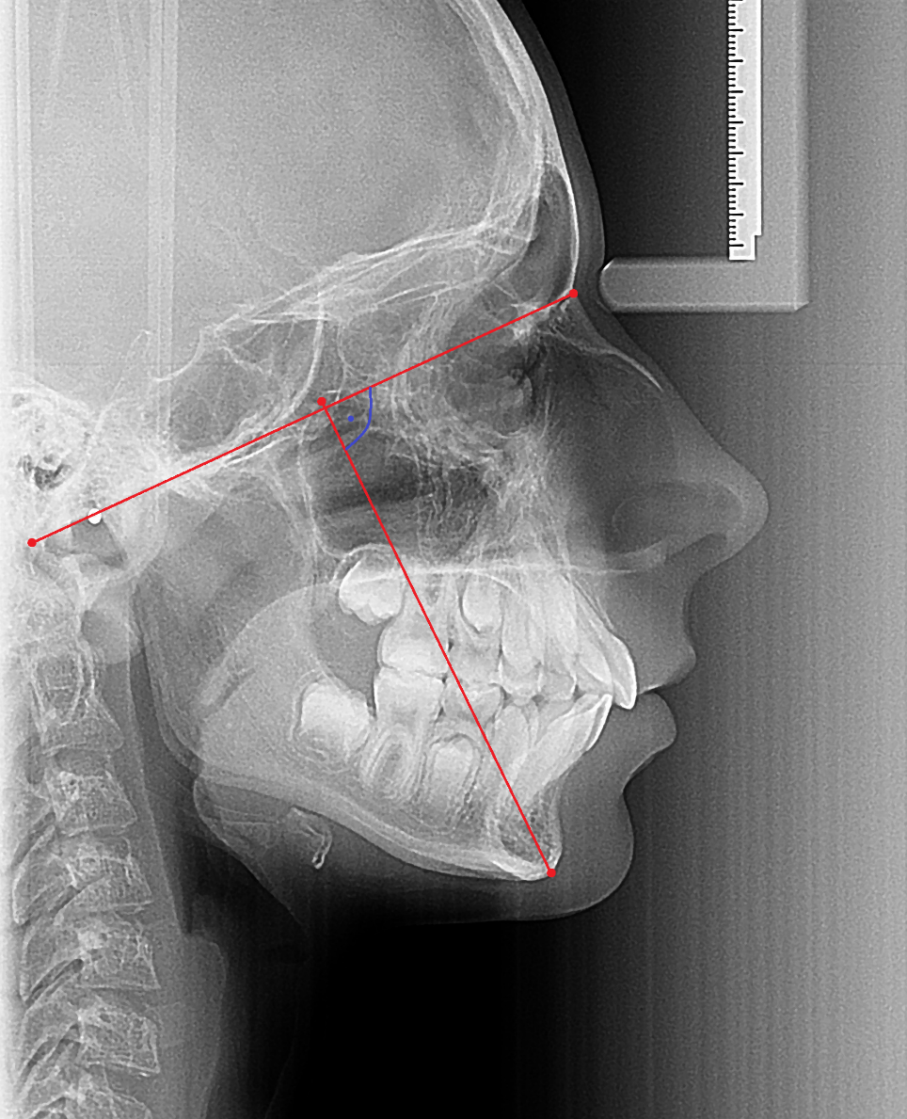
Analysis
Facial axis: the angle formed between the Ba-N plane and the plane from foramen rotundum (Pt) to Gn. On average, this angle is 90 degrees.
If less than 90º: Refers to a chin in a retroposition.
If greater than 90º: refers to a protruding chin or anteriorly rising chin.
Ba-N
Pt-Gn

Slide 72
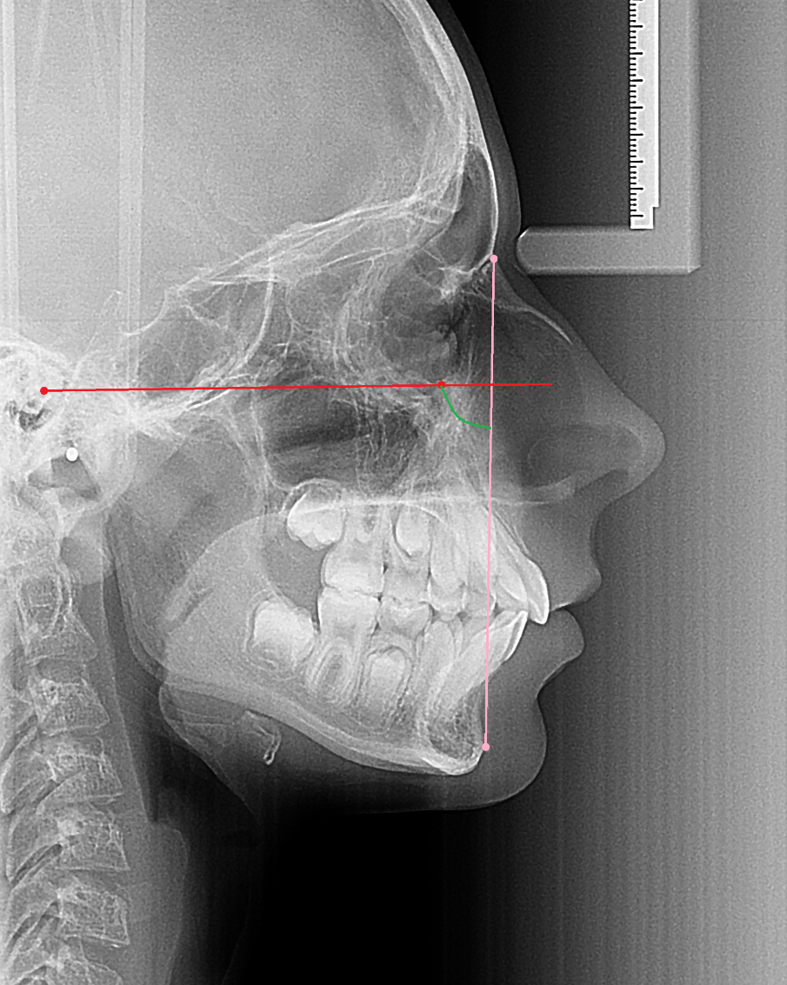
Facial angle: the angle between the facial plane (N-Pog) and FH. This angle provides some indication of the horizontal position of the chin. It also suggests whether a skeletal Class II or III pattern is caused by the position of the mandible.
FH
Facial angle
N-pog

Slide 73
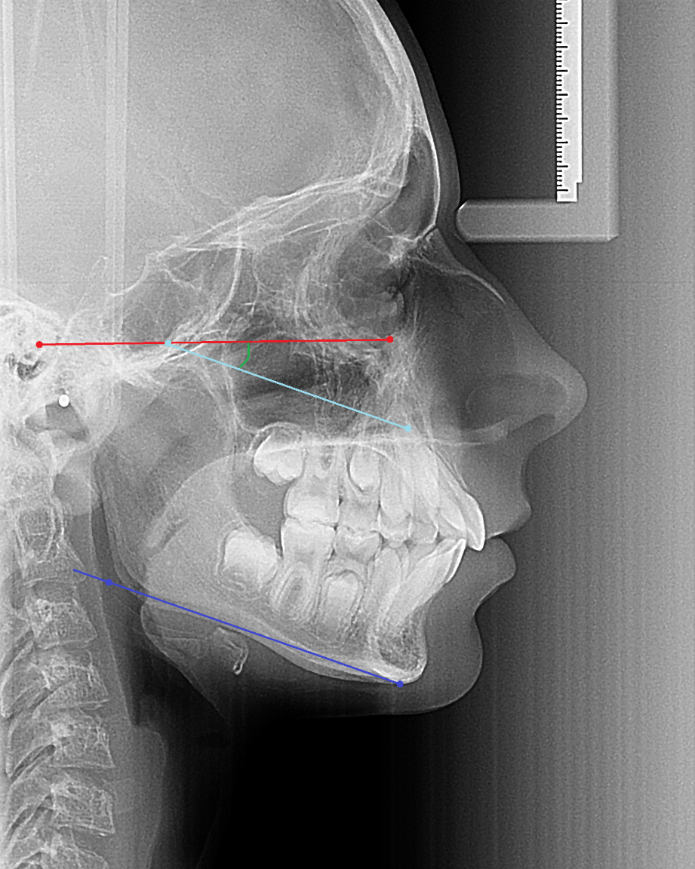
Mandibular plane: measures an angle to FH. On average, this angle is 26 degrees at 9 years of age and decreases approximately 1 degree every 3 years. A high or steep mandibular plane angle implies that an open bite may be caused by the skeletal morphologic characteristics of the mandible. A low mandibular plane suggests the opposite.
FH
Mandibular plane
Mandibular plane

Slide 74
Convexity at point A: the convexity of the middle face is measured from point A to the facial plane (N-Pog). The clinical norm at 9 years of age is 2 mm and decreases 1 degree every 5 years. High convexity suggests a Class III skeletal pattern.
N-Pog
A

Slide 75
Lower facial height: the intersection of two planes: ANS-Xi and Xi-Pog. On average: 45º.
SNA
XI
Pog

Slide 76
Occlusal plane: a line bisecting the cusp tips of the molars and passing through the cusp tips of the first premolars. In the white adult, the plane passes just inferior to Xi, nearly bisecting the angle of lower facial height. The long axis of the maxillary incisor intersects the long axis of the mandibular incisor at an angle of approximately 130 degrees, with a 2,5 mm horizontal (overjet) relationship and a 2,5 mm vertical (overbite) relationship.
SNA
XI
Occlusal plane
Pog

Slide 77
Teeth positions:
Mandibular incisor to A-Pog: the A-Pog line or plane is referred to as the dental plane and is a useful reference line from which to measure the position of the anterior teeth. Ideally, the mandibular incisor should be located 1 mm ahead of the A-Pog line. This measurement is used to define the protrusion of the mandibular arch.
Dental plane

Slide 78
Maxillary molar to PtV: this measurement is the distance from PtV to the distal of the maxillary molar. On average, this measurement should equal the age of the patient plus 3 mm (eg. A patient 11 years of age has a norm of 11+3=14 mm). This measurements in determining whether the malocclusion is due to the position of the maxillary or mandibular molar. It is also useful in deciding whether extractions are necessary.
FH
PtV
Occlusal plane

Slide 79
Mandibular incisor inclinations: the angle between the long axis of the mandibular incisor and the A-Pog plane.
On average: 22º + 4º.
Lower incisor inclination
A
Lower incisor axis
Pog

Slide 80
Canine relation: describes the occlusion of the canines. Measured from the tips of the maxillary and mandibular canines along the OPT.
Molar relation: describes Angle classification of occlusion. Measured from the distal surface of the mandibular molar to the distal surface of the maxillary molar along the OPT.
Molar relation
Canine relation

Slide 81
Interincisal angle: 130º.
Upper incisor axis
Interincisal angle
Lower incisor axis

Slide 82
Overjet (horizontal): describes the relative horizontal position of the anterior teeth. Measured from the tip of the mandibular incisor to the tip of the maxillary incisor along the OPT.
Overjet

Slide 83
Overbite (vertical): describes the extent of the overbite. Measured from the tips of the maxillary and mandibular incisors perpendicular to the OPT.
Overbite

Slide 84
Maxillary incisor inclinations: describes the position of the maxillary incisor relative to the mandible and maxilla. Measured by the angle formed by the long axis of the maxillary incisor to A-Pog plane.
Upper incisor inclinations
Upper incisor axis
A-Pog

Slide 85
Profil:
Lower lip to E-line
The distance between the lower lip and the esthetic (nose-chin) line is an indication of the soft tissue balance between the lips and the profile. The average norm for this measurement is -2 mm at 9 years of age. The positive values are those ahead of the E-line.
Li
E-vonal

Slide 86
Upper lip lenght: measured from ANS to Ls with the lips lightly touching. Norm = 24 mm + 2 mm.
SNA
Ls

Slide 87
Postero-anterior cephalogram
The head is rotated 90º relative to the setting used for lateral shots.
X-rays are parallel to the median-sagittal plane of the head.
When adjusting the head, make sure that the Frankfurt horizontal plane is horizontal.

Slide 88
Indications:
Determination of the localization and degree of skeletal asymmetries.
In case of maxillary skeletal constriction, when fracture of the palate occurs (Hyrax)

Slide 89
Examination of P-A cephalogram:
Vertical and transverse configuration of facial cranium
Skeletal and dental centerline differences
Intermolar distance
Intercanine distance
Asymmetries of jaws relative to each other
Asymmetries of jaws relative to cranial base

Slide 90
The analysis is performed using even and odd reference points.
The most well-known method of analysis is also associated with Ricketts.
The main formulas that can be seen on the P-A X-ray are:
Crista galli
Base of the hypophyseal fossa
Nasal septum
Frontozygomatic suture
Zygomatic process
Mastoid process
Angle of mandible
Orbita

Slide 91
Cone Beam CT
in the '90s, a completely new CT imaging procedure was introduced to those people who works on the head and neck region
it can operate at a significantly lower radiation dose than conventional CT imaging procedures
this is mainly due to lower current. Its voltage (90-120 kV) is similar, but current varies between 1 and 8 mA, while conventional CT operates at around 80 mA, but can be increased up to 200 mA

Slide 92
works with cone-shaped beam (CT with fan-shaped beam)
this is detected by a Flat Panel Detector (FPD) or a Charge-Coupled Device (CCD) after amplification
its resolution is better, the size of its elementary units, voxels, is smaller than that of a conventional CT
for CBCT, lower dose results in higher noise and less information on soft tissues
the CBCT is significantly cheaper and smaller than a traditional CT

Slide 93
Use of CBCT
used primarily for diagnostic purposes
about the location of wisdom teeth, their relation to surrounding formulas (judging the relationship of lower wisdom teeth to mandible canal)
for the design of implant dentures
examination of TMJ
planning orthodontic treatments and surgeries
mapping pathological processes in bone
for examination of the respiratory tract and sinuses
examination of the periapical area and the morphology of the teeth (number of roots, location, course)

Slide 94
nasal cavity and sinuses
- inflammation
- fungal sinusitis
evaluation of the tooth / sinus relationship
bone remodeling and mucosal calcification
postop. tracking (in benign processes)
trauma
salivary glands

Slide 95
Impacted tooth (kép beillesztése)

Slide 96
periodontology also gets a much larger amount of information → in 3D you can examine the hard tissue surrounding the teeth
orthodontics prefer to use it because of the possibility of distortion and magnification-free images, and a CBCT image does not pose much more of an additional load given the otherwise required (OP, Tele, possible intraoral) images. However, routine use in orthodontic diagnostics is not warranted.

Slide 97
Because we get real 3D information about an object, we can use this information for virtual or real-world modeling.

Slide 98
CBCTs typically display sections in 3 planes.
These are:
axial (or transversal)
coronal (or frontal)
sagittal
Compared to this, the CBCT is able to create and display slices perpendicular to the plane we have designated.

Slide 99
Axial slices:
mastoid process, 2. mandible head,
3. maxillary sinus, 4. zygomatic process of maxilla

Slide 100
Coronal slices:
1. temporal bone, 2. sphenoid bone, 3. optic nerve’s canal, 4. zygomatic arch, 5. sphenoid sinus, 6. medial pterygoid process, 7. lateral pterygoid process, 8. mandible

Slide 101
Sagittal slices:
1. frontal sinus, 2. sphenoid sinus, 3. sella turcica, 4. clivus, 5. incisive canal

