Slide 1
Removable Appliances
Funcional Appliance 2

Slide 2
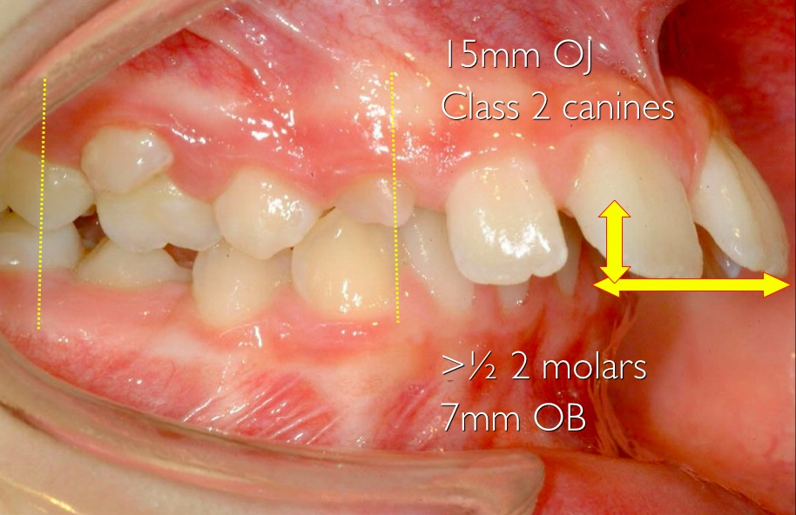
Functional appliances are perfect in treating Class II malocclusion
Stimulates anterior mandibular growth
Inhibits the anterior development of the maxilla
Produces dental and alveolar changes
Ceases bad muscle
functions

Slide 3
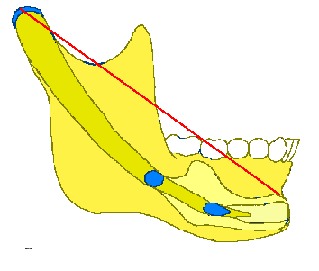
The growth of the mandible
The growth takes place mostly into the condyle
The summe of the growth is genetically programmed in the condyle
During the growth process the mandible has a morphogenetic change in his shape
And changes his position in the face with a positional rotation

Slide 4
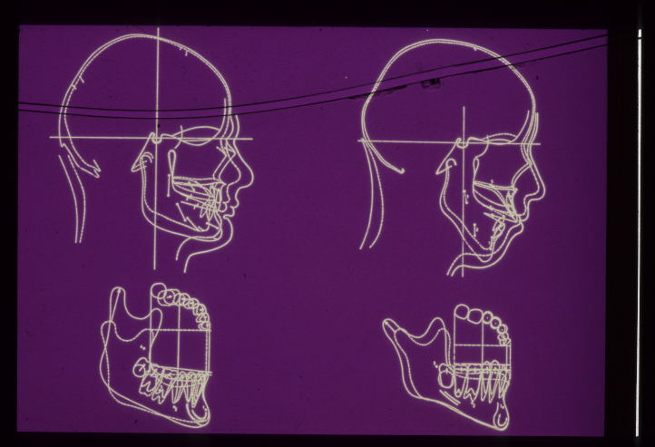
The Face in Profile
The two extreme growth rotation of the mandible

Slide 5
Two extreme structural shape of the mandible during growth process because of remodeling and translation
short face
long face

Slide 6
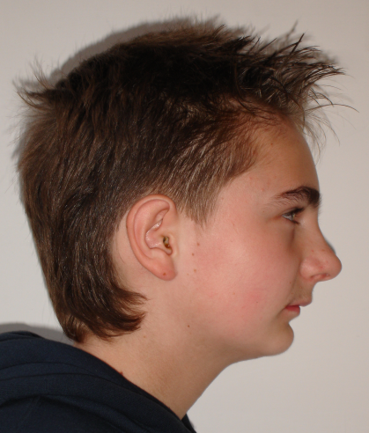
Mandible morphology, growth pattern and profile
Short face:
Shorter lower face high
Long face:
Longer lower face high

Slide 7
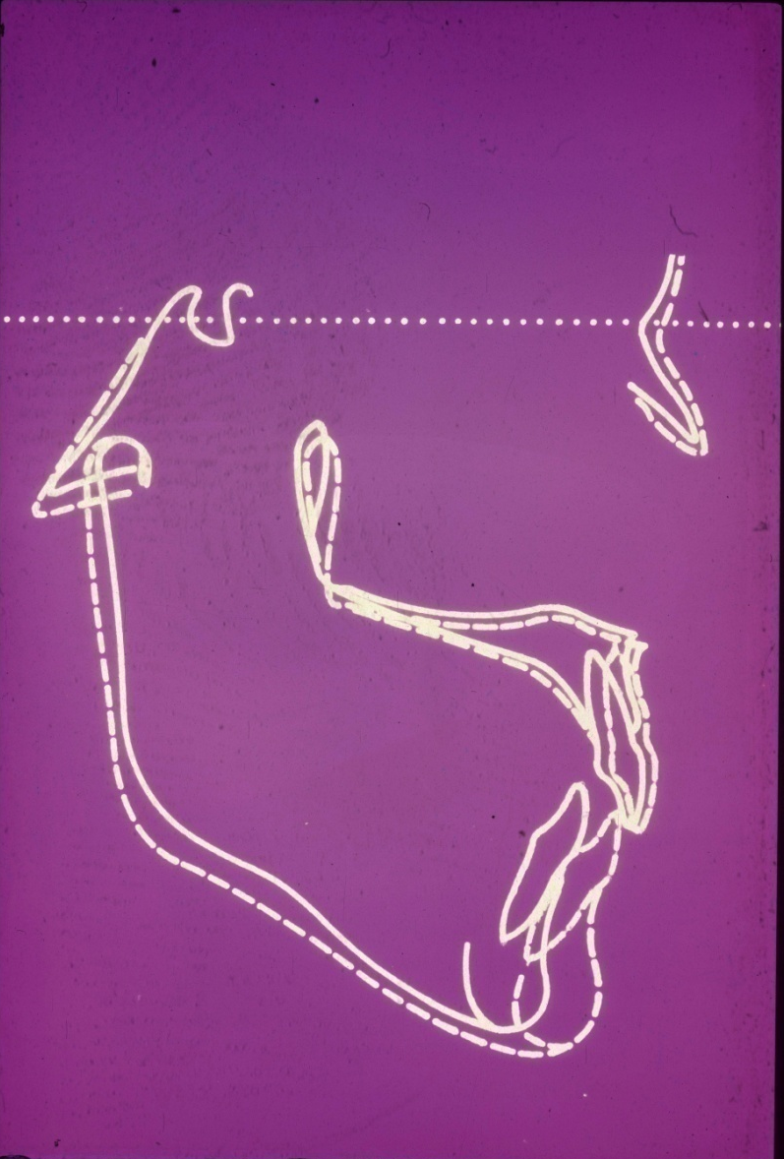
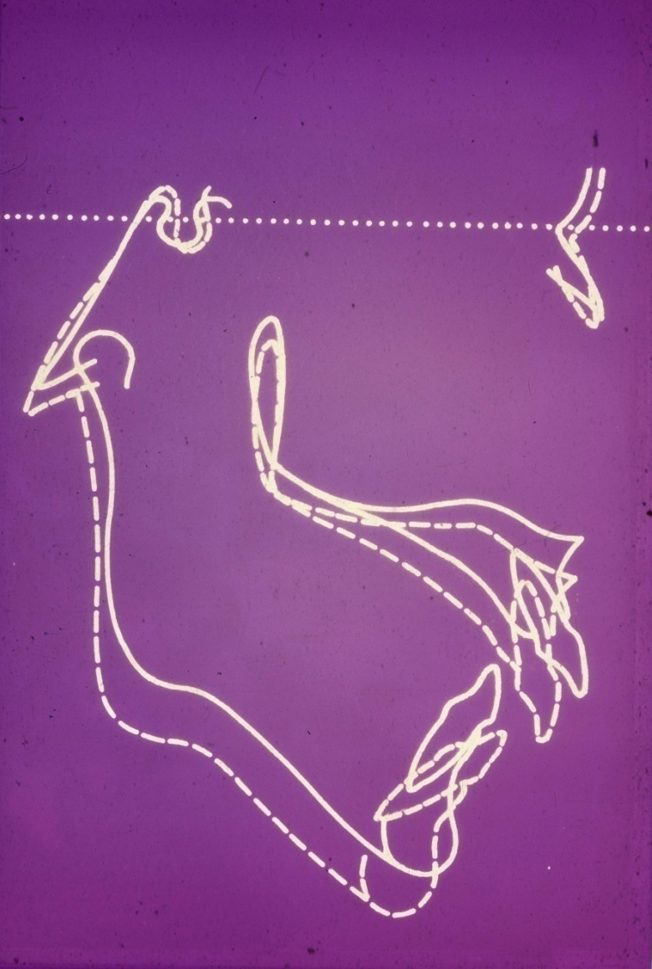
The main object of the functional treatment
To make a derivated growth guidance

Slide 8
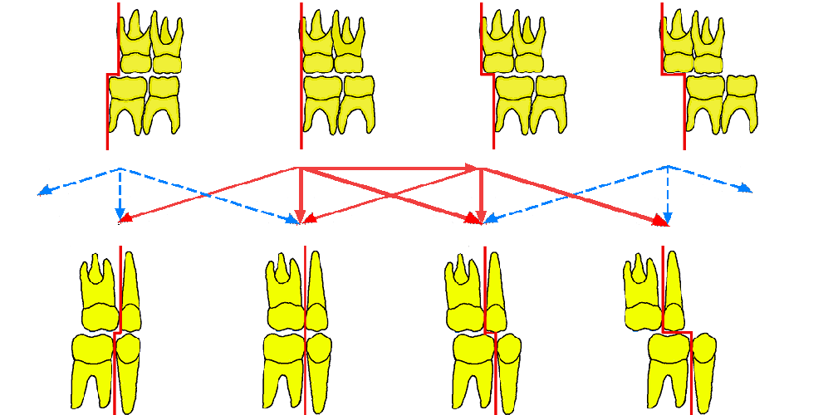
The significance of the terminal plane
in the development of Class II malocclusion
distal step flat terminal plan mesial step strong mesial step
Class II 1/2PM Class II Class I Class III
In the pure Class II malocclusion the maxillary terminal plane is relatively more anterior than the mandibular terminal plane

Slide 9
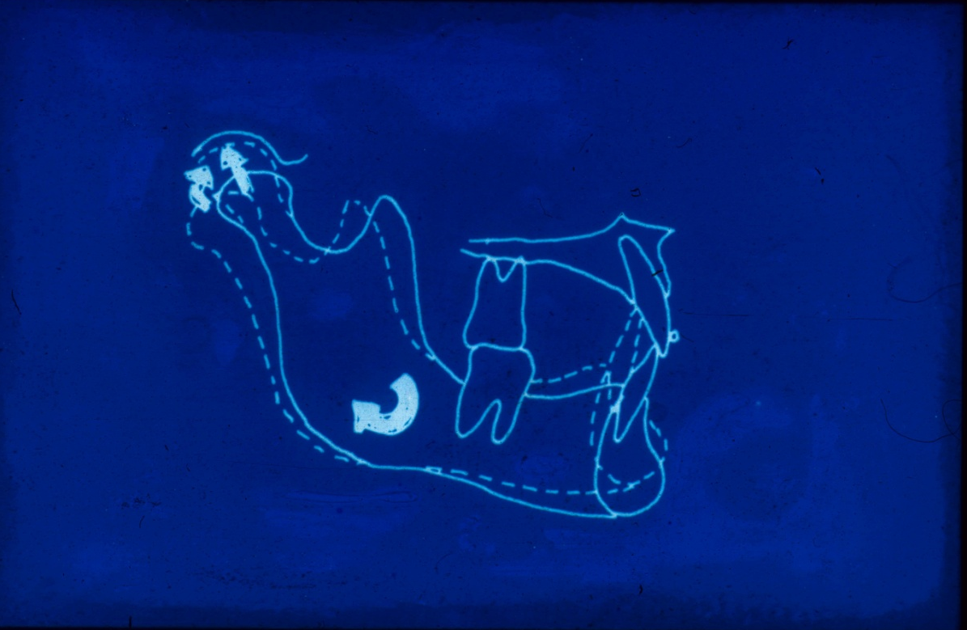
Sagittal effect of the functional appliances

Slide 10
Vertical effect of the functional appliances Harvord Effect
Harvord
effect

Slide 11
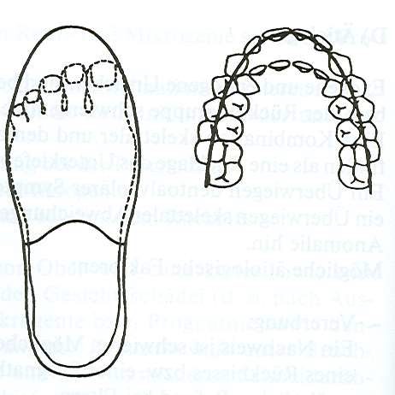
The feature of the upper arch in Class II/1
(Transversal direction)
Like a narrow slipper
Körbitz

Slide 12
The Phases of the Growth

Slide 13
The timing of growth spurt of the mandible on girls and boys
♀11
♂13
boy
girl
6 8 9 10
14
16
18
11
13
ages

Slide 14
Construction bite
The functional appliances are fabricated from a construction bite in order to register the desired intermaxillar relationship

Slide 15
Clearly functional appliance
Vestibulum plate
Myofuncional trener
Fuction regulator of Fränkel
There are all tissue-borne appliaces, contact with the teeth is avoid

Slide 16
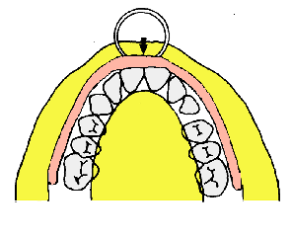
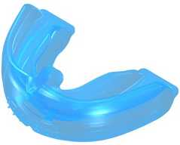
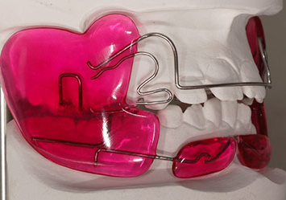
Clearly functional appliances
Vestibulum plate
Trener
Fränkel appliance 1966

Slide 17
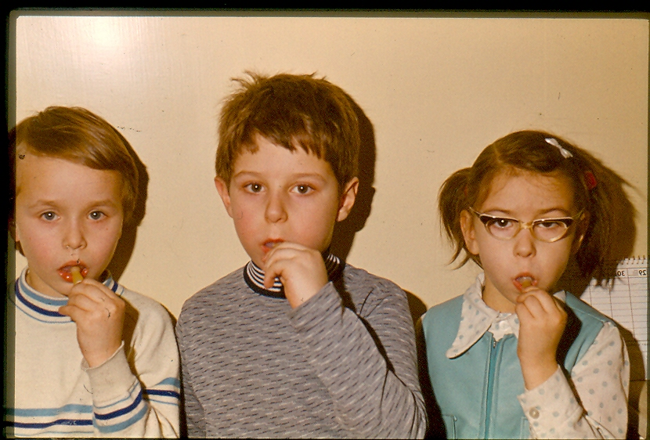
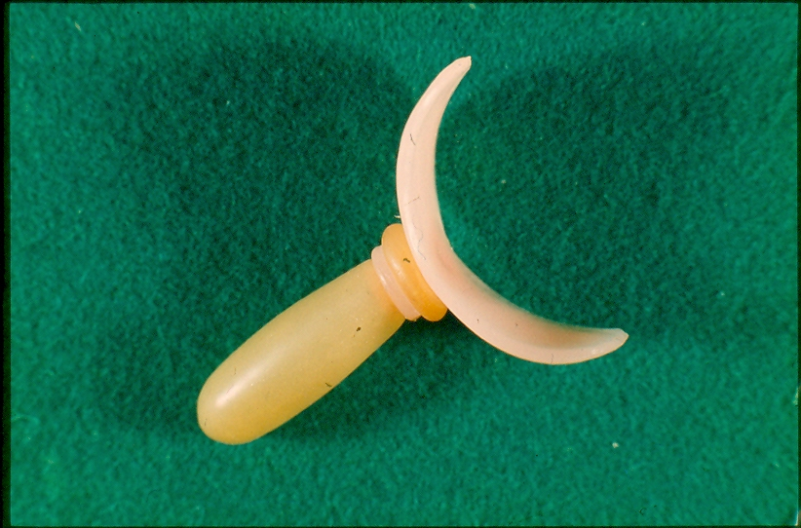
Children make muscles exercises with vestibulum plate

Slide 18
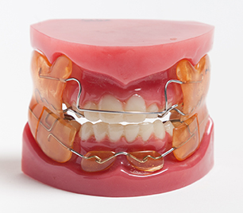
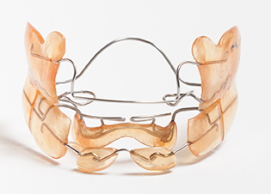
FR I. Appliance
tournament tool

Slide 19
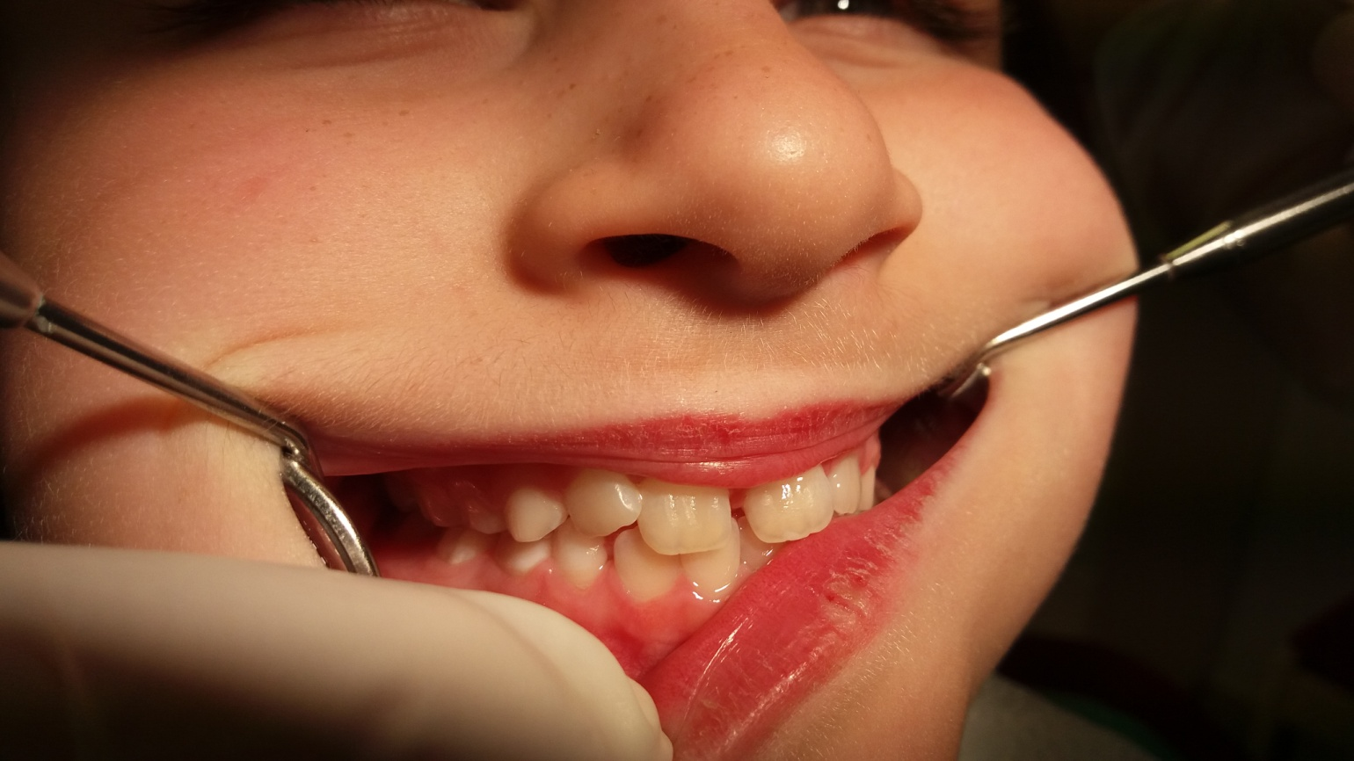
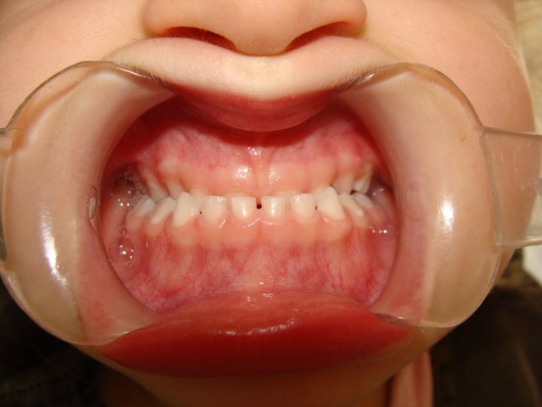
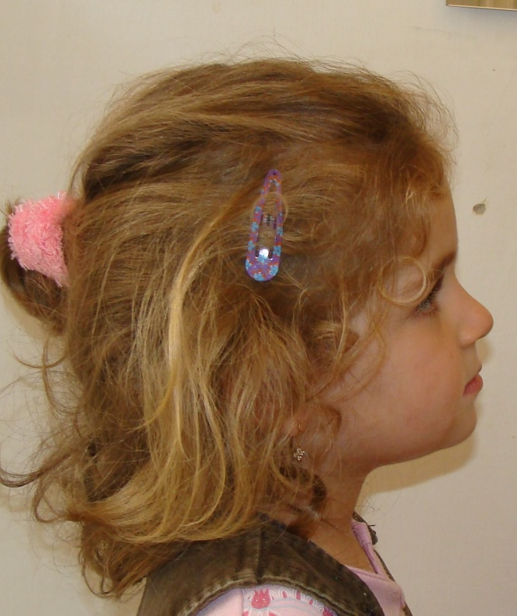
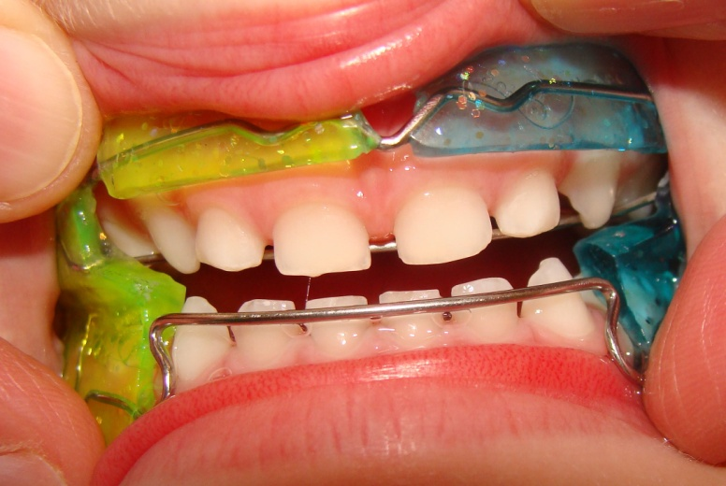
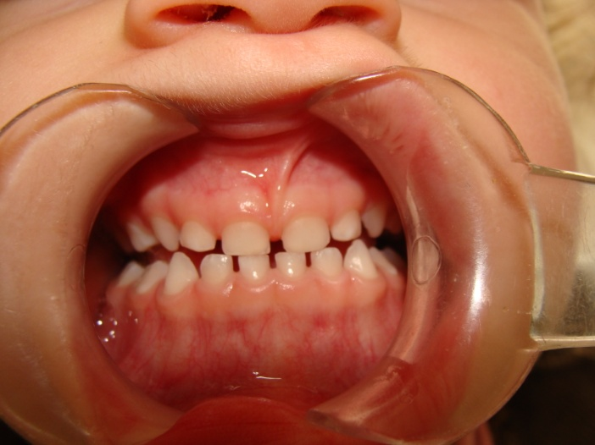
K.K. 5-year old girl with FR III appliance

Slide 20
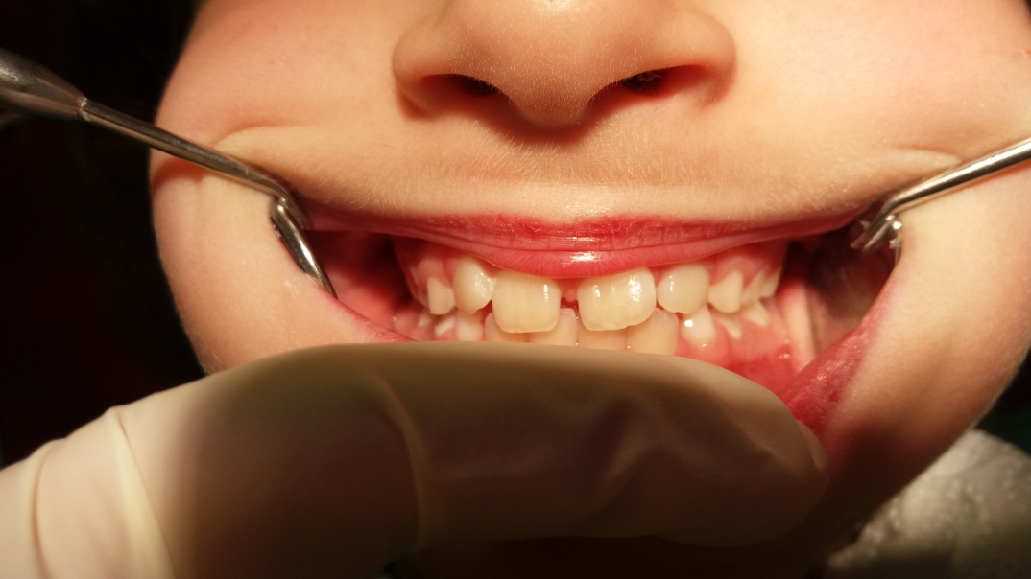
K.K. 6,5 year old girl after the eruption of the permanent front teeth

Slide 21
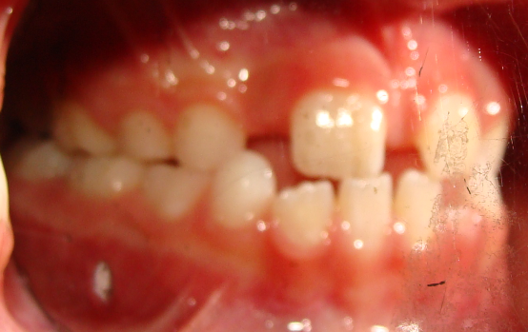
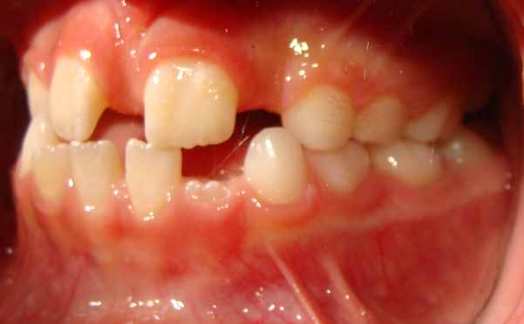
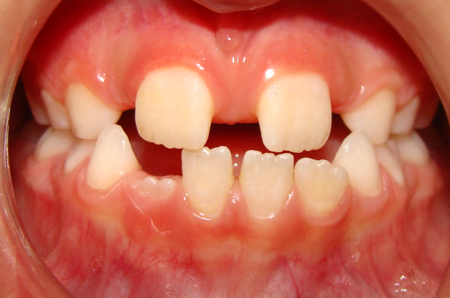
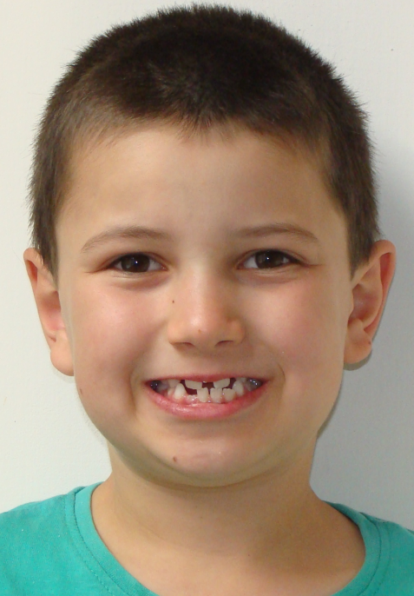
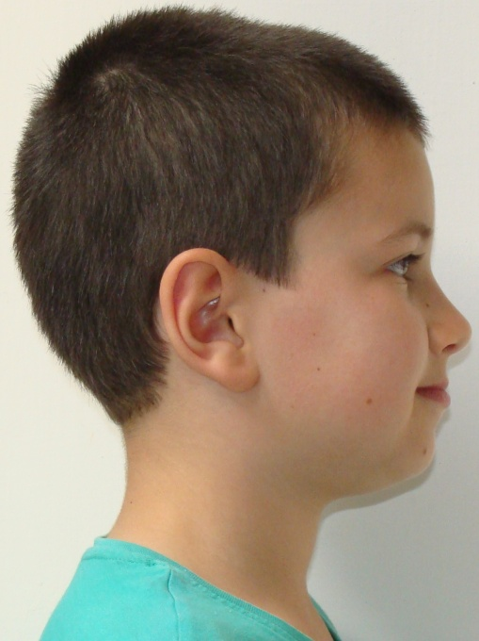
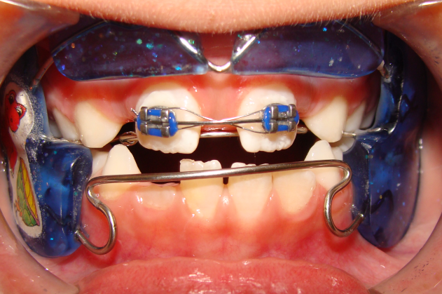
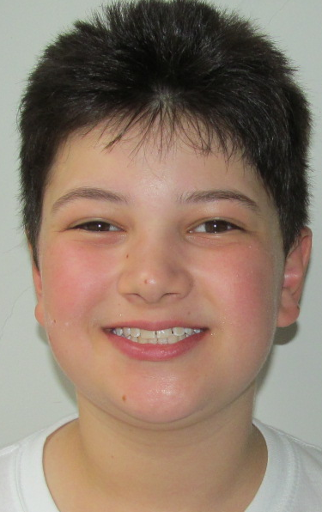
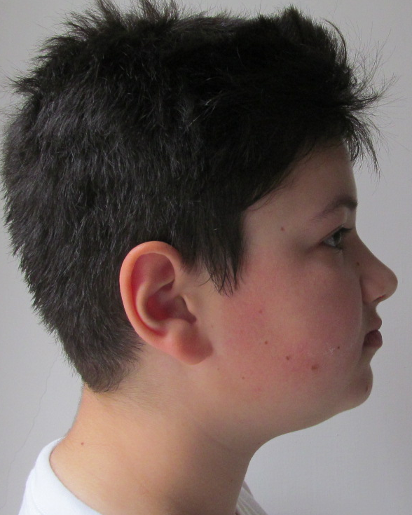
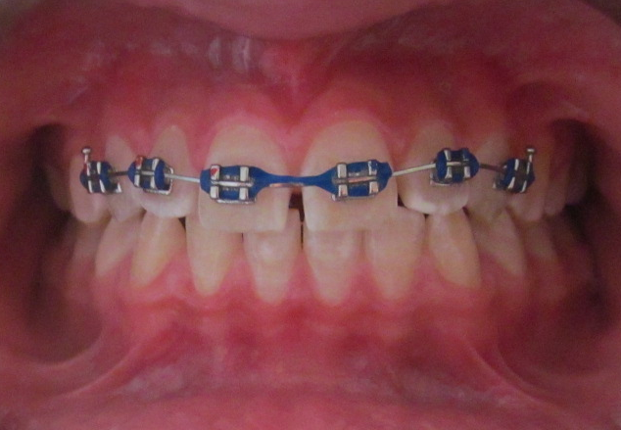
Ny.Zs.8-year old boy
FR III, 8 years
5 years later

Slide 22
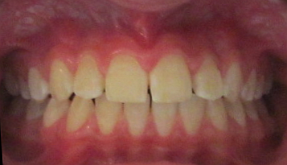
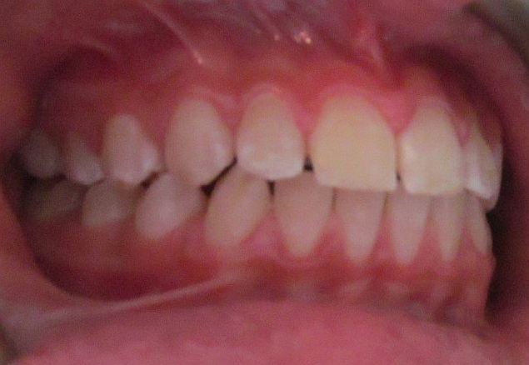
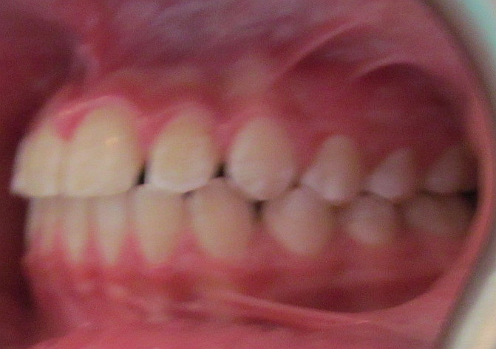
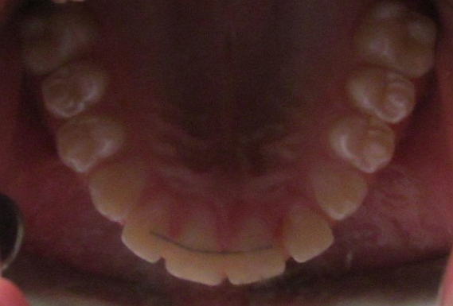
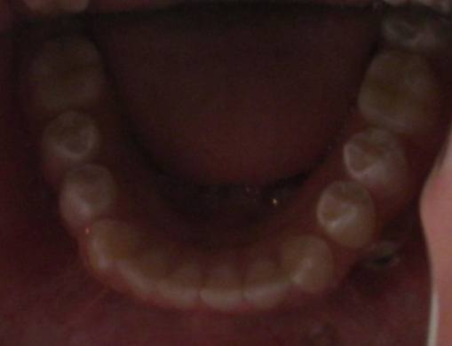
Ny.Zs. occlusion when ne was
8 and 13 years old

Slide 23
Functional appliances
The earliest functional appliance was the monobloc developed by Pierre Robin, a French stomatologist, in 1902
The first functional appliance to gain widespread clinical use was the Activator designed by Vigo Andresen, a Danish dentist
Andresen developed in 1936 his system with Karl Häupl into the Norwegian system of Functional Jaw Orthopaedics.

Slide 24
Different theories about the effect of functional therapy
Functional appliace does not produce a supplementary mandibular growth, only accelerate that already exists
There is no differce between mandibular changes produced by functional therapy or by normal growth or Class II conventional fix therapy
Functional therapy helps the mandible to express its genetic growth potential through anterior repositioning, because this position could stimulate condylar growth

Slide 25
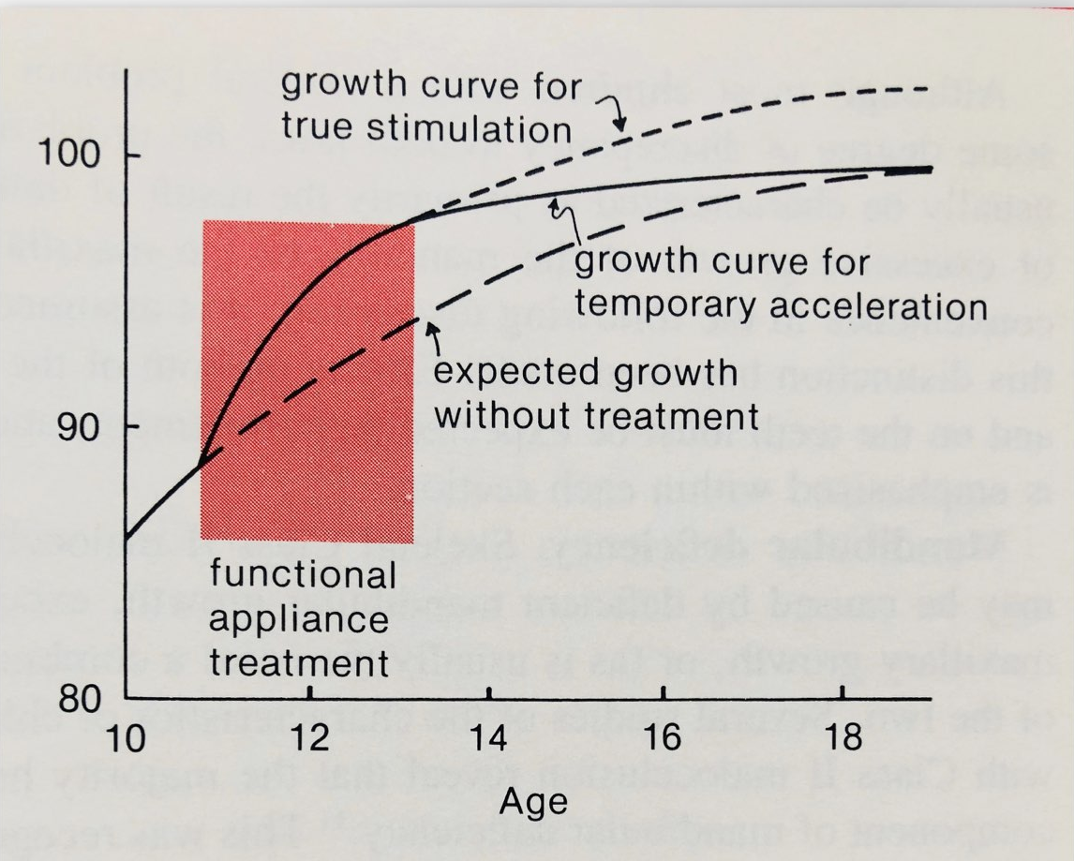
Growth stimulation by Class II treatment

Slide 26
The design of activator
The Andresen Activator is a passive tooth-borne appliance consisting of a plate covering the palate and teeth of both the mandibular and maxillary arches.
It transferred muscular stimuli to the teeth and jaws and was designed to move the mandible forward for correction of Class II malocclusions and open the bite. It could also direct erupting posterior teeth.

Slide 27
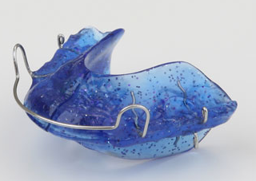
Andresen activator
the acrilic has a lingual imprints of the crown surfaces
we have to trimm
recesses into the
acrilic
the blocc touchis
the frontal teeth

Slide 28
The results of the activator treatment
Reducis overjet and overbite
The changes are mainly dentoalveolar
Favorable growth occurs in some cases
It has not been possible to show that these growth changes are in excess of the genetically determined growth for the patient or to predict which patients will grow and which will not

Slide 29
About incisal trauma
When we consider the risk of trauma we need to evaluate if the child is at risk because of their general activities
Moderate level of evidence suggests that providing early Class II treatment with functional appliances reduces incisal trauma.
Most of the reduction in overjet is achieved by tooth movement. There is minimal skeletal change and this cannot be predicted.

Slide 30
Fix functional appliances
1.Herbst
2.SUS
3.Forsus
Herbst
1905
SUS
Forsus

Slide 31
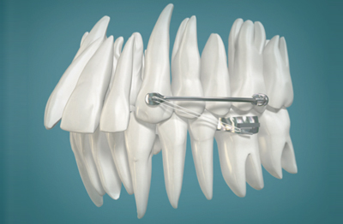
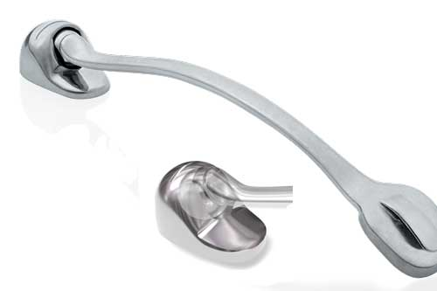
Carriere Motion Class II Appliance

Slide 32
Fixed functional appliances
There is little difference in the dental and skeletal effects of fixed and removable functional appliances.
Most of the correction of the overjet is by dento alveolar movement, but there is a small amount of skeletal change (1-2mm).
There is greater co-operation with fixed functional appliances but this is not 100%.

Slide 33
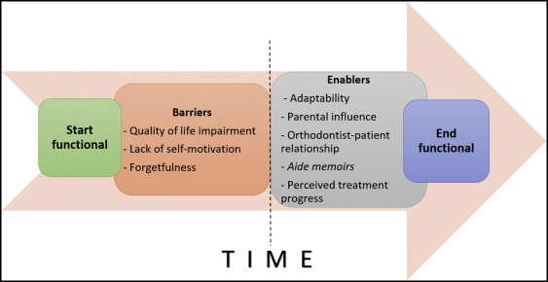
Troubles with the functional treatment

Slide 34
Thank you for your attention

Slide 35
Thank you for your attention

