Slide 1
Removable Appliances
Other functional appliances 3

Slide 2
Randomised controlled trials

Slide 3
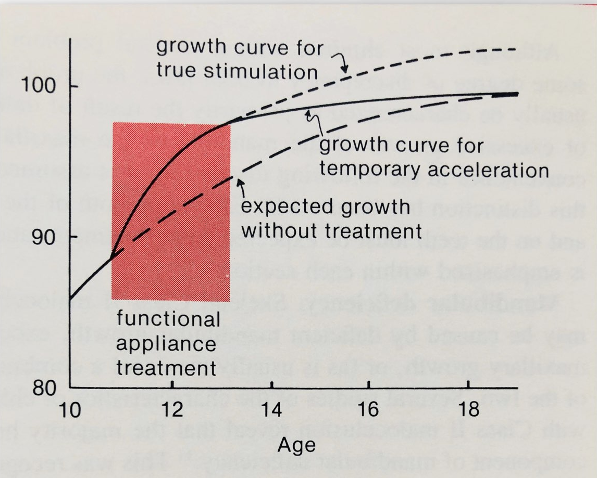
Growth stimulation by Class II treatment

Slide 4
Combined Functional Appliances

Slide 5
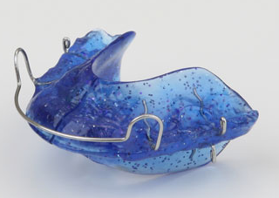
Disanvantage of Activator
Bulky configuration
Few place for the tongue

Slide 6
To increas the comfort they reduced the bulk of the appliances
1949:H.P. Bimler introduced the Bimler appliance
1953: H. Stockfisch developed the kinetor
1956: M. Schwartz introduced the double plate
1962: Rehák R. developed the dinamic appliance
1963: R.Klammt introduced the EOA
1964: W. Balther introduced the bionator
1977: W. Clark developed the twin block
1981: A.Hasund introduced the Hansa appliance

Slide 7
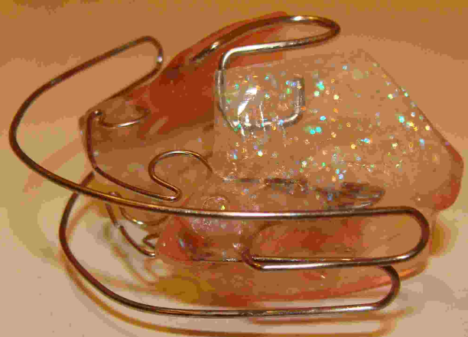
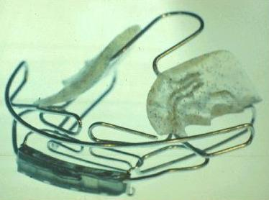
Other Functional Appliances
A.M.Schwartz was one of the first to construct an activator in two parts. It consisted of upper and lower plates designed to occlude with the mandible in a protrusive position.
Most of the inventors increased comfort by reducing the bulk of the appliance thus facilitating daytime wear.

Slide 8
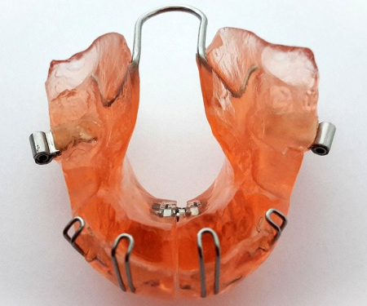
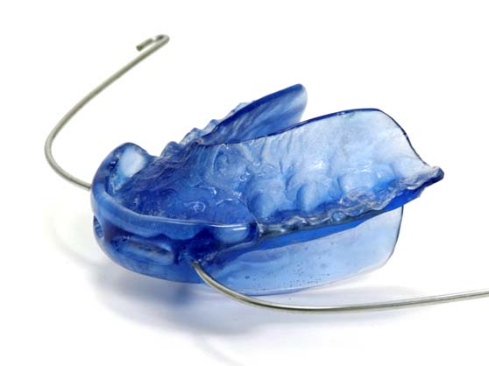
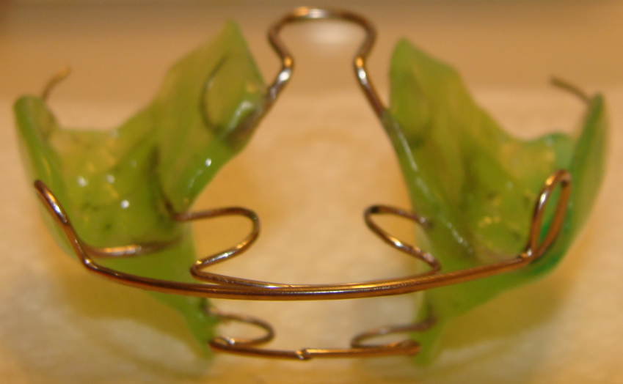
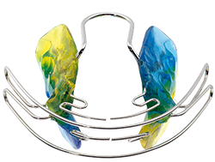
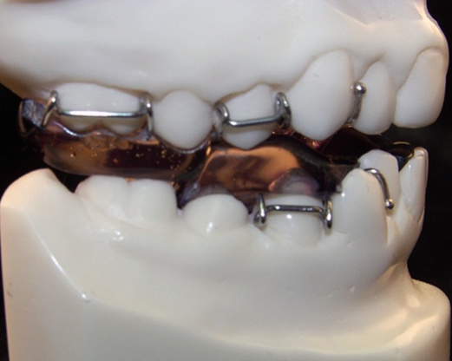
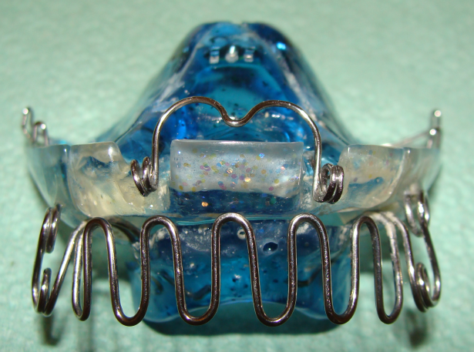
FJO Appliances
Activator with torque springs and headgear
Balter Bionator
Rehák R. dinamic appliance
Klammt EOA
Bimler Appliance
Clark
Twin block
Hasund
Hansa Appliance

Slide 9
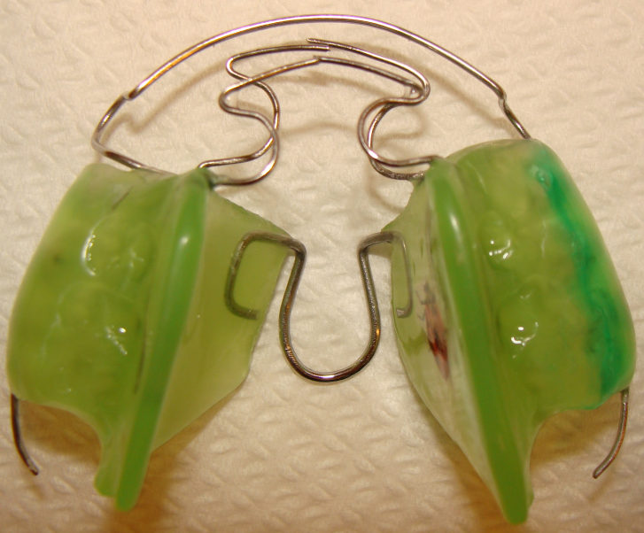
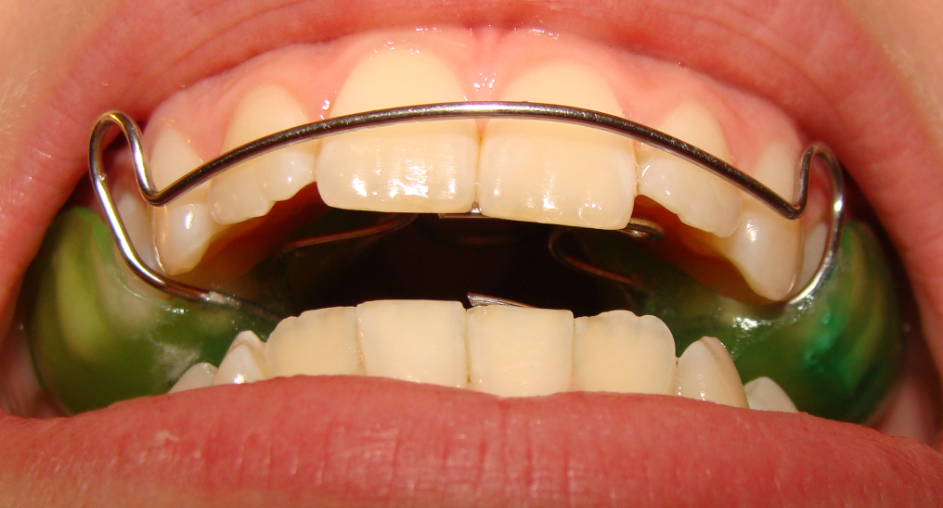
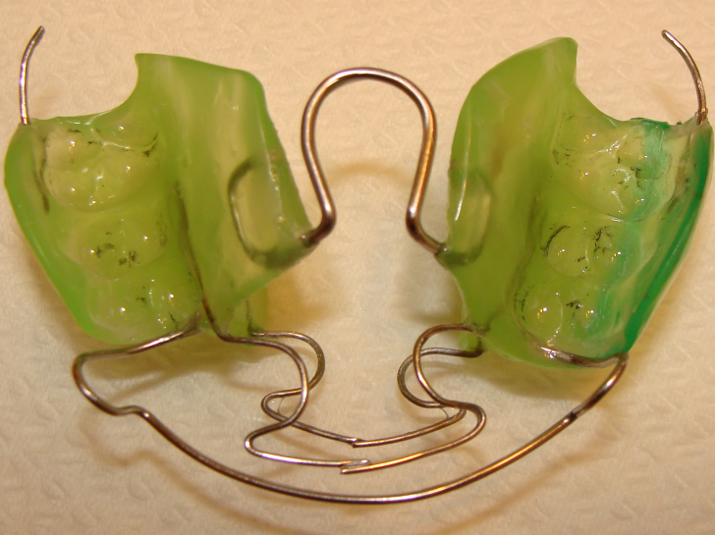
Dinamic appliance by R.Rehák

Slide 10
EOA by Klammt

Slide 11
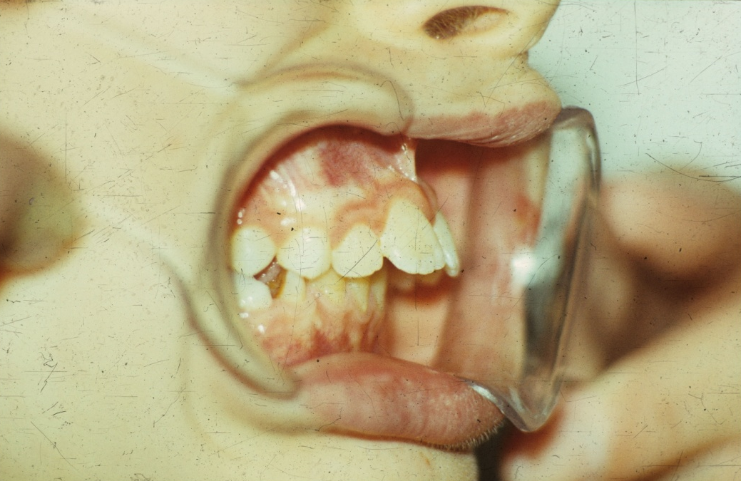
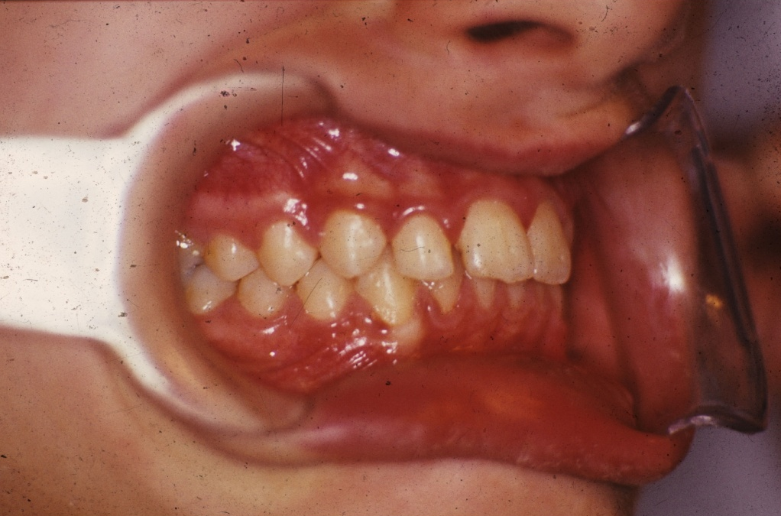
Treatment with Klammt- EOA

Slide 12
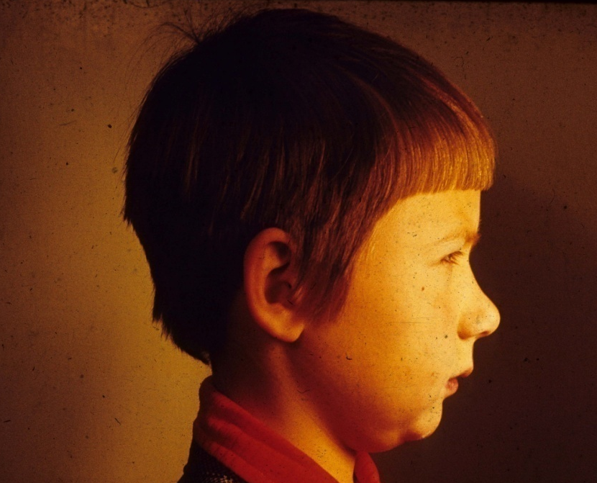
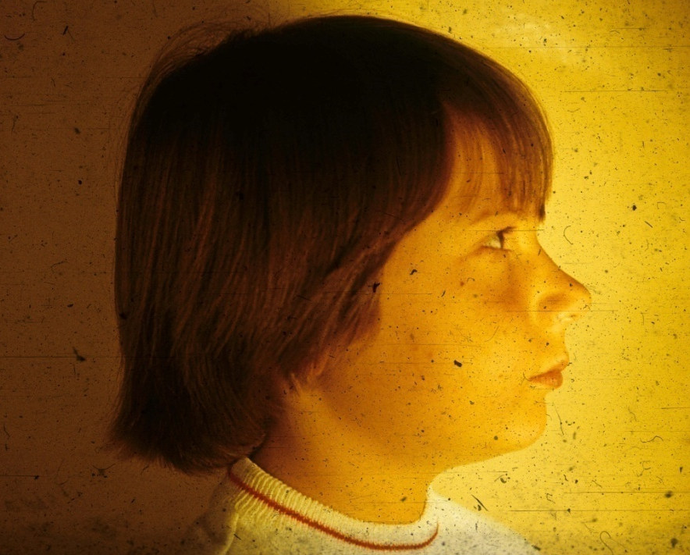
Profilchanges because of FJO treatment

Slide 13
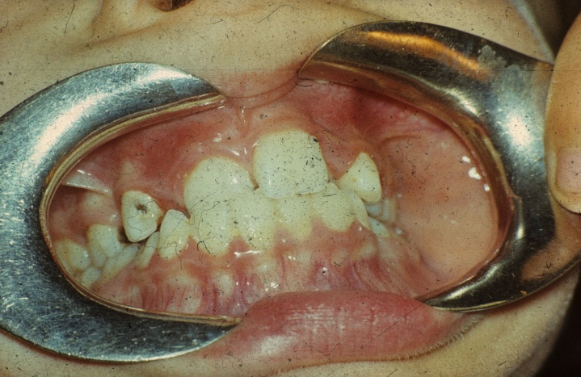
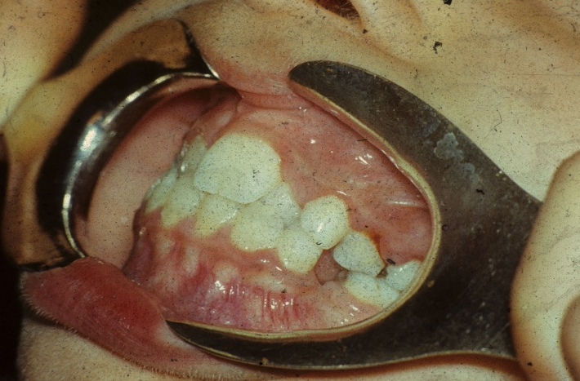
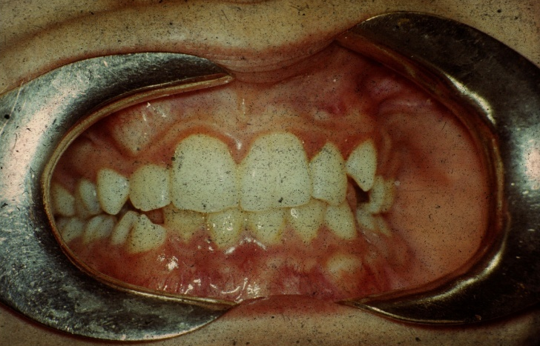
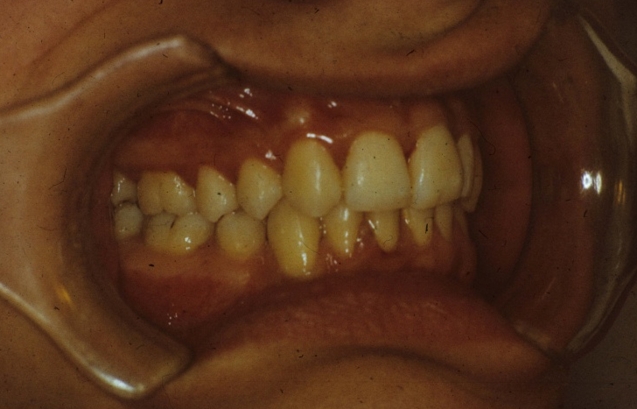
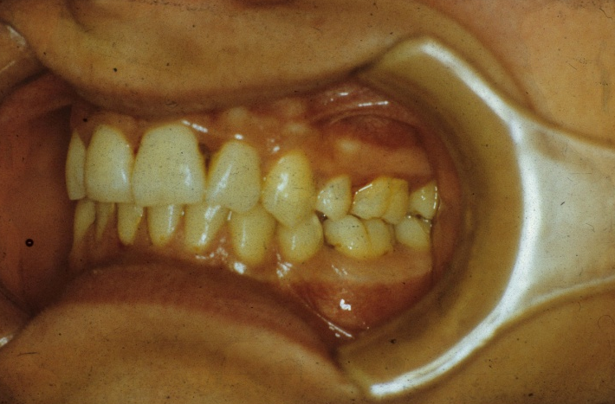
Treatment with Klammt-féle EOA

Slide 14
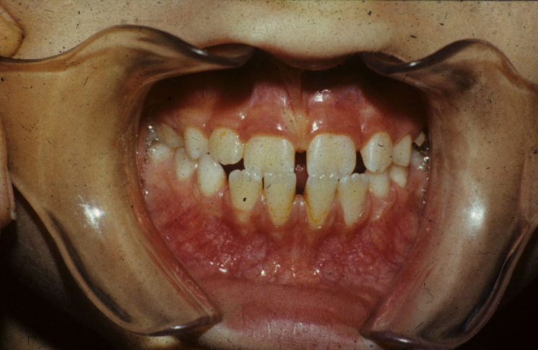
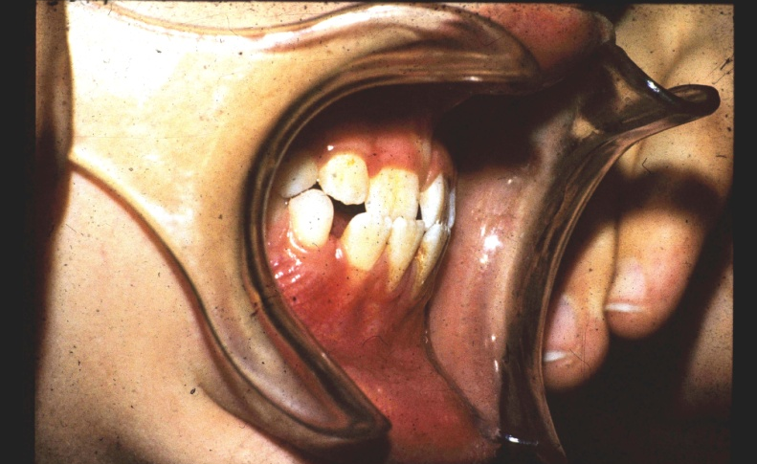
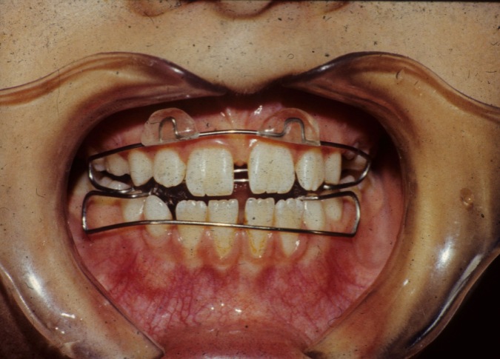
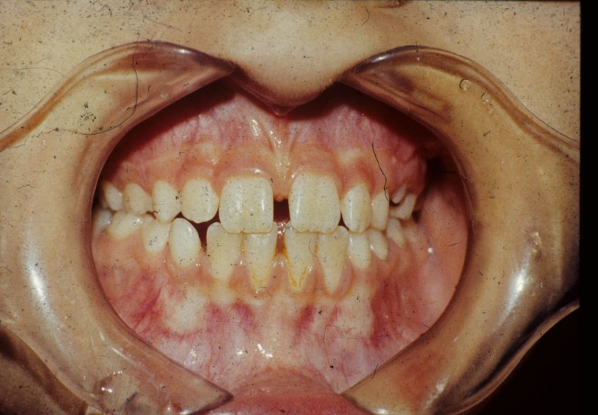
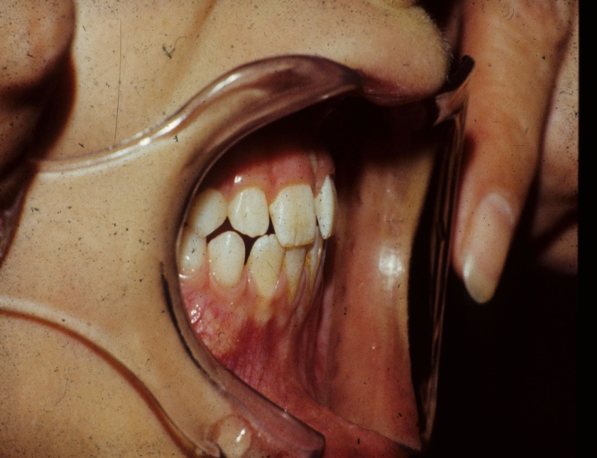
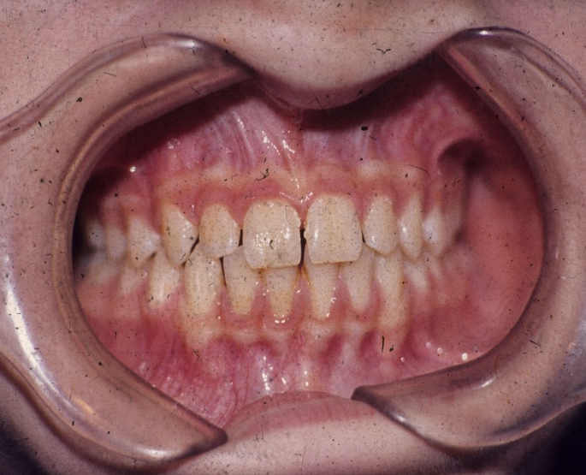
2-year old boy
Before treatment
Before treatment
With appliance
After treatment
After treatment
2 years later

Slide 15
Classical Hansa appliance and treatment timing

Slide 16
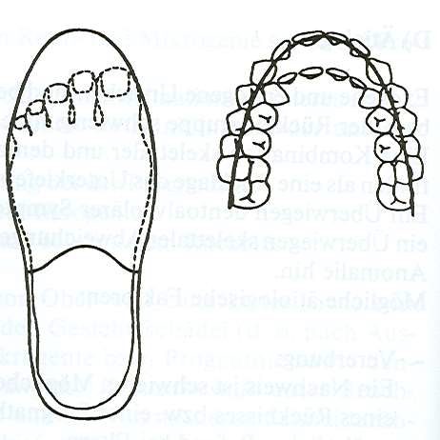
The feature of the upper arch in Class II/1
Like a narrow slipper
Körbitz

Slide 17
Twisting springs for moving the apex distally
Bass spring
Teuscher spring

Slide 18
Harvord effect

Slide 19
Grinding of Hansa appliance for bite opening (Harvord effect)

Slide 20
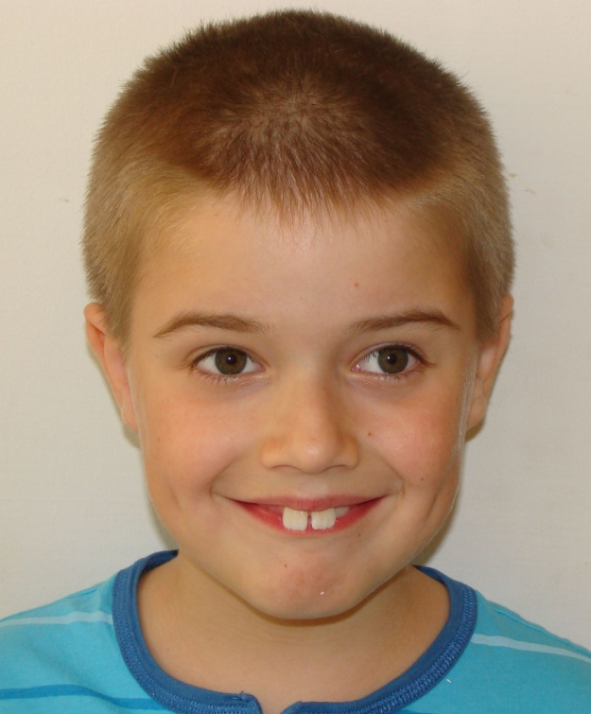
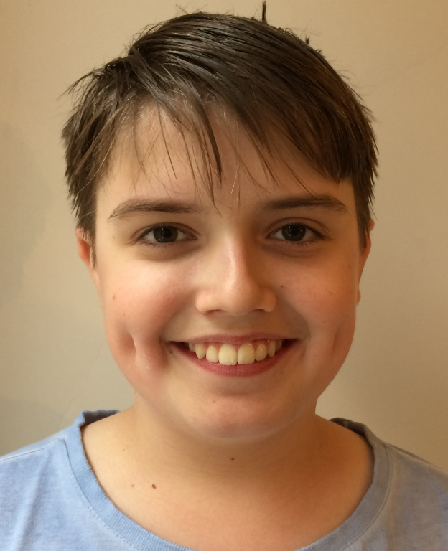
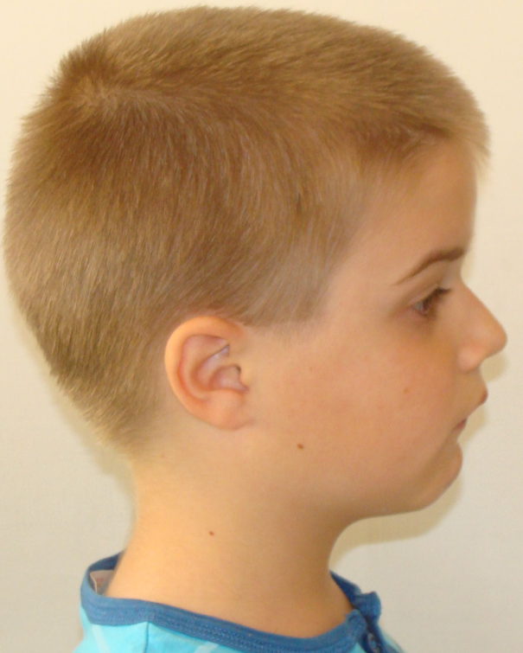
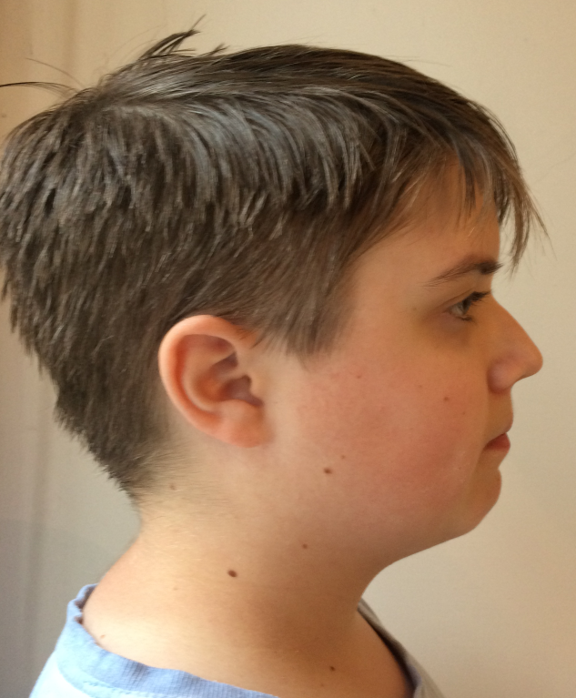
The face
before
and
after FJO
treatment

Slide 21
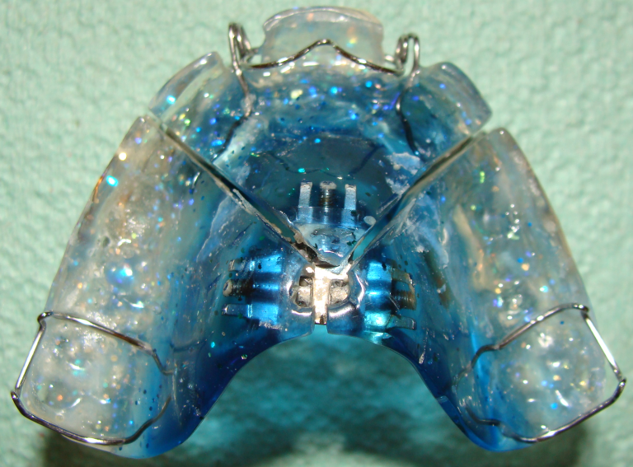
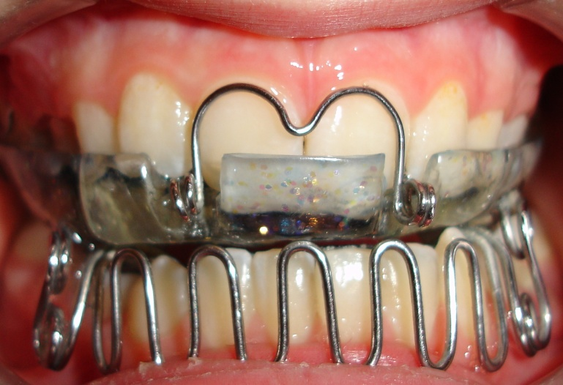
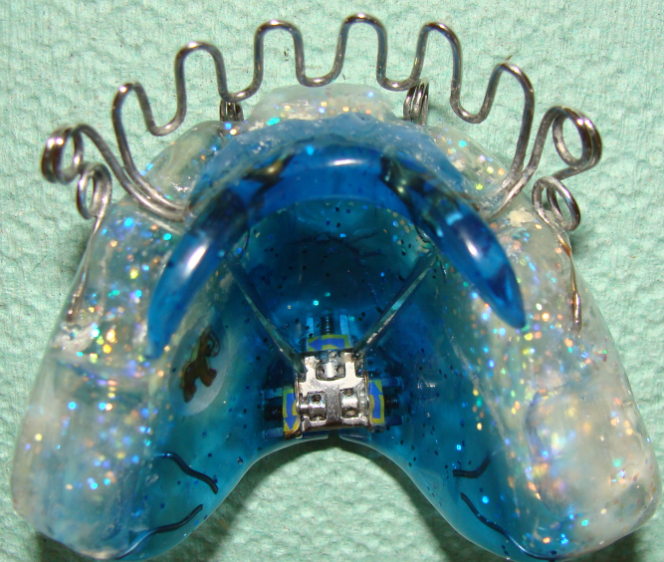
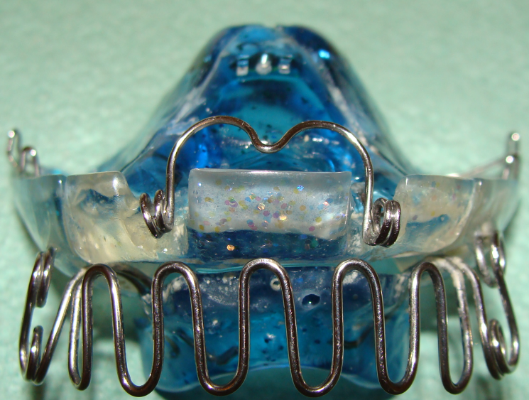
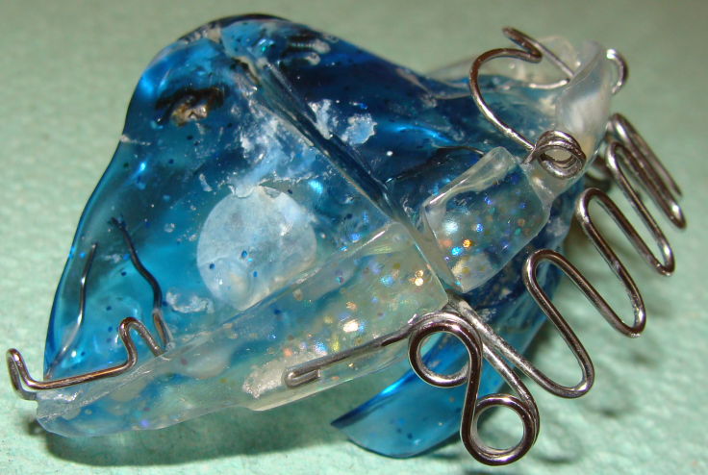
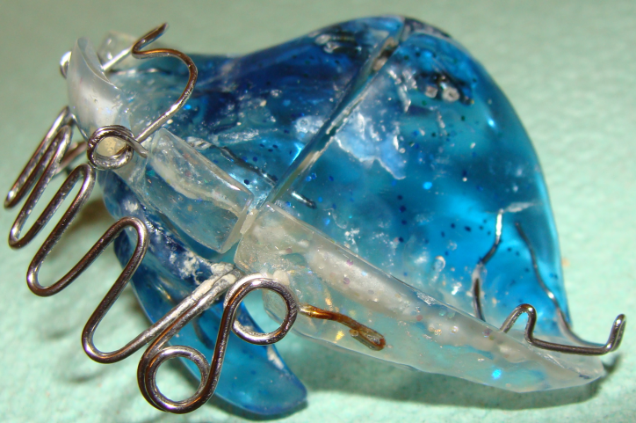
Hansa appliance with Bertoni srew

Slide 22
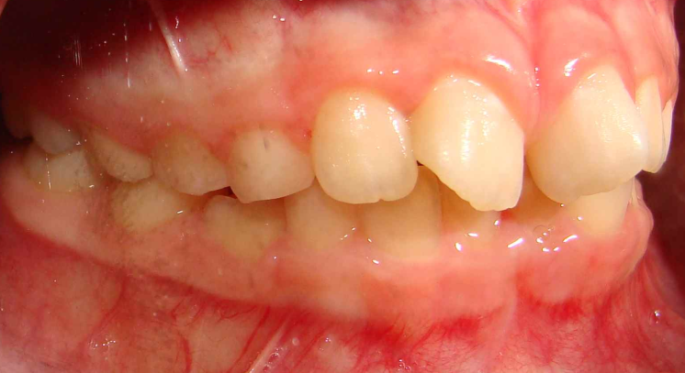
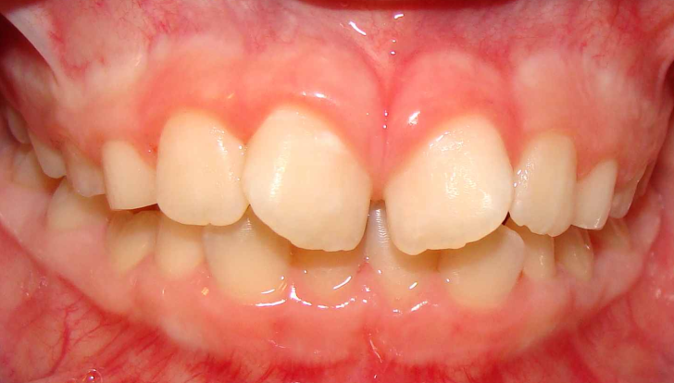
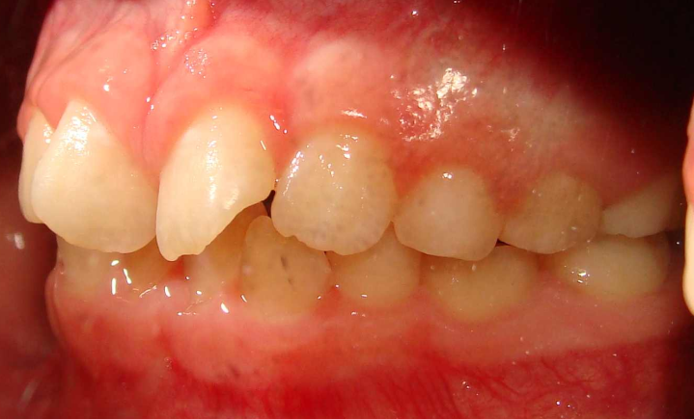
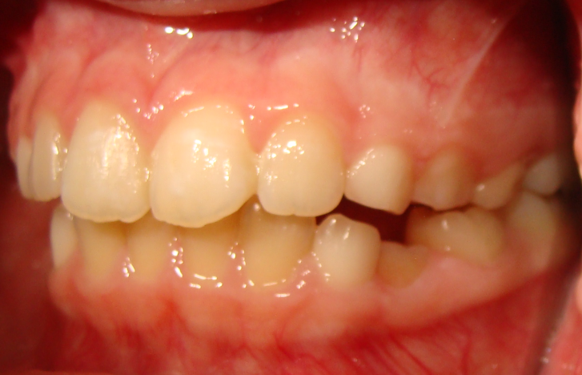
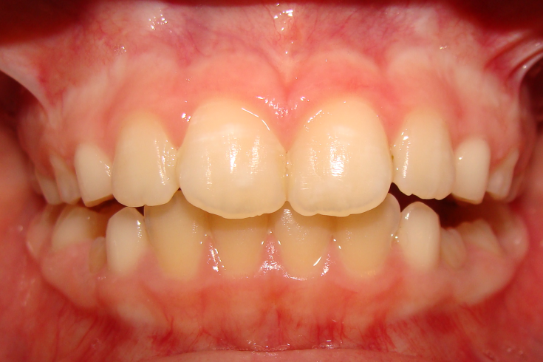
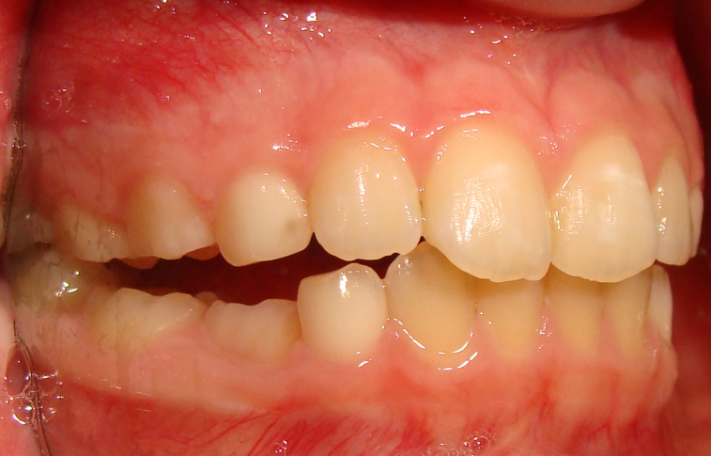
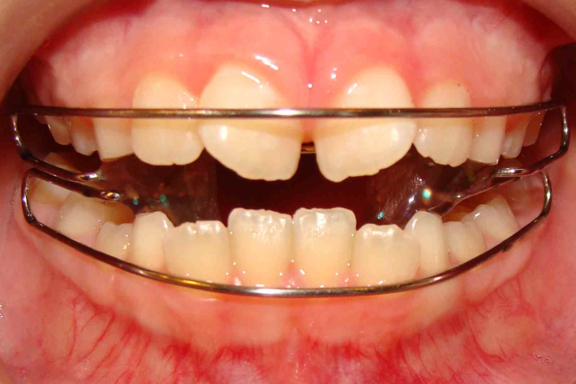
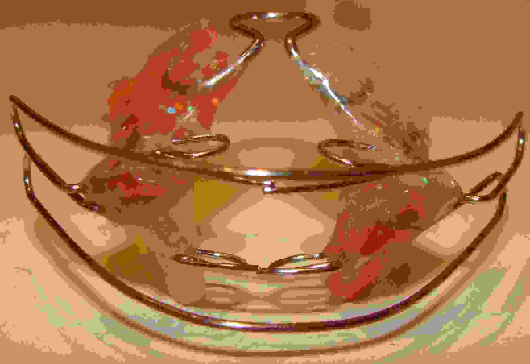
9-year old girl. Bite opening by Klammt EOA. Extrusion of lowe first molar

Slide 23
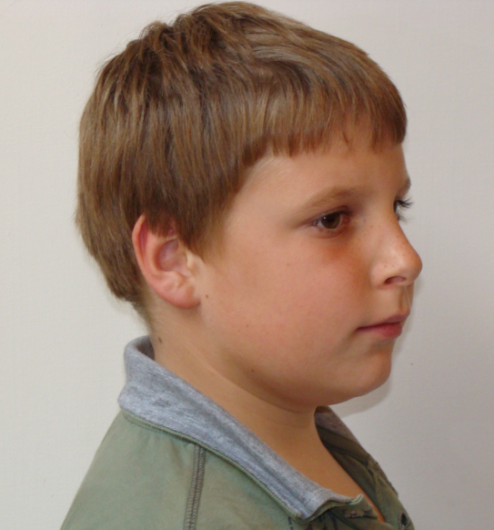
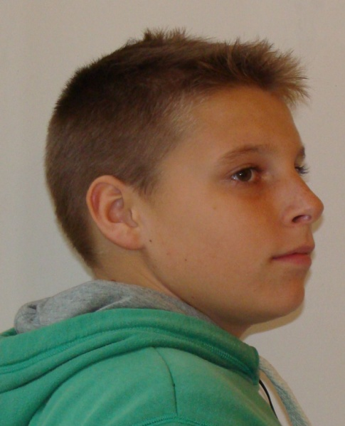
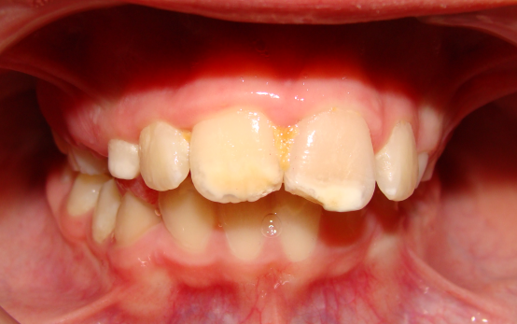
4 évi FKO kezelés és a növekedés hatása két testvér fogazatára és profiljára
II/1
A profil egyenessé, az okklúzió szabályossá vált
II/2
Az alsó arcmagasság és a harapás megemelődött, a mand. nem jött előrébb

Slide 24
13-year old boy before treatment with Hansa Appliance
Facial type: prognath,
Sagittal distal: ANB= 6,3° Deep vertical skeletal relation: T1mand.
Dental deep bite

Slide 25
B.L. 13,4 éves fiú
93.12.16. 13,4 év
SNA
NL-NSL
NSBa
ML-NSL
SNB
ML-NL
15
14
13
12
11
10
9
8
7
6
5
4
3
2
1
142
140 138
136
134
132
130
128
126
124
122
121
65
68
71
74
77
80
83
86
89
92
95
97
27
26
25
24
23
22
21
20
19
18
17
16
15
14
13
12
63
67
71
74
78
82
86
90
94
98
103
42
39
36
33
30
27
24
21
18
15
14
Prognát Ortognát Retrognát
ANB=6,3
T1 mand.

Slide 26
2-year after retention

Slide 27
6-year after retention

Slide 28
Profilképek a kezelés előtt és után

Slide 29
Angle II/1 eset FKO kezelése extraorális erővel kombinálva, a vertikális szkelettális eltérés miatt
Orthognath/Retrognath arctípus Disztális szagittális bazális viszony ANB= 6,3° Nyitott vertikális bazális arcszerkezet N1mand.
Elülső nyitott harapás, Angle II/1 Szabálytalan nyelés Interdentális ejtés

Slide 30
9 éves leány teleröntgen képe

Slide 31
A kezelés hatására bekövetkező profil- és funkció változás

Slide 32
Thermoplastic Appliance

Slide 33
Positioner by Kesling (1944)

Slide 34
Different Thermoplastic Appliances
Invisaligne
clear and virtually invisible solution for straightening the teeth, uses a series of clear, removable teeth aligners
Clear aligner (1998)
transparent orthodontic devices used to adjust teeth. They are effective for moderate crowding of the front teeth
Bio aligner
3D printed
3D before
3D after

Slide 35
Attachments
3Dimensions form on the teeth which are perfecting the interaction between the teeth and aligner
Ellipsoid form
Rectangular curved root tipper RCT
Beveled form

Slide 36
Invisaligne: thermoplastic appliance

Slide 37
Invisaligne

Slide 38
Bioaligner design

Slide 39
Advatages of Thermoplastic Aligners
Can be take off any time
Hygenic and easy to clean
Its habituation is easy
Reduced treatment and chair time
Rapid and spectacular change
Painless
Treatment duration with aligners may be shorter than with Fixed Appliances.

Slide 40
Disadvantages of Thermoplastic Appliances
Not for every case is appropriate
Midline shift correction and perfect occlusion setting is not achievable alon with them
It needs a good patients compliance
If the patient does not wear for more days the appliance, the teeth would mov back to their original place
There is insufficient evidence of any difference in treatment effectiveness and stability.
We just have clinical experience.

Slide 41
SmileDirectClub teleorthodontic treatment
Smile Direct Club and Invisalign Stores are new developments in orthodontic treatment provision. Importantly, they both start the process of orthodontic treatment without a person seeing a dentist.
The patients attend a Smile Shop, and they are seen by a member of staff who looks in their mouth and discusses treatment with them. If they are suitable for treatment, the staff take a scan of their teeth.
Then a registered dentist or orthodontist approves the aligner treatment plan, and then post the aligners to the patient who starts their treatment.

Slide 42
“The use of the Aligners is far more complicated than most people believe.
It takes a knowledgeable clinician with considerable experience to use the appliance
to its maximum.
What that maximum is, I do not know.”
Dugoni, 2002

Slide 43
Thank you for your attention

