Slide 1
Removable appliances
Plates 1

Slide 2
Malocclusion is multifactorial
caused by a combination of
genetic and environmental factors.
We cannot be sure of their relative contributions.

Slide 3
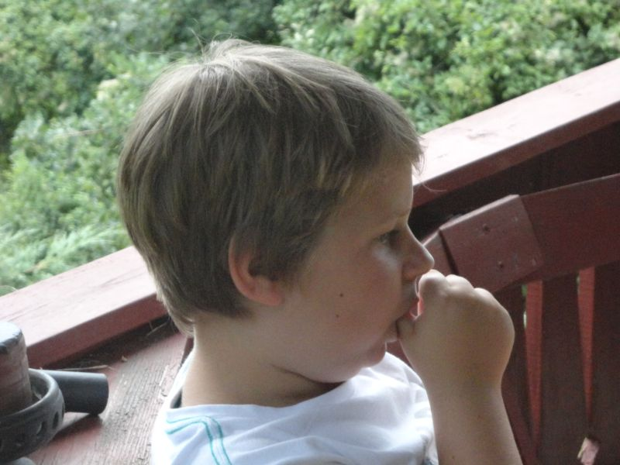
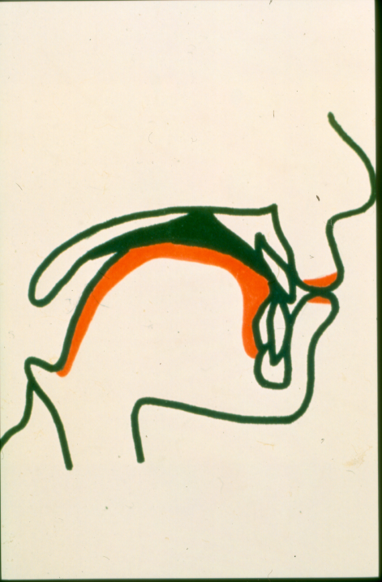
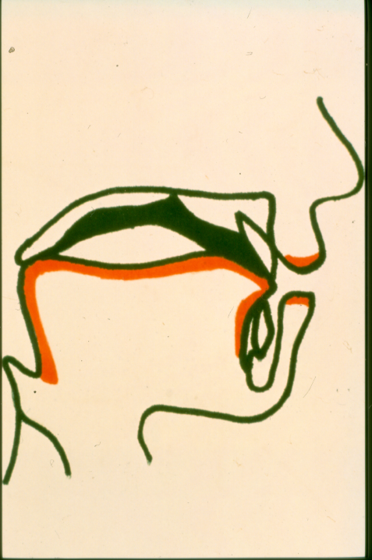
Enviromental Factors
Bed habits
Irregular swallowing
Nasal obstruction
Tongue thrusting
swallowing
Normal swallowing

Slide 4
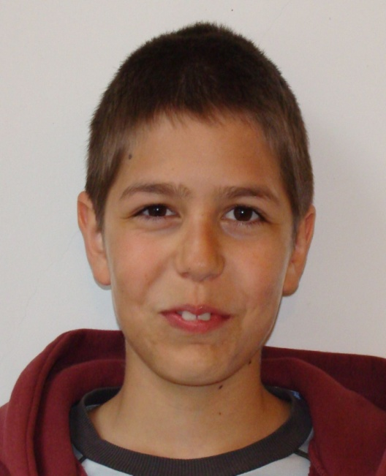
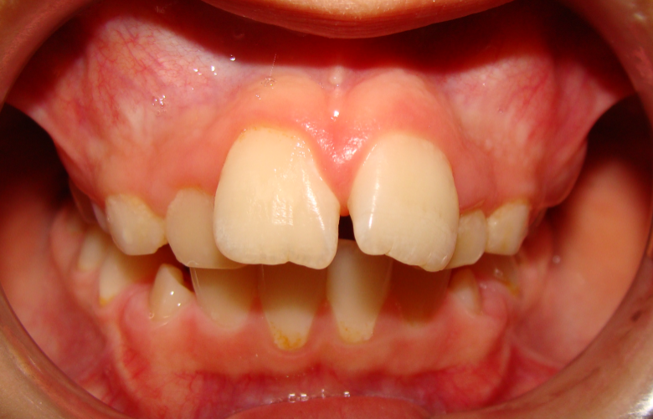
Incompetent lip closing

Slide 5
Lip-sucking swallow

Slide 6
Obstructive Sleep Apnea (OSA)
OSA is a multi-factorial disease, it is a complex interaction of neurological, muscular, and physical variables that results in the collapse of the oropharynx (upper airway).
It causes daytime sleepiness, cognitive impairment, vehicular accidents, nighttime snoring with intermittent pauses, restlessness, Finally, it can also result in hypertension, strokes, decreased life expectancy, and even death.

Slide 7
What is the prevalence of Obstructive Sleep Apnea?
1-4% in children of healthy weight. But those numbers climb to over 50% in children who are obese.
The prevalence of OSA in obese men and women rises to over 75%.

Slide 8
There is no evidence that the following cause OSA
the position of the teeth,
the width of the arches,
the size of the nasal cavity,
the length of the lingual frenum

Slide 9
What Is The Appropriate Role Of The Orthodontist In OSA?
Orthodontists cannot predict, prevent, diagnose, or correct OSA
no-one has shown that maxillary expansion prevents or cures OSA.
the role of orthodontist is to screen for the condition, identify those who exhibit signs and symptoms, make referrals to the appropriate physicians

Slide 10
Classification of the Malocclusion
Skeletal dysgnathy
Sagittal
Vertical
Transversal
Dentoalveolar dysgnathy
Sagittal
Vertical
transversal
Functional disorder

Slide 11
The main goal of the treatment
Normal occlusion
Normal fuction
Esthetic facial profil
Satisfied patient
To improve the quality of life of our patients
Emotional and social well-being

Slide 12
Evidence based Care (Kevin O’Brien)
We should base our treatments on the evidence. When it is absent, we need to accept that our treatment is based mostly on clinical experience. We need to explain this to our patients. When we do this we are practicing evidence-based orthodontics.
The relative influence of these factors varies according to our level of scientific evidence.

Slide 13
Where do we get our Clinical Experience and Knowledge?
Treating our own patients
Discussions with colleagues
Our failures are of equal importance
We need to consider our personal clinical experience and consider whether this is sufficient to base treatment decisions upon

Slide 14
Clinical Experience
We can correct lateral crossbites „early”
We know that this treatment is effective

Slide 15
Where do we get the Scientific Evidence and knowledge?
the best source is the scientific literature we can find an increasing number of published trials and systematic reviews.
we can obtain information from magazines, the internet and blogs
it is essential that we can spend time reading the papers and applying our research knowledge to the findings

Slide 16
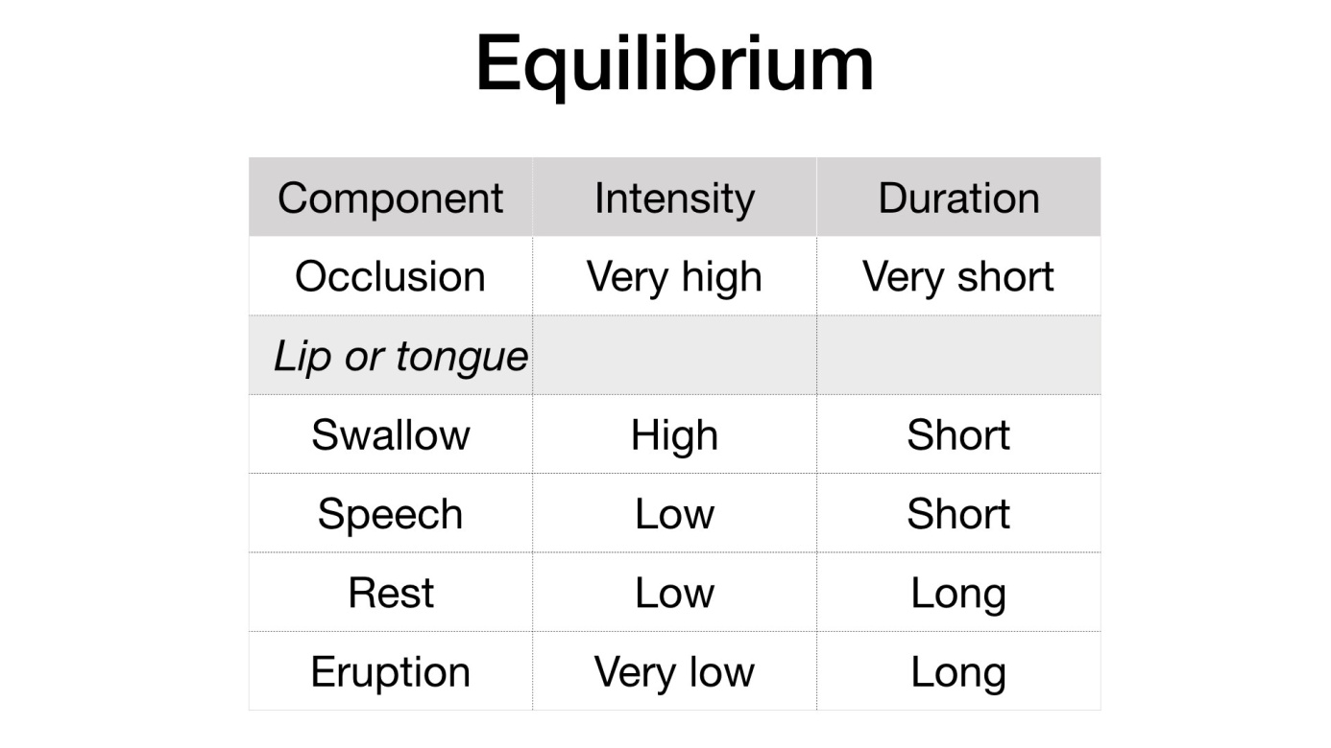
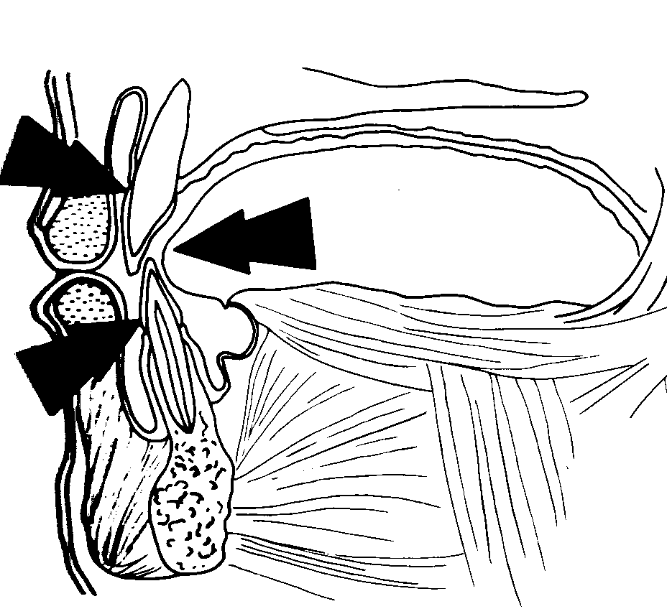
Scientific Evidence
When the teeth are
aligned and placed in the
„zone of stability”
the treatment is successfull.
Proffit.

Slide 17
Scientific Evidence
There is evidence that early overjet reduction is of benefit
But the level of uncertainity about this treatment is still high

Slide 18
Patients opinion
The ortodontist who approves the treatment plan is liable for that care and is responsible for giving inform consent
It is also crucial to inform our patients of studies that do not show any benefits for our proposed treatment. Good examples of this are the studies on self-ligation and methods to speed up treatment
The orthodontist must be ensure that the patients understand the treatment decision that they are choosing together

Slide 19
About the three components
These three components are not equal. The proportion of each component that influences a final clinical decision is influenced by their relative strengths.
There is no doubt that if good scientific evidence is available it should outweigh clinical experience.
We are not practicing ethically if we do not explain the presence or absence of research findings to our patients, so that they can make informed choices about their treatment.

Slide 20
About treatment
We can never be 100% certain about our treatment.
There are many ways to treat malocclusion and most of these treatments work.
One way of reducing clinical uncertainty is to carry out research and incorporate this evidence into our decisions.
I wish that I knew how to intercept malocclusion…

Slide 21
Timing of treatment
One of the most controversial areas in orthodontics is about the timing of orthodontic treatment.
There are many orthodontists who introduce “early or interceptive” treatment into their clinical practices
But is this evidence based?

Slide 22
Timing of the craniofacial growth
The size of the face is growing more than the cranial skull after birth:
cephalo-caudal gradiens
Position of the mandible is more caudal than of the upper jaw and it is growing faster, larger and for a longer time than the maxilla:
cranio-caudal gradiens

Slide 23
Növekedési ugrás ideje lányokon és fiúkon
♀11
♂13
fiú
leány
6 8 9 10
14
16
18
11
13
életkor években

Slide 24
Timing for the interceptive treatment: 9-10 ages

Slide 25
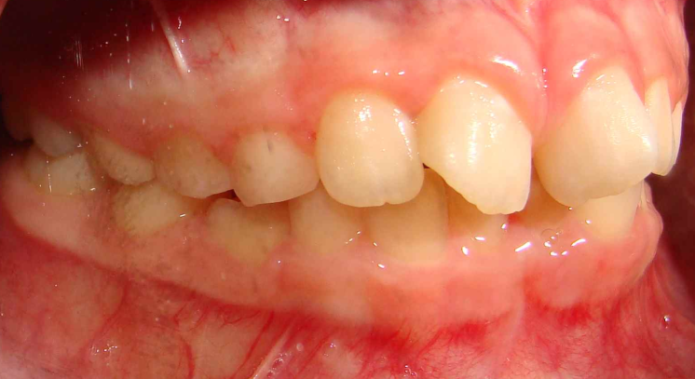
Interceptive Treatment
Detect diseas early and „cure”orthodontic problems by providing treatment when it has not done harm or can be treated easily
Crossbite treatment
Functional treatment
Space management
Strategic extractions
To use the reserve place

Slide 26
Classification of Removable Appliances
Active appliances
plates
Passive appliances
Acting only with muscles movement
Vestibulum plates
Excercisers (treners)
Function Regler by Fränkel
Activator by Andresen-Häupl
Fuctional Jaw Orthopedics
Other functional appliances

Slide 27
Advanteges of Removable Appliances
reduces the chairtime
is cheeper then the fix therapy
there may be reduction in the incidence of trauma
and could also be provided to reduce teasing and bullying
probably can change the growth process of the maxilla and mandible, making not only dentoalveolar but skeletal changes
there was some evidence that part-time wear was as effective as full-time wear

Slide 28
Disadvateges of the Removable Appliences
depends on the complience of the patient
one crucial key to co-operation is the relationship between the patient and the orthodontist
a positive attitude towards treatment progress is fundamental.
There is no such thing as non-compliance treatment!

Slide 29
Active plate with labial wire, Adams clasps and widening screw

Slide 30
Arch Widening Appliances
Widening screws
Screw divided
into three parts
Bertoni screw

Slide 31
Most commonly used clasps
Adams clasp
with tube
Adams clasp
Double Adams clasp
Canine clasp
0,7 mm
0,6 mm
Incisors clasps by Adams
Bass clasp
arrowhead clasp

Slide 32
Labial wire and retractor spring
labial wire for incisors retraction, incisors and canine retraction, labial wire and palatal spring in order to distalize the canine

Slide 33
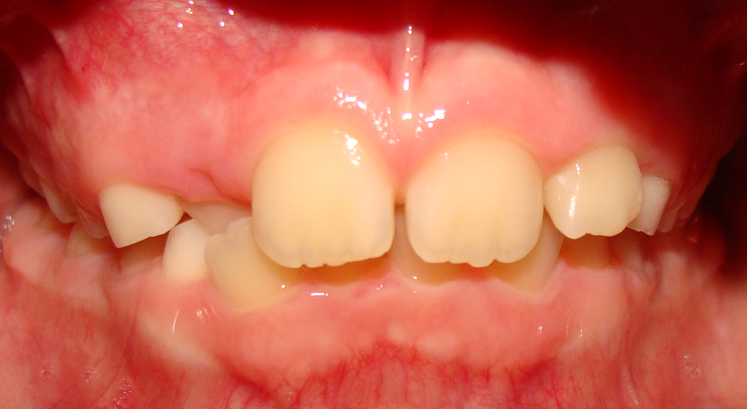
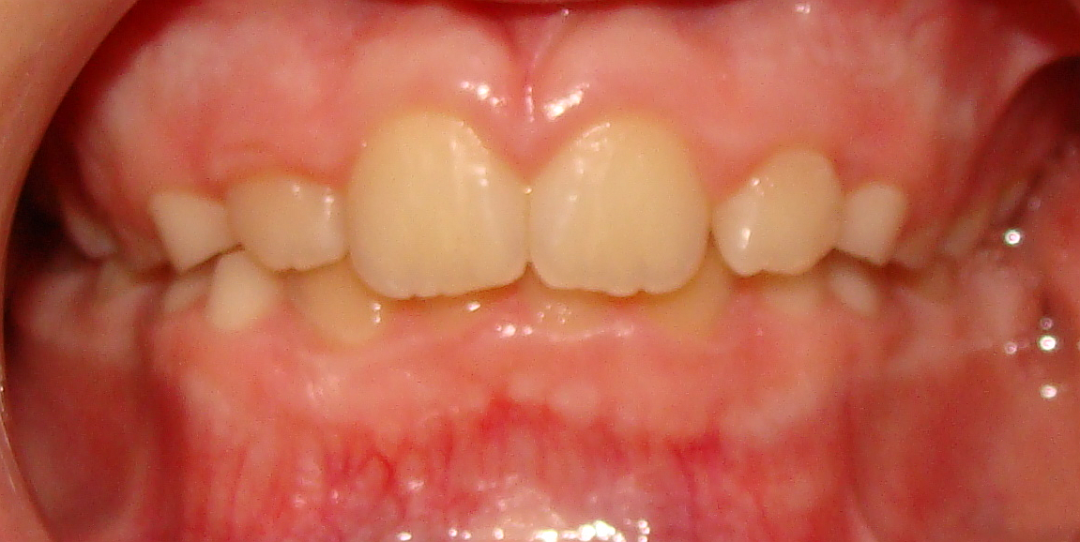
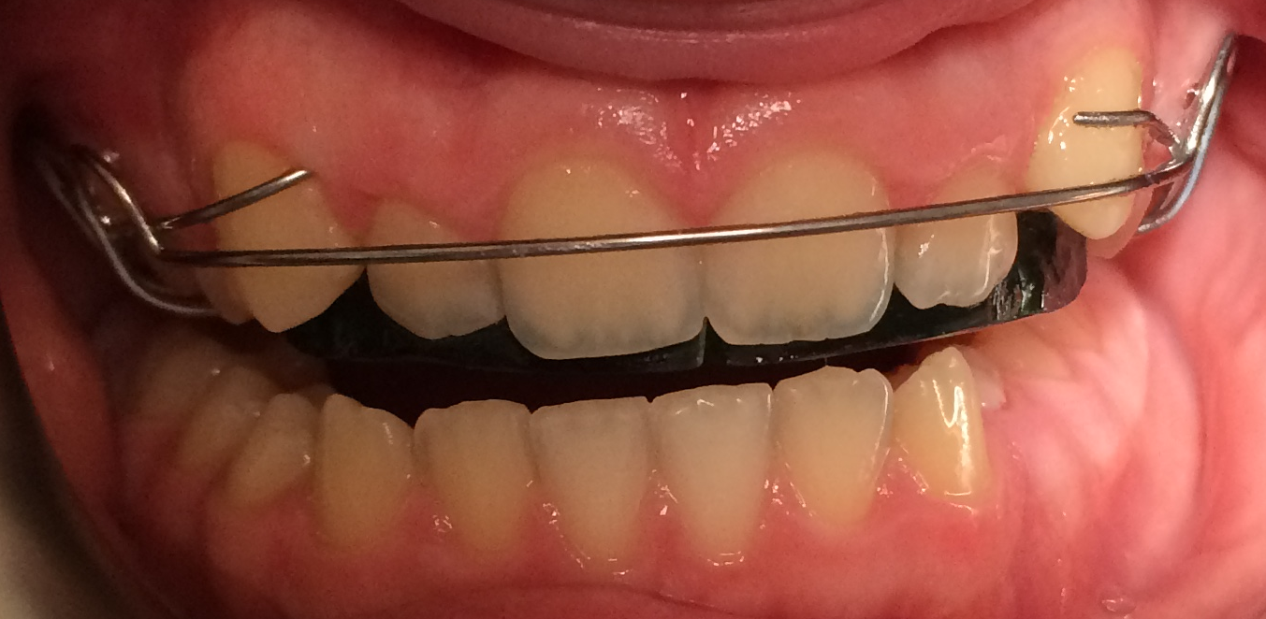
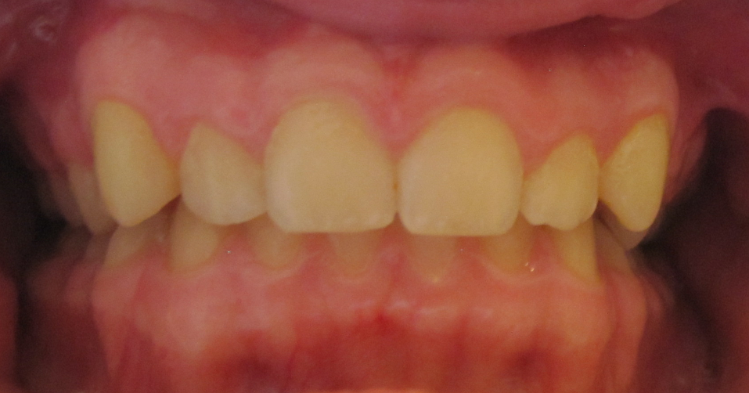
Plate with retractor springs

Slide 34
The best time to treat the maxilla
Between 8-10 years
After 10-11 years the growth of the upper jaw stops

Slide 35
Plate combined with headgear by sceletal vertical open bite
Growth inhibition of the maxilla
Autorotation of the mandible
forward
uppward

Slide 36
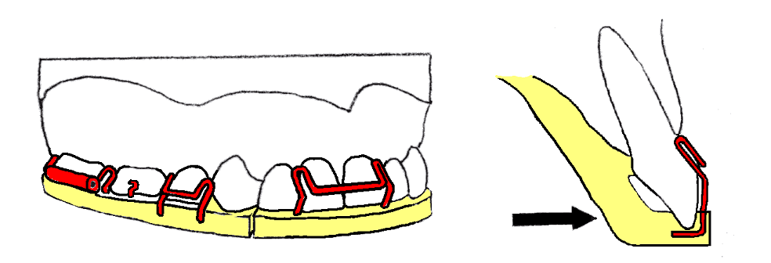
Plate with headgear tube and frontal clasp

Slide 37
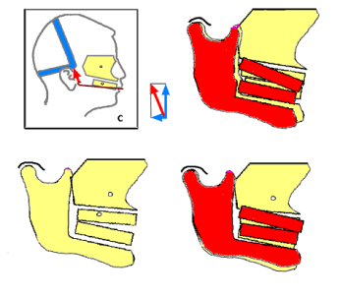
High pull headgear

Slide 38
Growth inhibition on the maxilla and
autorotation of the mandible coused by
high pull headgear

Slide 39
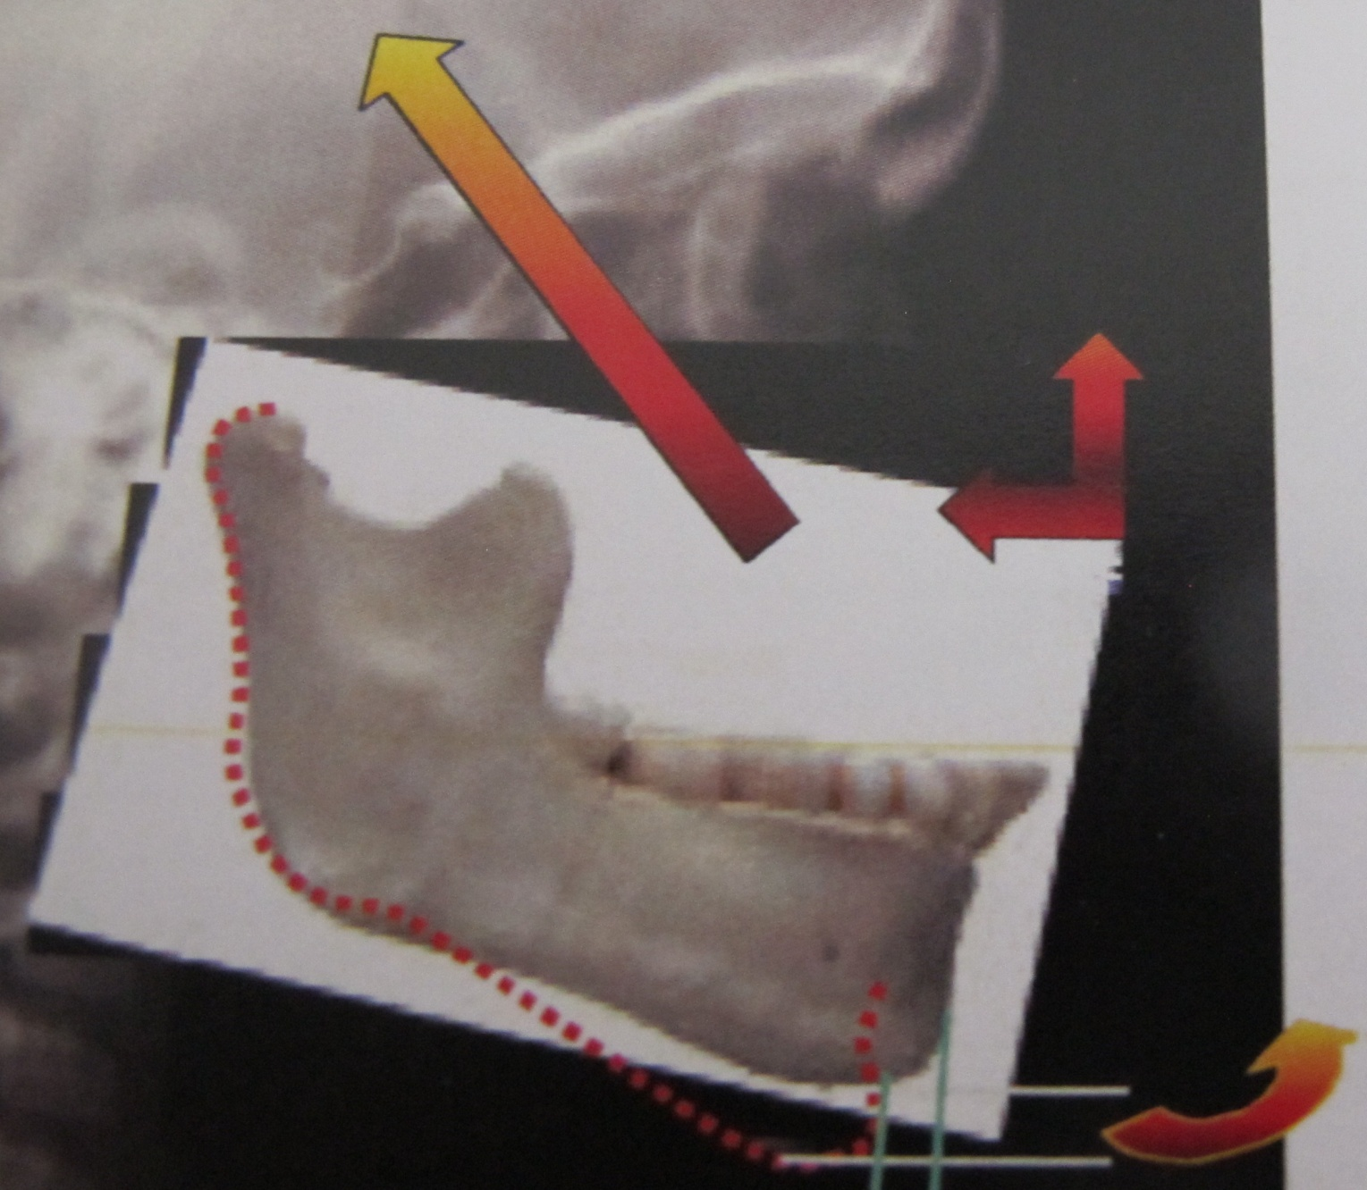
Autorotation of the mandible

Slide 40
Other interceptive treatments

Slide 41
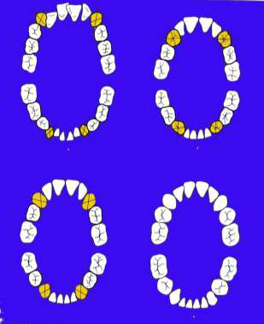
Interceptiv extraction of primary teeth
Directed
tooth
eruption

Slide 42
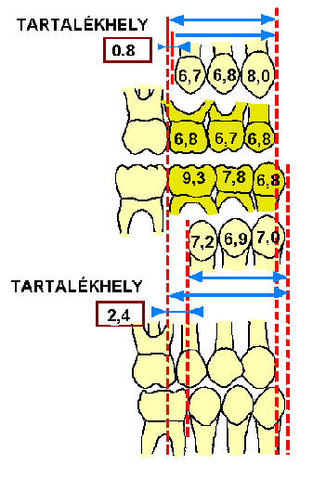
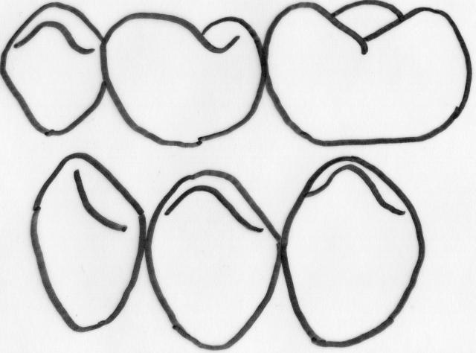
The best time just before
eruption of 45 and 55
Reserve place
upper arch
III
IV
V
3
4
5
Reserve place
lower arch
Primary lateral teeth
-mostly in the lower arch-
are larger than the
permanent lateral teeth.
We can win place
to solve the mild crowding
in the lower arch.

Slide 43
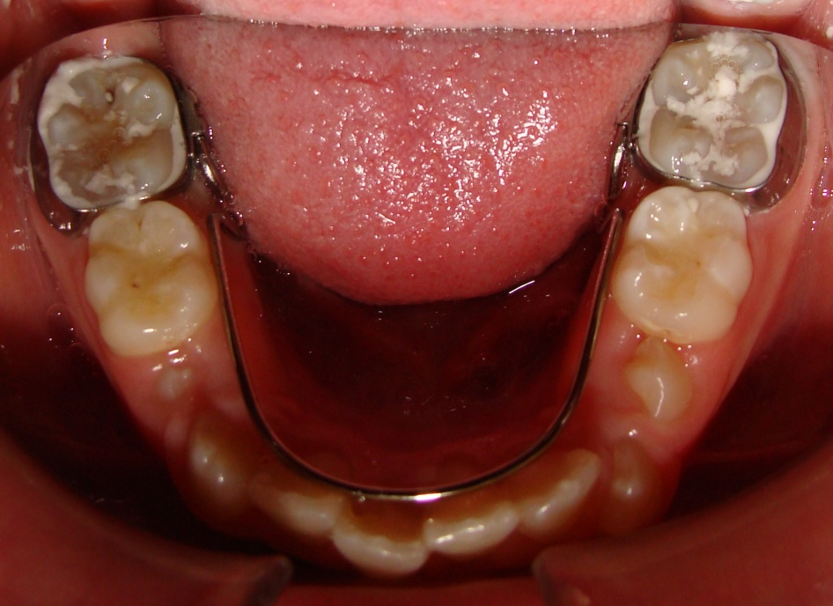
Space maintaires

Slide 44
About interceptive treatment
Interceptive treatment may effective, but sometimes it does not result in perfect occlusions.
However, we need to consider if all our patients require perfect occlusions and whether some (or many) may be happy to “trade-off” a less ideal occlusion for a shorter and easier course of treatment.
Perhaps the next step is to develop this concept further and ask our patients what they want?

Slide 45
Thank you for your attention

